Slide 1
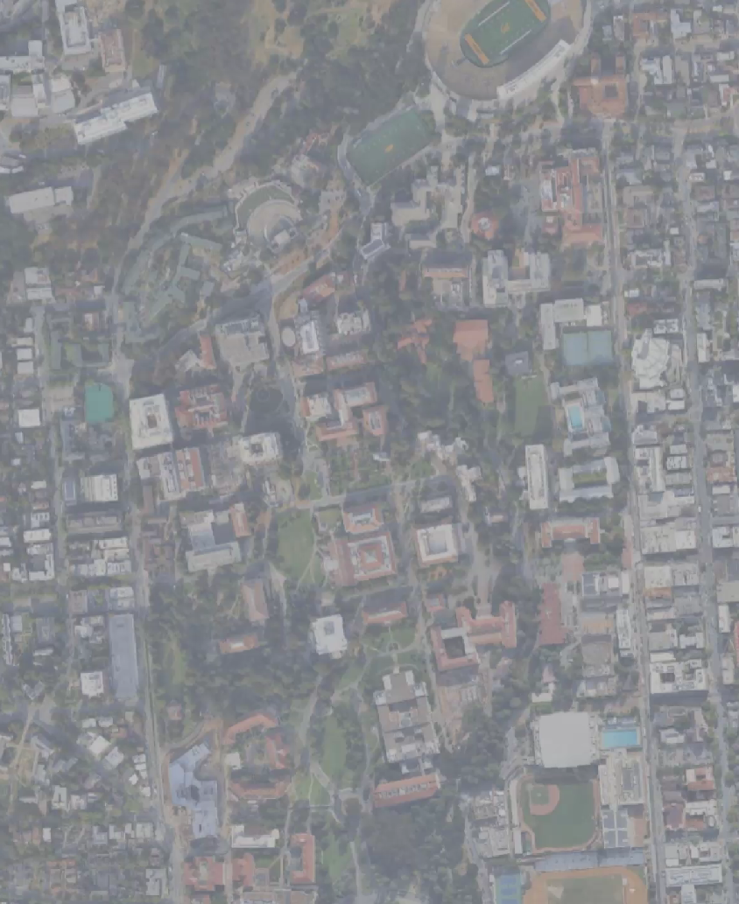
Green Depth on Campus
Ching Yuen EPS 109

Slide 2
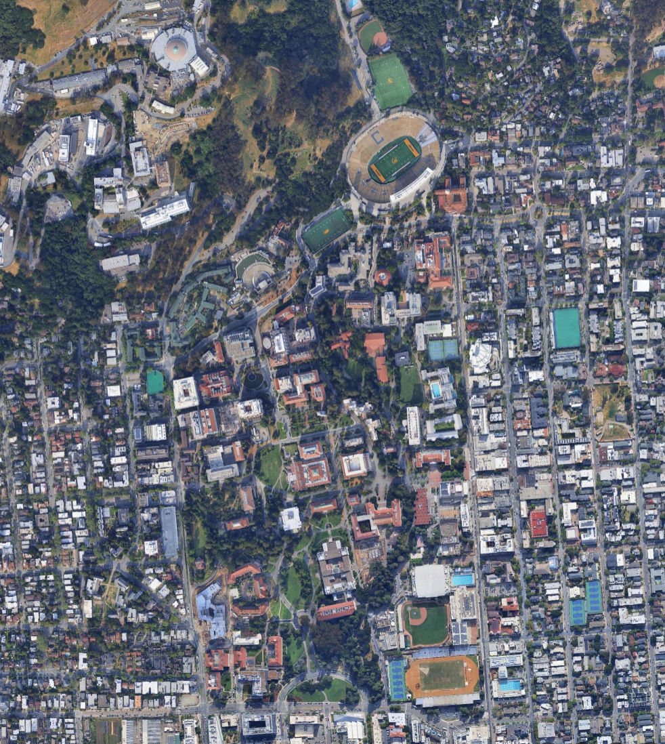
Green Depth on Campus
Screenshot from Google Earth
Libraries Used: numpy, matplotlib (for plotting), skimage (for image)
Methodology:
Break down image into R,G,B
Detect green if G > R and G > B
Group similar greens and plot
Finding: Natural greens are usually darker than man made objects.

Slide 3
