Slide 1
Mapping the Intensification Rates of North Indian Ocean Cyclones
Basim AlHarbi

Slide 2
Why Study Cyclone Intensification?
Visualizing where and when tropical cyclones rapidly intensify in the
North Indian Ocean (Bay of Bengal and Arabian Sea) from 1980 to 2025.
The problem:
- Rapid intensification = wind increase of 30+ knots in 24 hours
- Gives coastal communities very little time to prepare
- Examples: Cyclone Amphan (2020), Cyclone Fani (2019) both rapidly intensified
Project goals:
1. Map all cyclone tracks in the North Indian Ocean (1980-2025)
2. Calculate intensification rate at each point along the track
3. Visualize patterns: where and when do storms intensify fastest?
4. Identify differences between Bay of Bengal and Arabian Sea
Why it matters:
- Better understanding leads to improved forecasting
- Early warnings save lives
- Helps identify high-risk coastal zones

Slide 3
Data Source and Methodology
Data source:
IBTrACS (International Best Track Archive for Climate Stewardship)
- Maintained by NOAA (National Oceanic and Atmospheric Administration)
- Global cyclone database with records back to 1842
- We use 1980-2025 (reliable satellite-era wind measurements)
- Observations every 3 hours: latitude, longitude, wind speed, pressure
Dataset statistics:
- 454 unique cyclones analyzed
- 15,543 individual track observations
- 45 years of data
- Two subbasins: Bay of Bengal (BB) and Arabian Sea (AS)
Method - Discrete time evolution:
For each storm, at each time step:
Intensification Rate = (V2 - V1) / dt × 24
V1 = wind speed at previous observation
V2 = wind speed at current observation
dt = time difference (typically 3 hours)
× 24 converts to "knots per 24 hours" (standard unit)
Classification:
- Positive rate (red) = storm strengthening
- Negative rate (blue) = storm weakening
- Rate >= 30 kt/24hr = rapid intensification

Slide 4
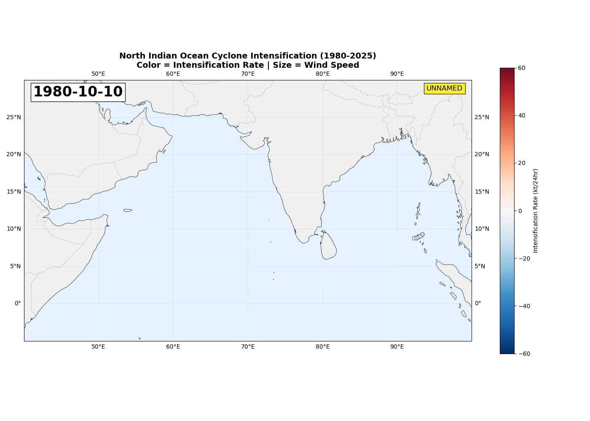

Slide 5
45 Years of Cyclone Intensification (1980-2025)
What the animation shows:
- Each dot = one cyclone observation at that location
- Color = intensification rate
- Red = rapidly strengthening
- Blue = weakening
- White = steady
- Size = wind speed (larger dots = stronger storms)
- Faded trail = storm path over previous 5 days
- Time progresses day-by-day through 45 years
Key observations to point out:
1. Bay of Bengal (right side) has ~3x more activity than Arabian Sea (left)
2. Rapid intensification (red) occurs mostly over open warm water
3. Storms turn blue (weaken) when they hit land
4. Two cyclone seasons visible: pre-monsoon (Apr-Jun) and post-monsoon (Oct-Dec)
5. Some years have more activity than others

