Slide 1
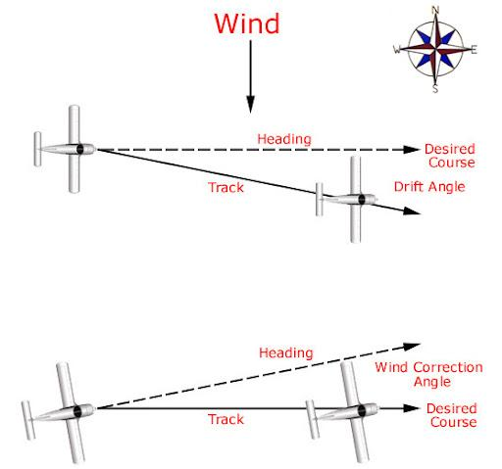
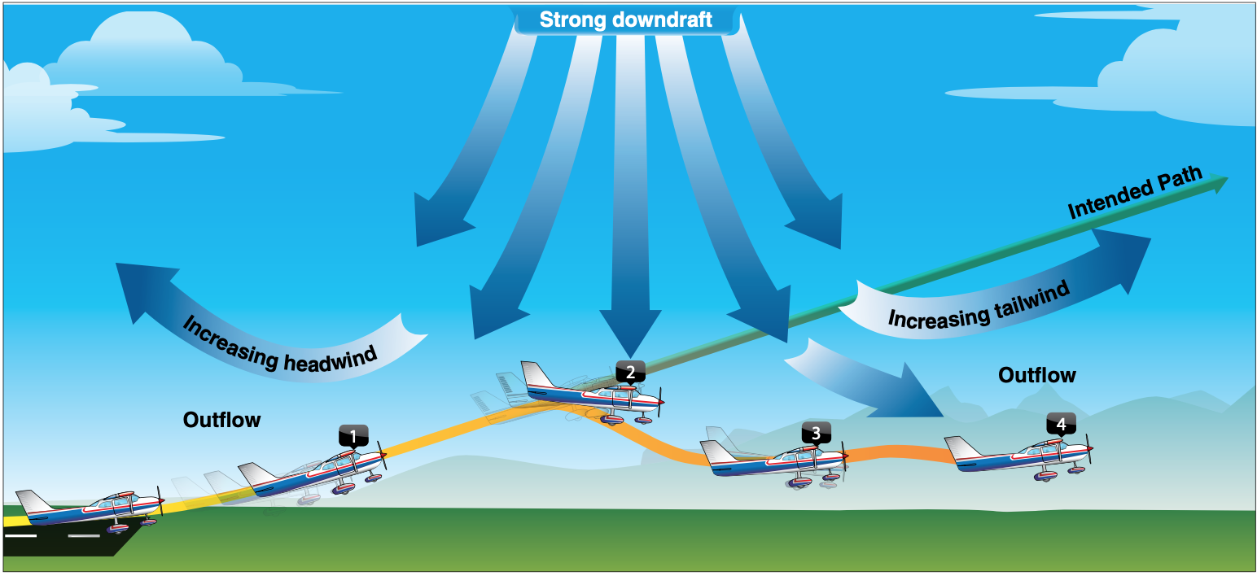
Airplane Flight Path Drift
Hailey Pham

Slide 2
Simulation and Methods
Simulation
modeling the deviations in flight paths due to factors such as wind and other weather conditions, simulating turbulence and drift
help plan routes more intentionally for places with extreme weather conditions.
Methods
coordinates for each Airport and intended flight path
Added the wind path to simulate changes in weather
uses ODE to update the aircraft’s position in small time intervals
Euler’s Method to update the plane’s position for a given timestep
dr/dt ​= V_{intended}​+W

Slide 3
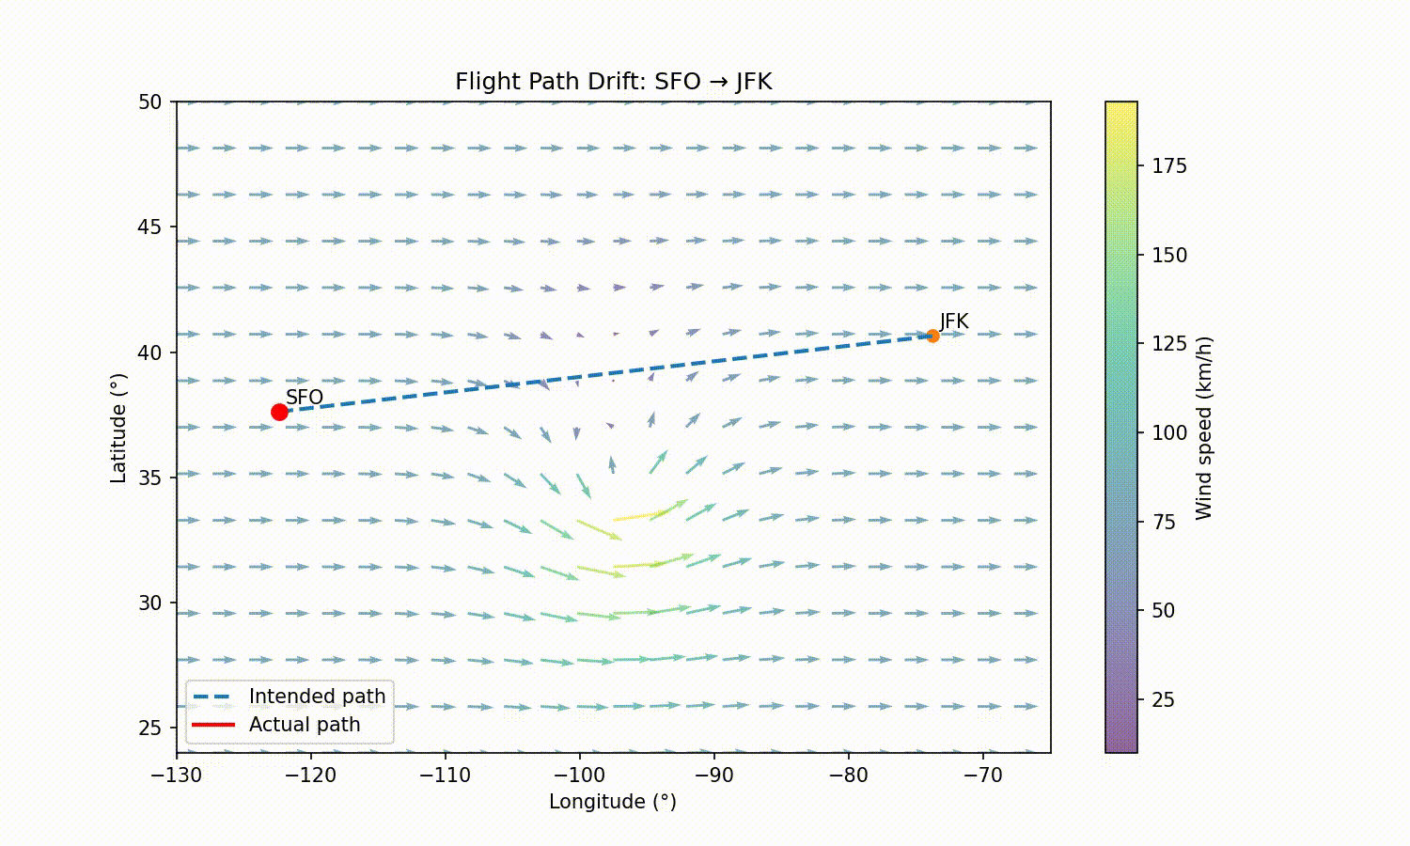
Animation

