Slide 1
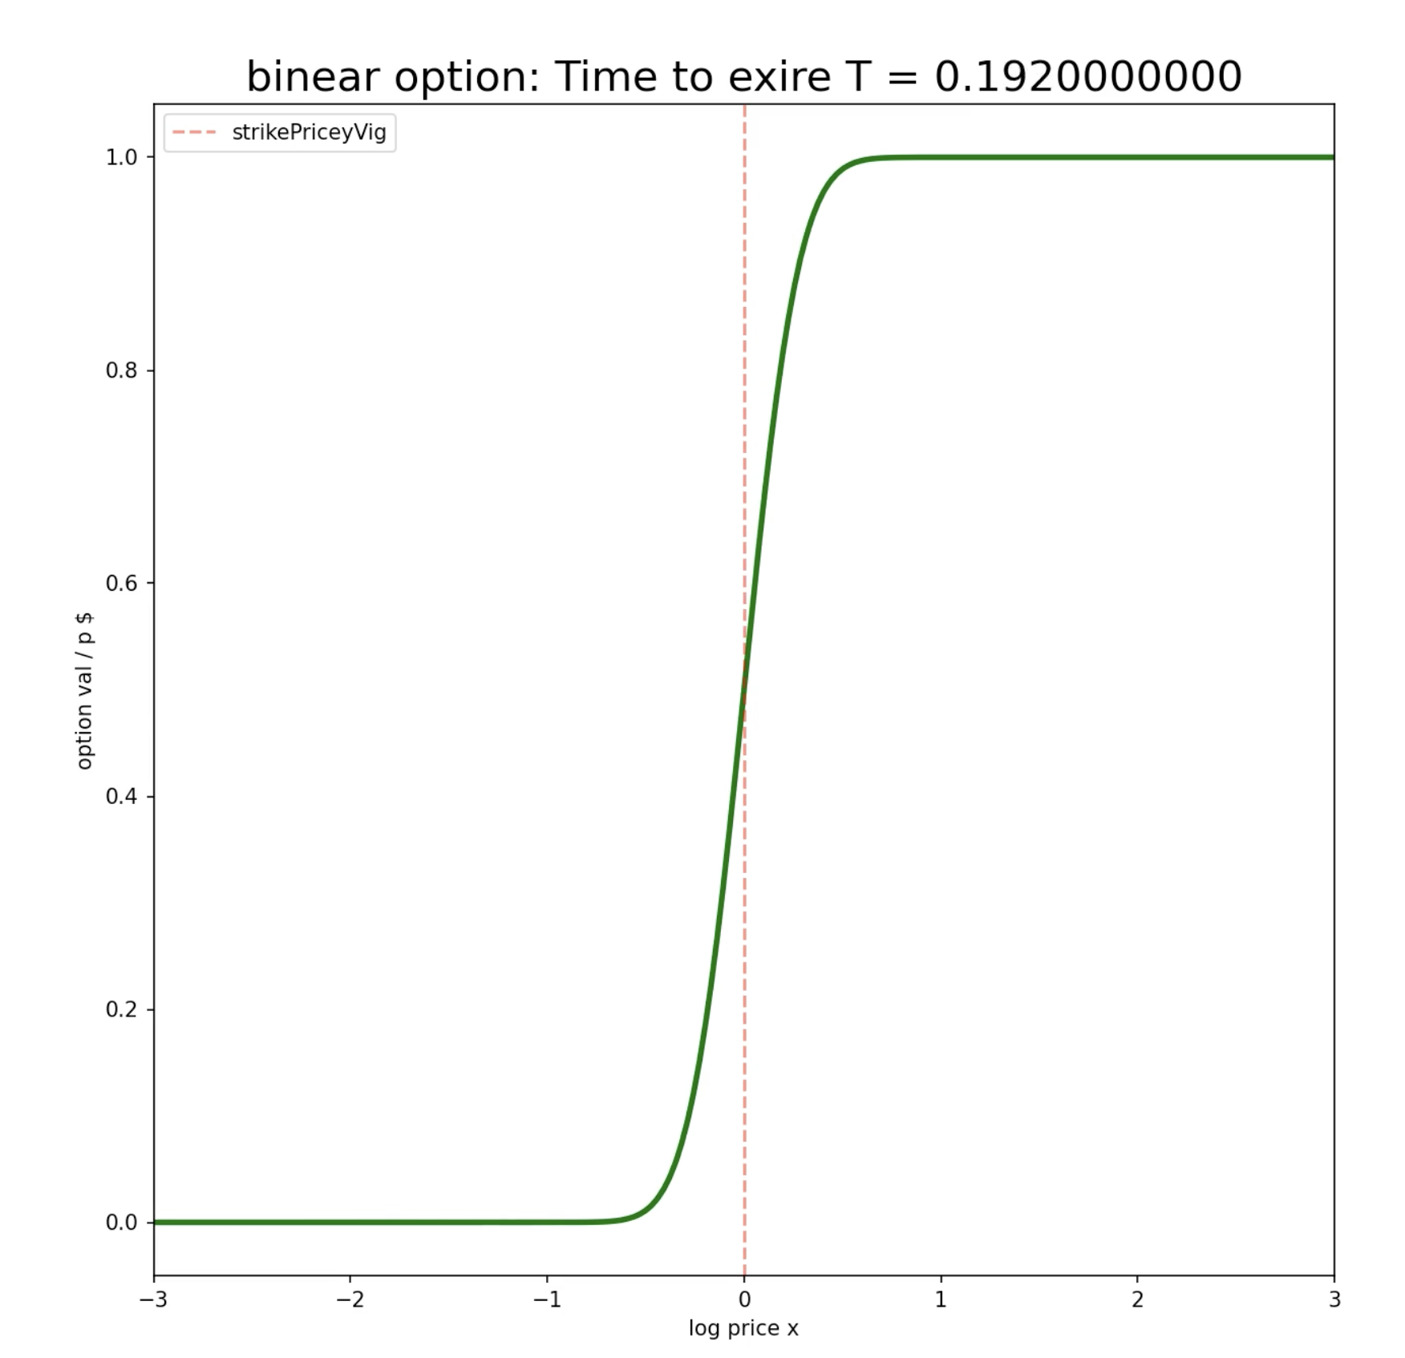

Binary Options in Prediction Markets: Visualizing Price History as a Probability Diffusion (PDE)
By: Trent McQuaid
This simulation demonstrates the deep connection between:
Heat diffusion in physics
Option pricing in finance (Black-Scholes)
Probability evolution in prediction market like Kalshi

Slide 2
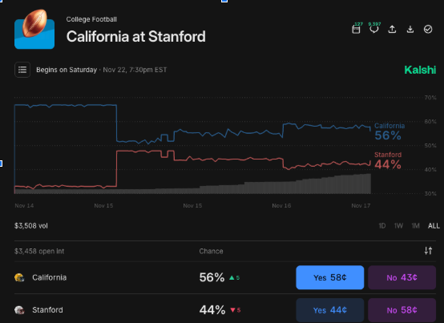
2) Explaining Topic / Simulation Method + Sources
PDEs for Modeling in EPS109
I used Partial Differential Equations (PDEs) to simulate the probability diffusion for contract prices over time, similar to that on Kalshi, which I use or Polymarket.
Binary Step Function
A binary step function shows the option's $ at the end of the event.
Diffusion Equation metaphor
I used a dumbed down diffusion equation, similar to the Black-Scholes model for financial contracts. That formula is used on Wall Street to efficiently price the ‘fair value’ of a contract. Edge is the delta between FV at market rate, and your adverse selection.
Sources:
*note the full URLs can be found in my Jupytr Notebook submission via #comments* #source: https://matplotlib.org/stable/api/_as_gen/matplotlib.pyplot.colorbar.html 1) https://www.simscale.com/blog/cfl-condition/ for a math equation, / it’s relative code (CFL)
2) Wikipedia for more details on math equation - https://en.wikipedia.org/wiki/Courant%E2%80%93Friedrichs%E2%80%93Lewy_condition
3) Inspiration credit: https://www.youtube.com/watch?v=A5w-dEgIU1M Veritasium, Youtube.com, Feb 27, 2024.
4) #idea source: https://stackoverflow.com/questions/25698448/how-to-embed-html-into-ipython-output stack overflow for deciding what libraries to import to make the mp4 easier, others linked in notebook
5) #source: https://math.stackexchange.com/questions/321569/approximating-the-error-function-erf-by-analytical-functions
if tauAura == 0: more math functions used to calculate error
6)Inspiration credit: https://www.youtube.com/watch?v=A5w-dEgIU1M Veritasium, Youtube.com, Feb 27, 2024.
IRL binary time step function, of a game which Cal threw, RIP the Axe

Slide 3
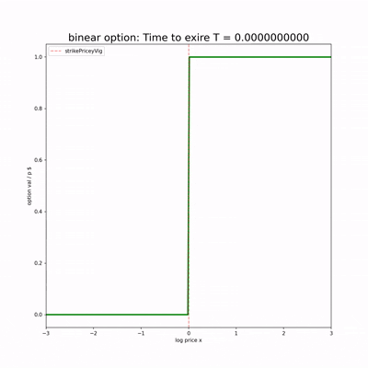
Animation
The​‍​‌‍​‍‌​‍​‌‍​‍‌ key insight: with the before of the expiration date, the uncertainty becomes bigger, and the sharp binary payoff gets smoothed out into a probability curve the further back in time. This is the thing that prediction market traders, like myself observe - contracts that are distant from expiration have prices that slowly vary with the underlying conditions, but contracts that are close to expiration abruptly move to 0 or ​‍​‌‍​‍‌​‍​‌‍​‍‌1. In lower liquidity markets, it’s less smooth.

Slide 4
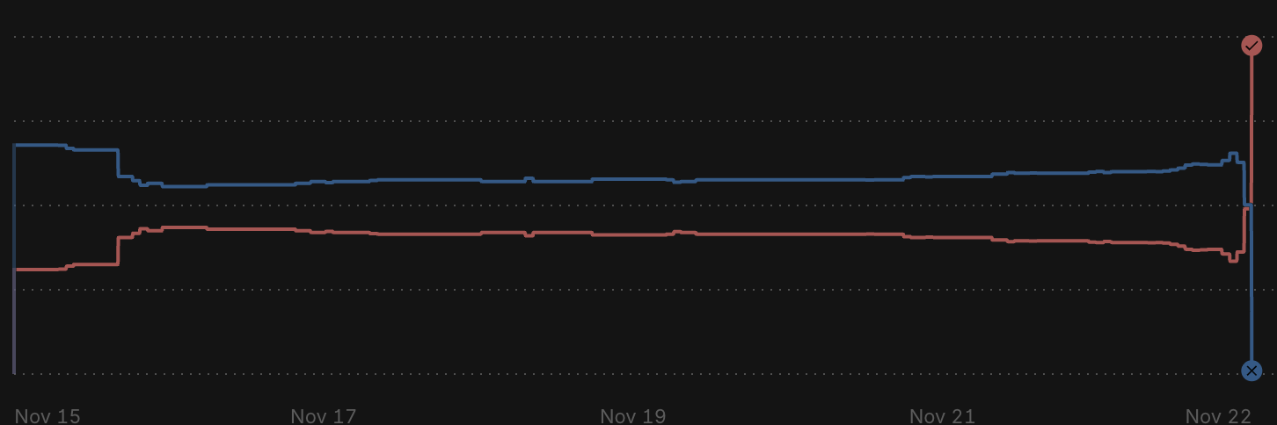
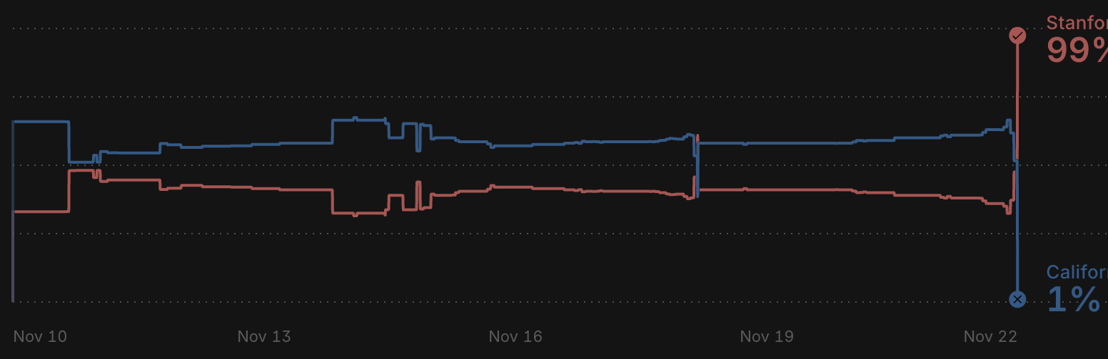
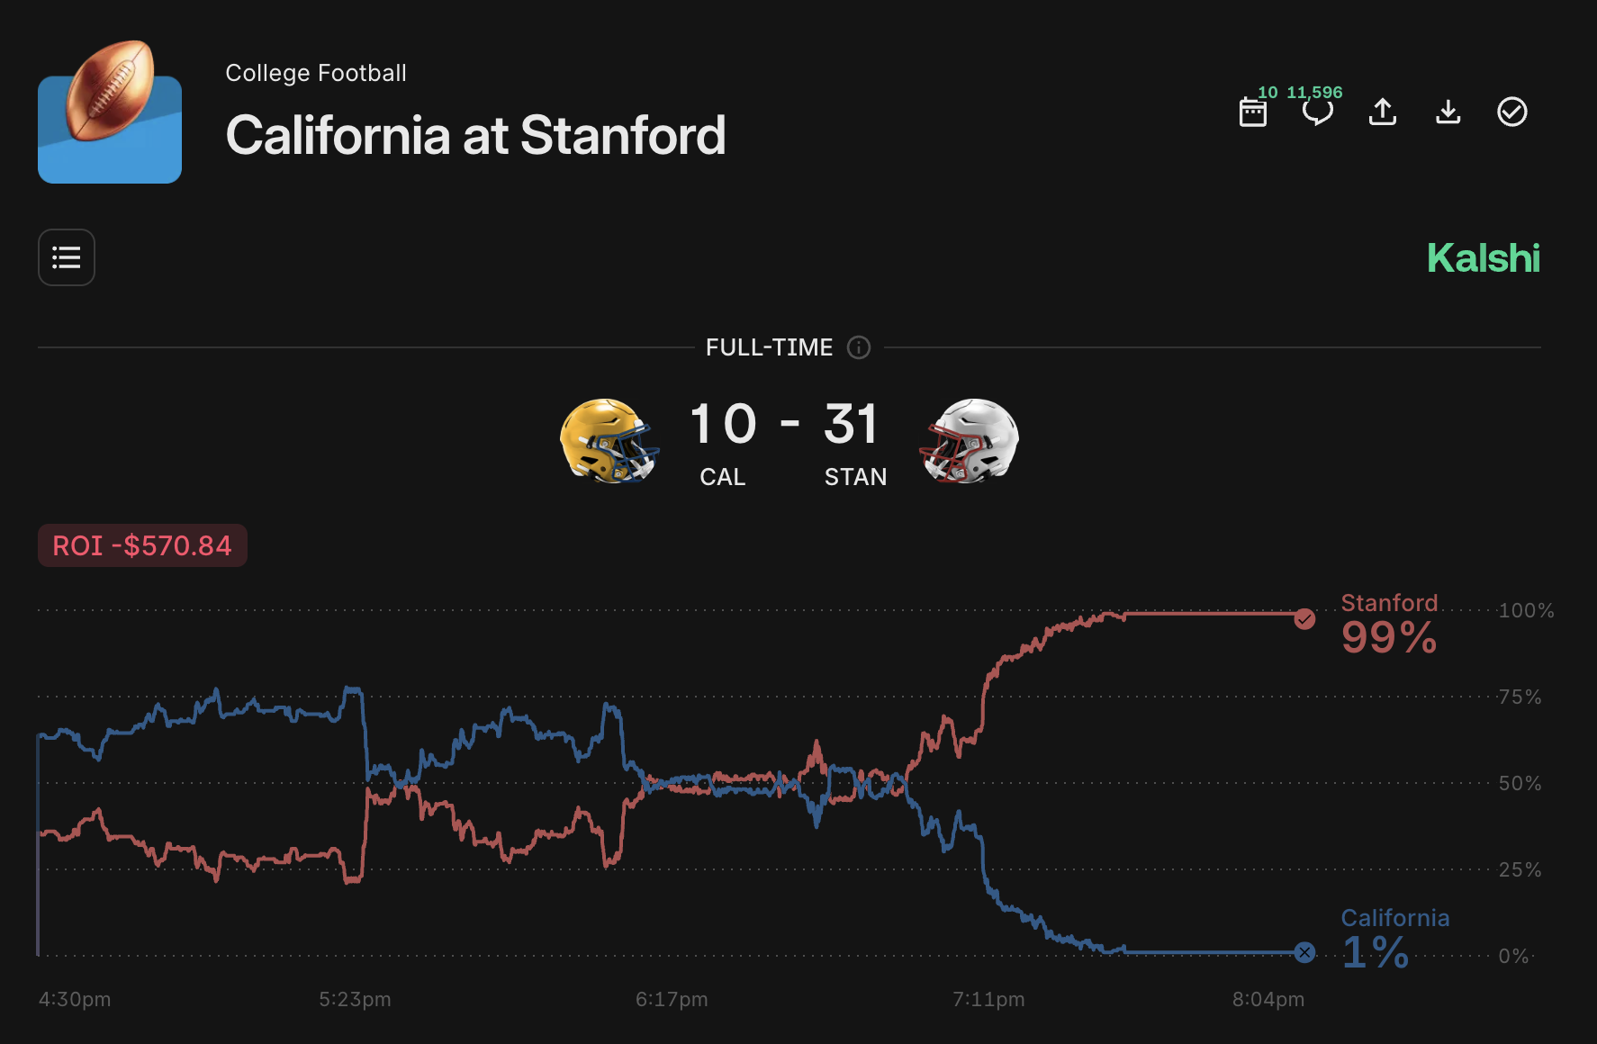
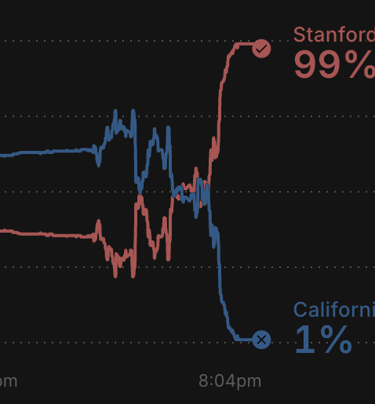
Method
month
This displays how the binary functions EV shifts from left to right, a month before the game, a week before the game, and the day of of Cal VS Stanford
week
https://kalshi.com/markets/kxncaafgame/college-football-game/kxncaafgame-25nov22calstan
Day of

Slide 5
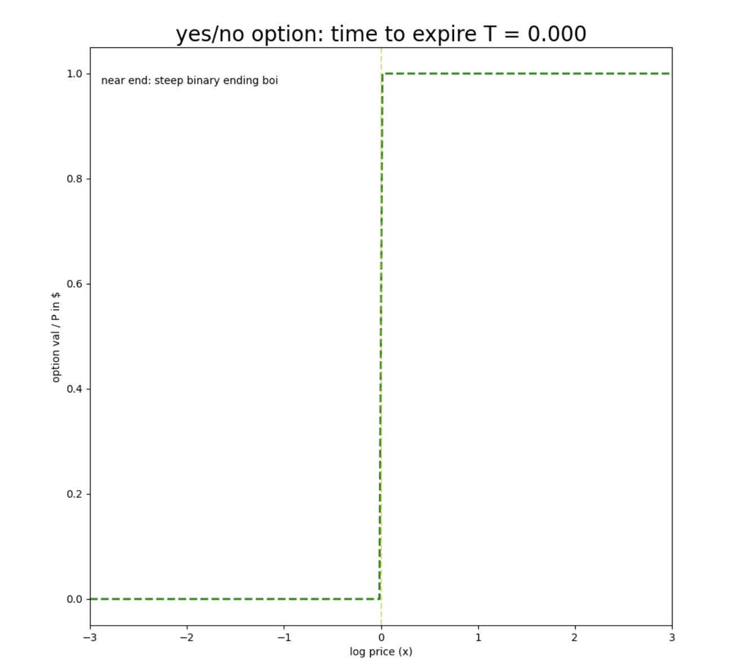
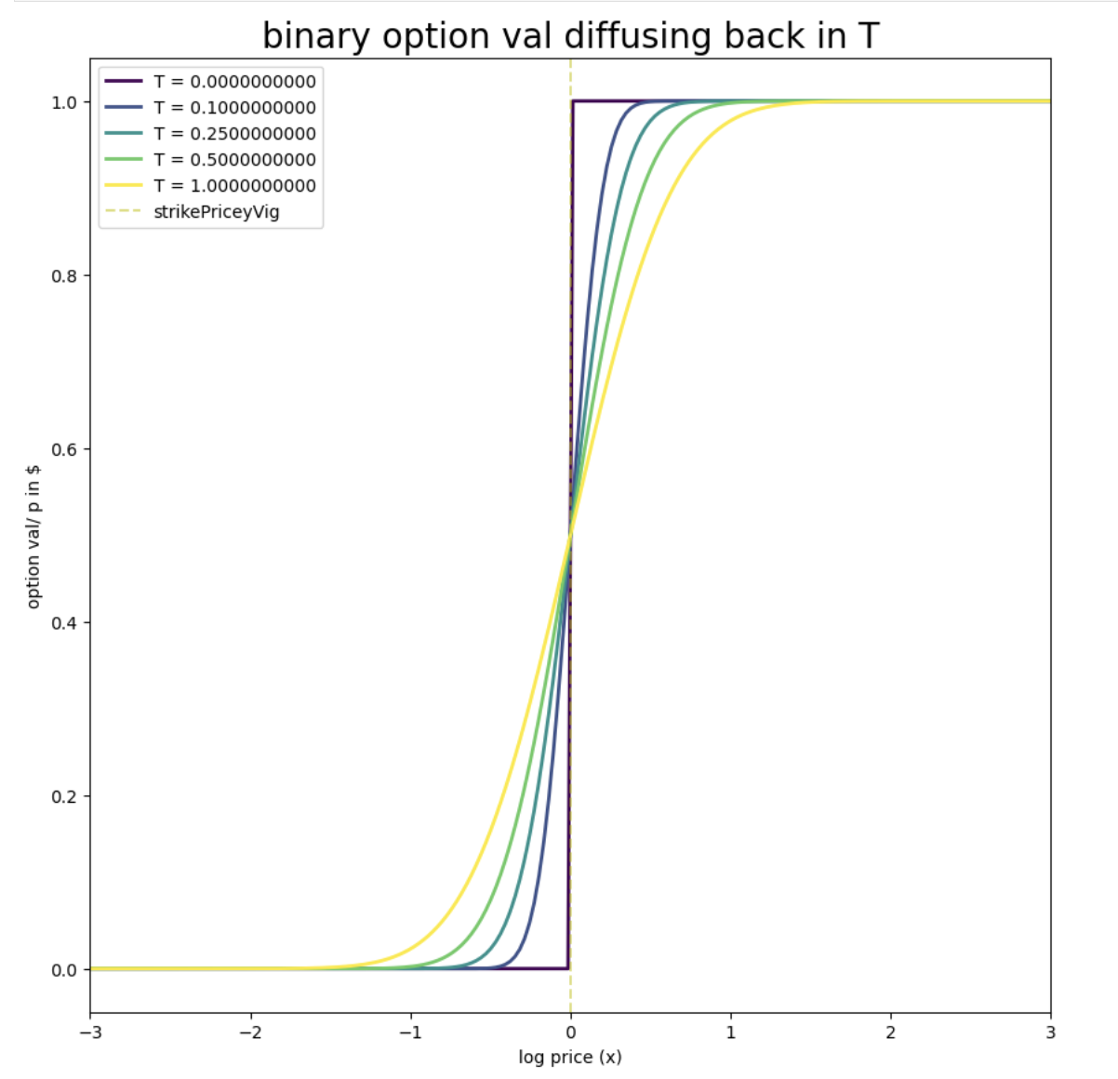
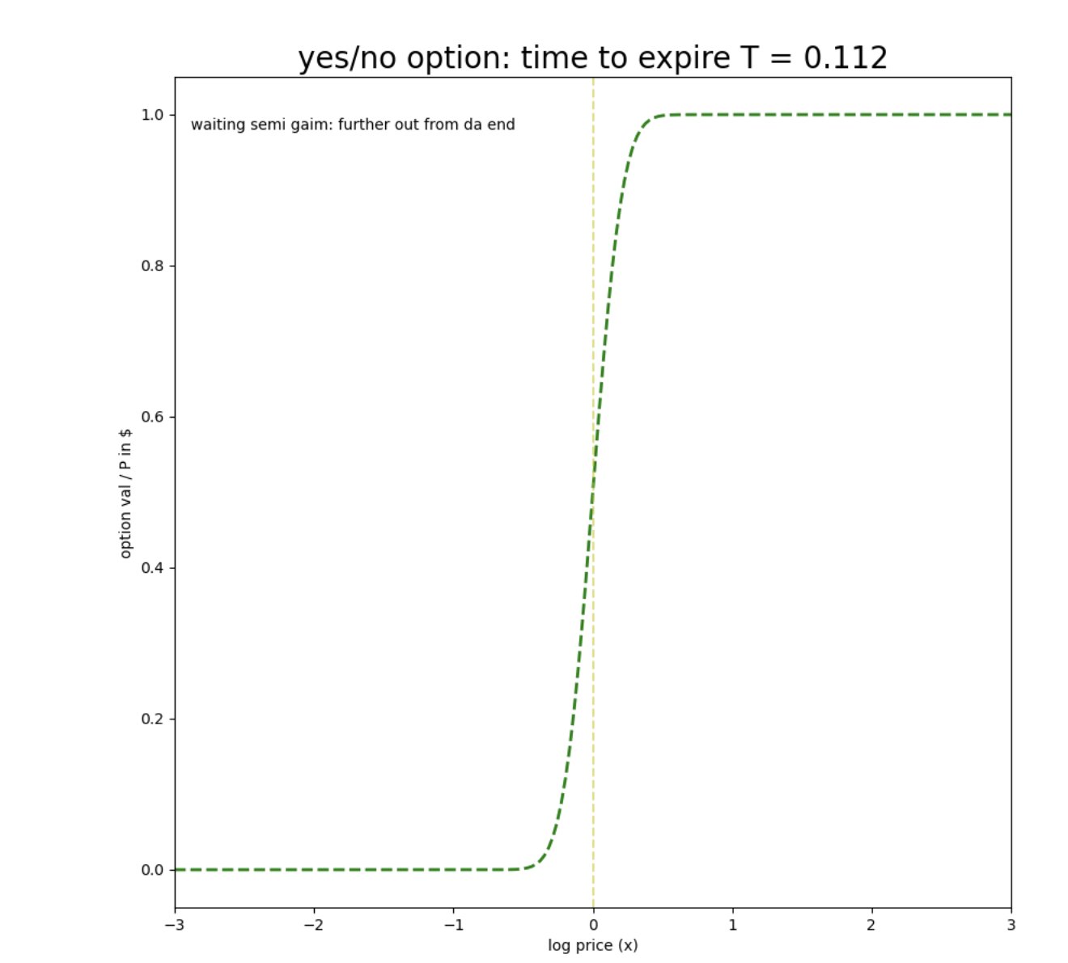
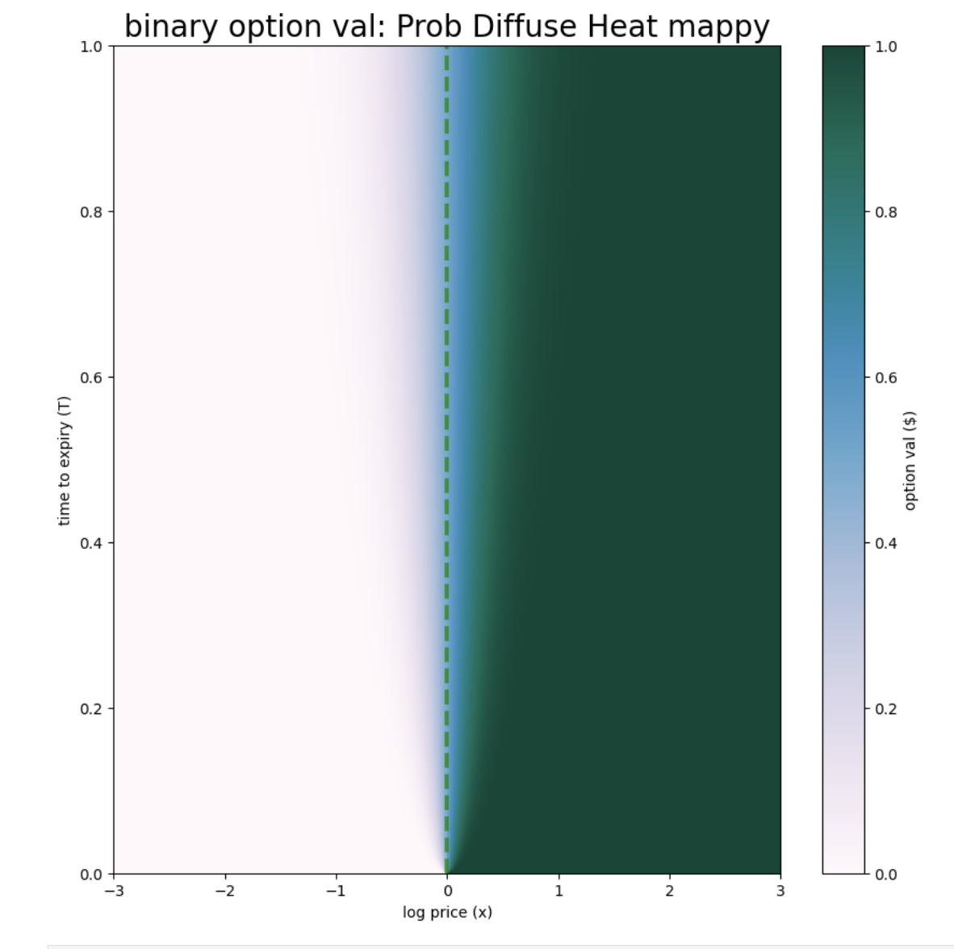
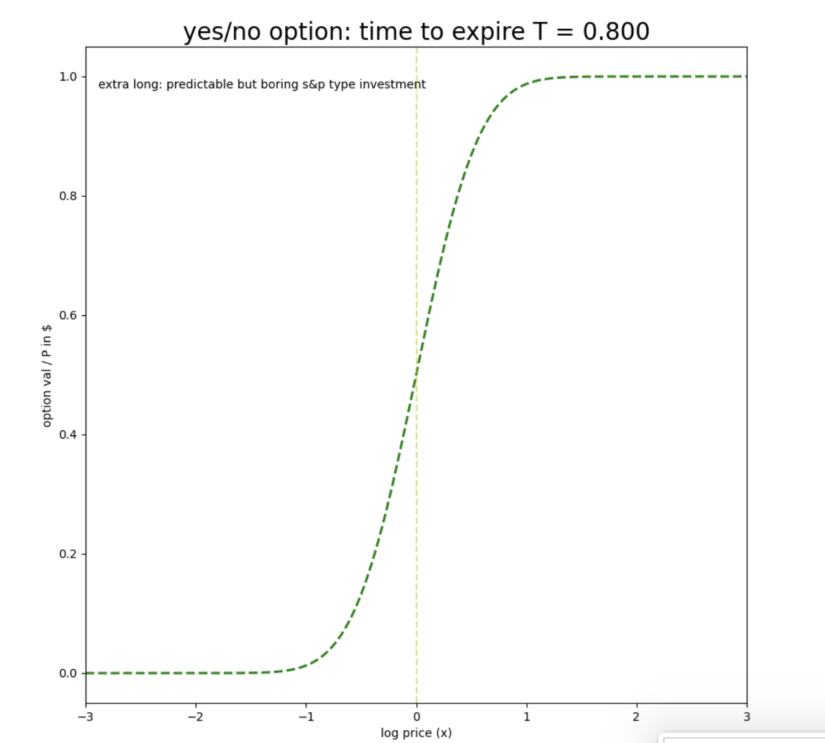
Method Pt.2 - Price v Time
Option at event End time or resolution, the probability function at difference time steps, and the heat map matrix of the probability of pierce v time

Slide 6
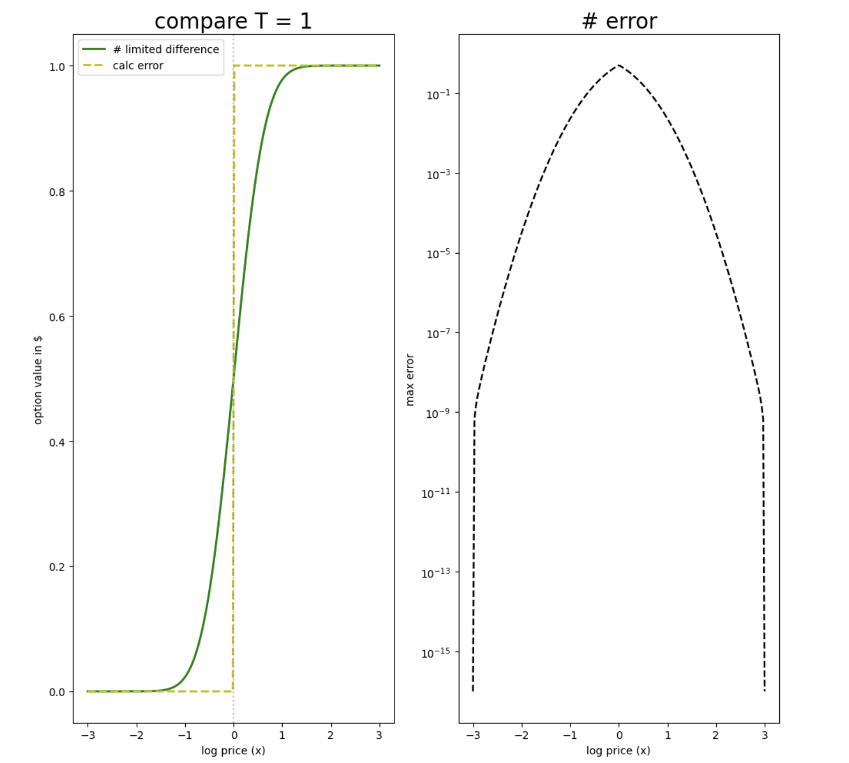
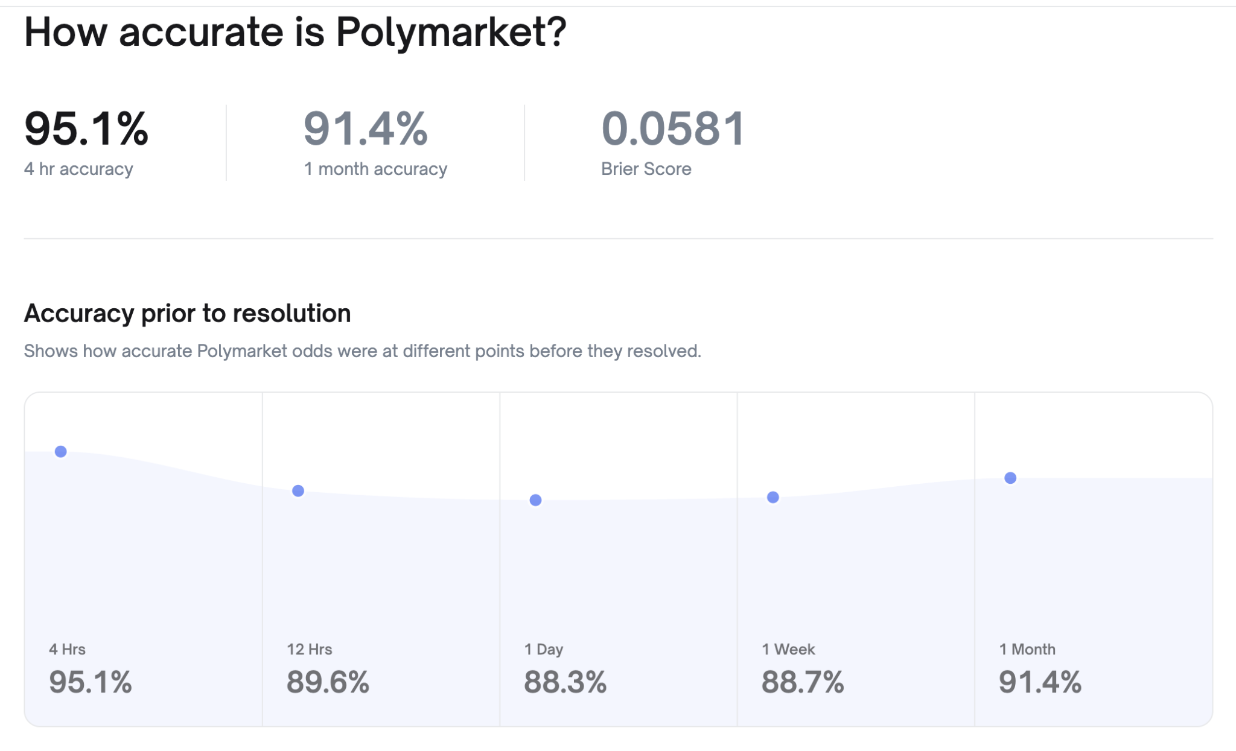
Method Pt3 - Accuracy
I used the Error Function ERF
And this is comparable to Polymart’s accuracy by user predictions, while one prediction / guess may not be accurate, when normalized to n=500, It shows the % accurate / error over T, but the IRL is not a perfect fit
(that’s why the S&P 500 is 500, to have a ‘normalized stock market)

Slide 7
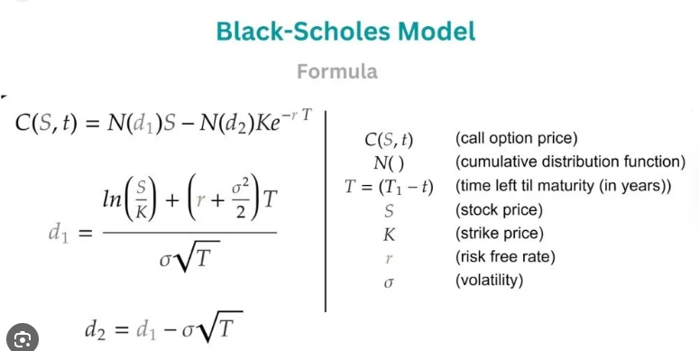
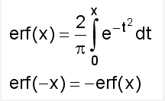
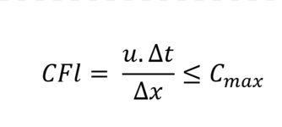
Formulas Used:
The B model is log based because it assumes that stock prices can’t be negative
ERF: “The equation uses a definite integral to represent the area under a specific Gaussian curve”
Courant–Friedrichs–Lewy (CRF): “a stability criterion for numerical methods solving partial differential equations (PDEs)”
Error func Calculator
Stability adder
Source: descrip: https://www.google.com/search?sca_esv=8dfe9edb86176f37&q=erf+error+equation&source=lnms&fbs=AIIjpHwUHhyZpxKVYPomBDxFHasDEaJxdV5GnL9atqb6hm9GVc70KHWLIfnvDRoGdQb0ui1w6Ozr-4_SuIR7qMoxExJfW-jNBS0QDmDQSHCxW_ltmBusxvzN-VLtk_m1-FbELnvYwcVsk0nwWUMafT3LEJMXKnySQHr3HRvmfo8fHGUEKfIij69bBE2HsPzIl8yaHIgYvy1O4aFPmOwtkd5zMiuFHieGBxOJulcQhDIQYE8ZzyPb7vg&sa=X&ved=2ahUKEwjK-MjanaKRAxWTCjQIHcbqFygQ0pQJegQIDRAB&biw=1307&bih=827&dpr=2
Source: descrip: https://www.google.com/search?q=courant%E2%80%93friedrichs%E2%80%93lewy&oq=Courant%E2%80%93Friedrichs%E2%80%93Lewy&gs_lcrp=EgZjaHJvbWUqBwgAEAAYgAQyBwgAEAAYgAQyBwgBEAAYgAQyBwgCEAAYgAQyBwgDEAAYgAQyBwgEEAAYgAQyCggFEAAYgAQYogQyBggGEEUYQNIBBzUzMGowajeoAgCwAgA&sourceid=chrome&ie=UTF-8

Slide 8
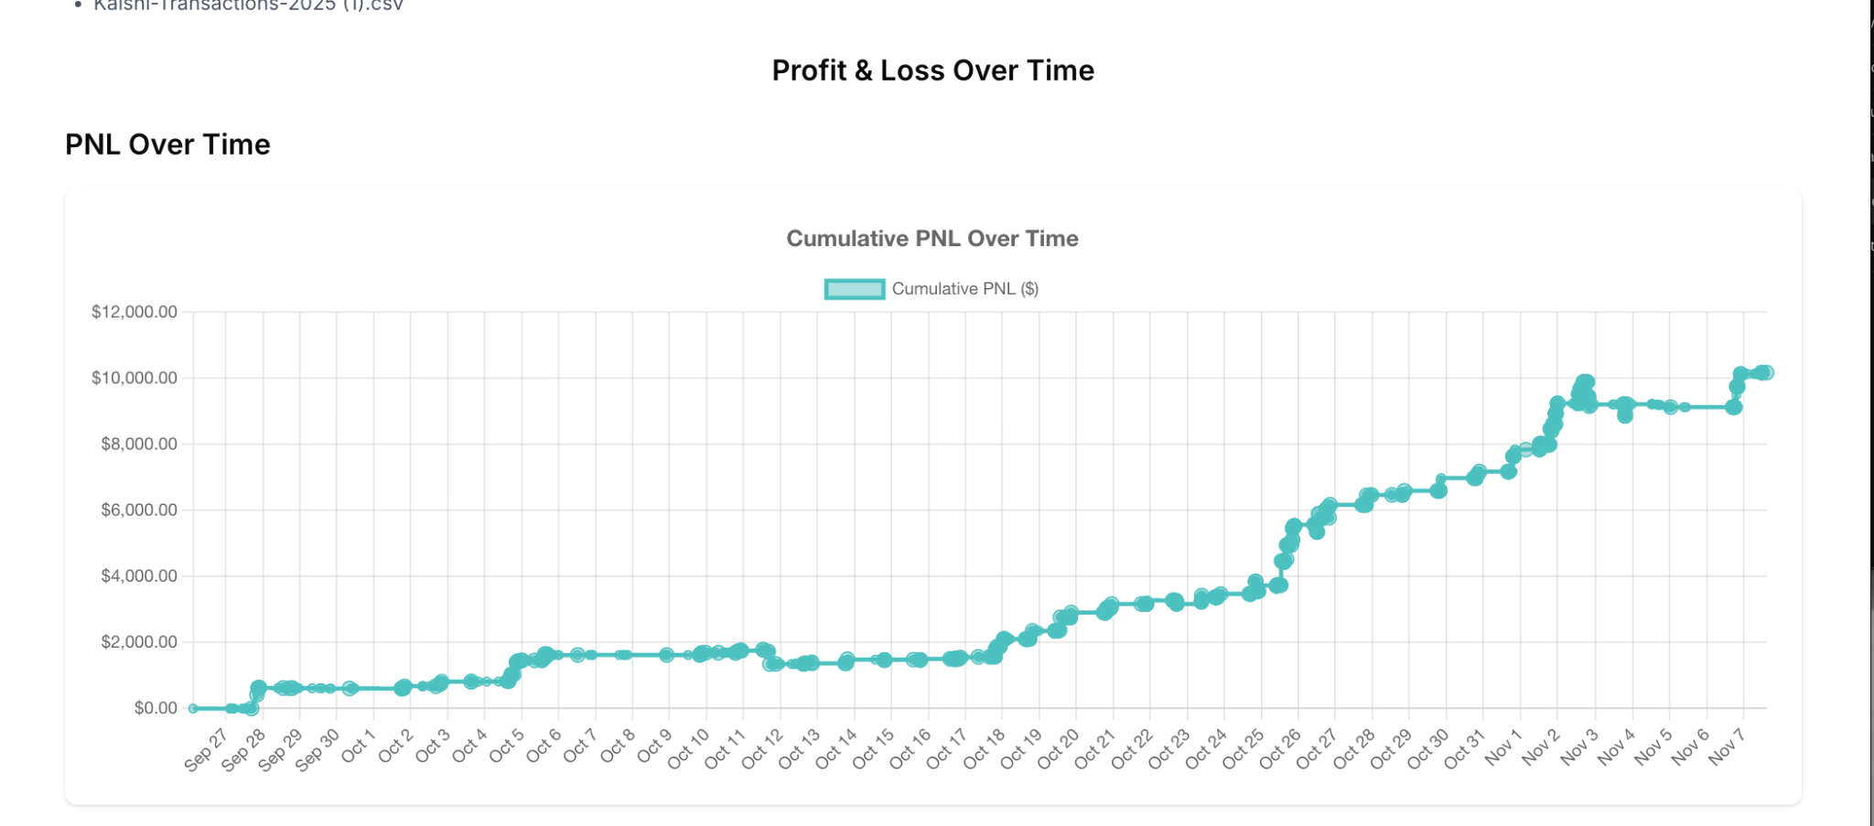
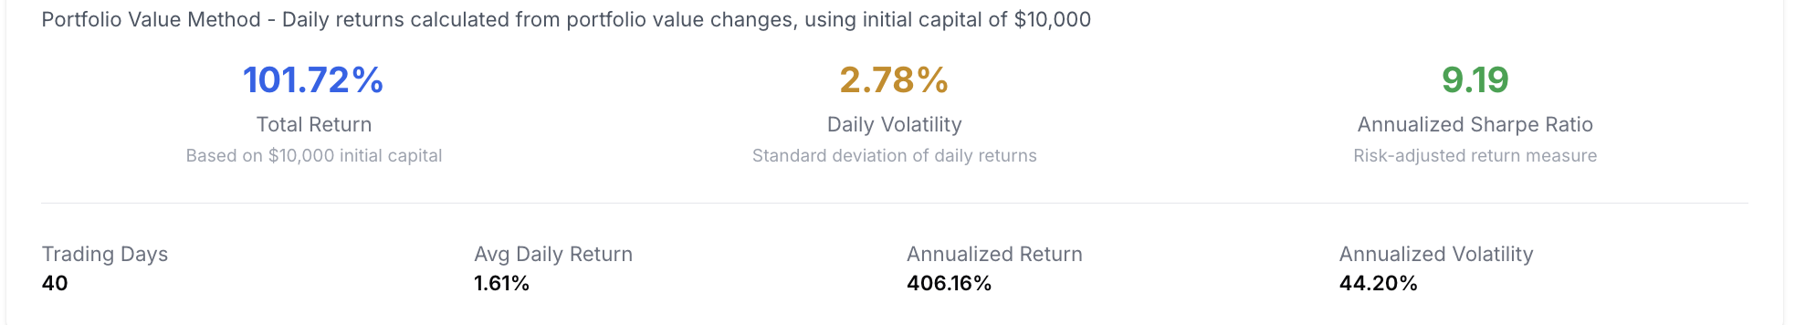
My personal journey as a prediction market trader:
Traded more than $250,000 in volume at greater than a 4% edge as of 11/12/25, with more than a 9.0 Sharpe ratio. ROI: 406.88% in 42 days.
Prediction Market Trader as of 9/27/25
Extra Trader Data:
9/27/25 thru 11/07/25
Total Trades: 2585
Unique Tickers: 449
Win Rate: 72.97%
Average Hold Time: 0.2 days
Sharpe Ratio: 9.19
Daily volatility: 6.37% With winter break I’ll be creating a bunch of
models to improve my trading.
404.72%*

Slide 9
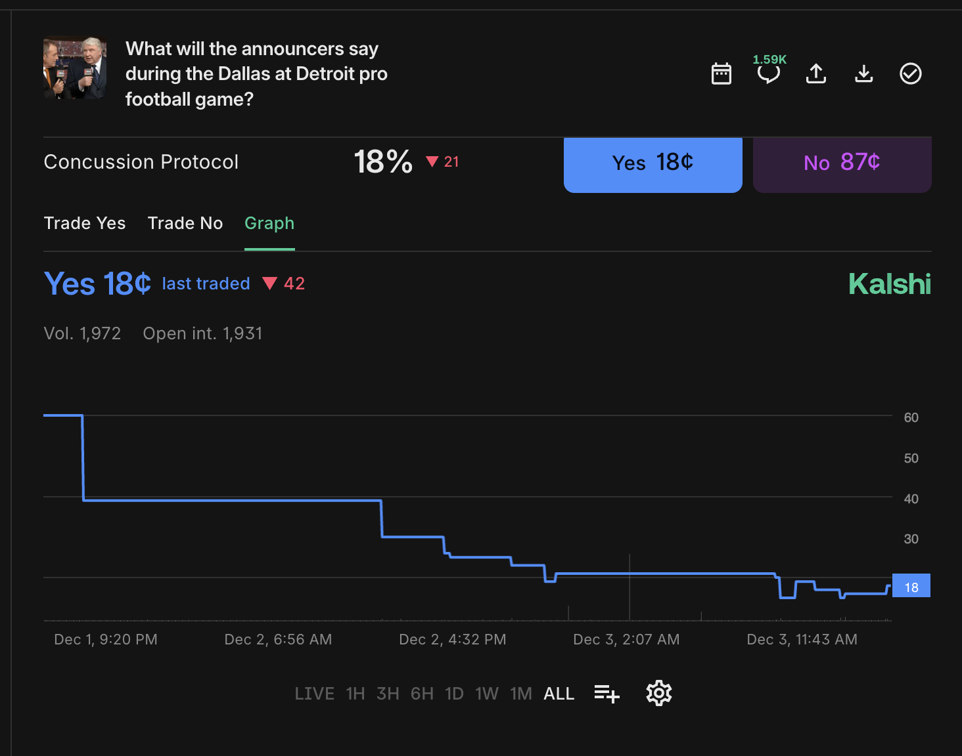
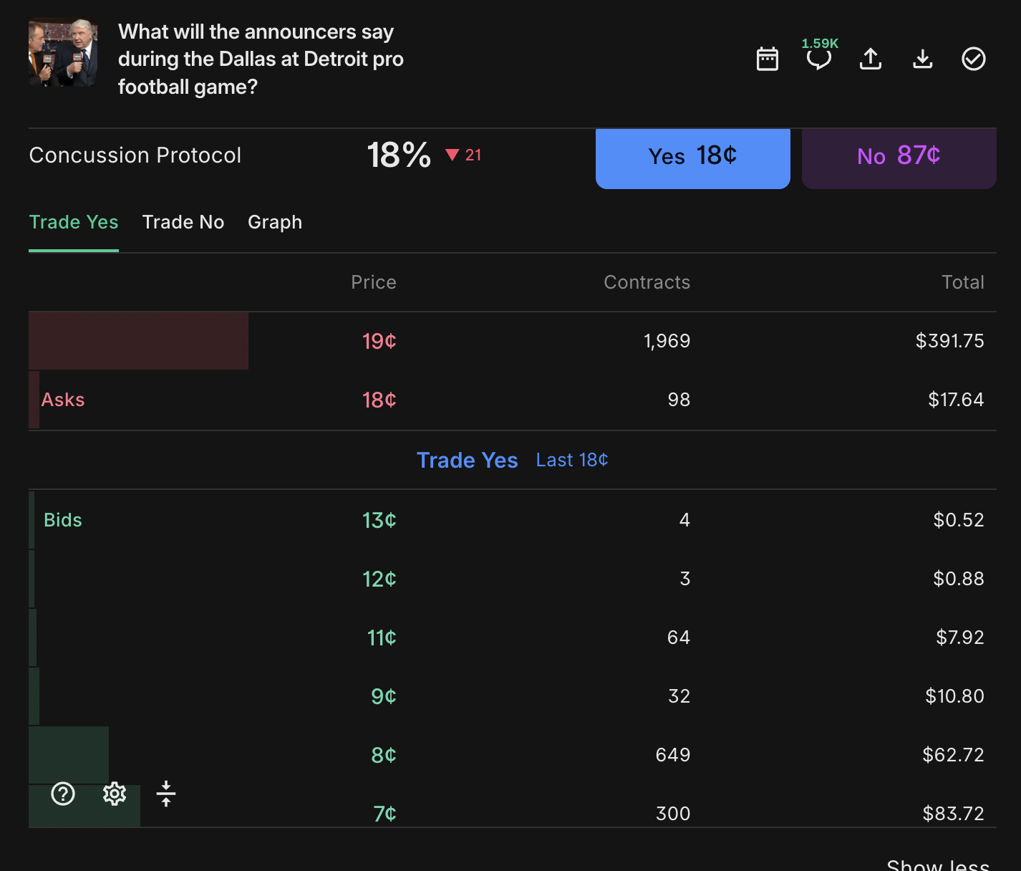

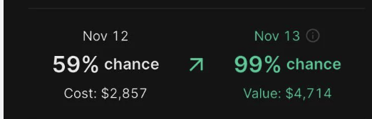
IRL Application: Professor Militzer Mention Market
What is a Mention Market?
Will <X> word be said in <Y> speech / Event
Ex: Will “Concussion Protocol” be said by the announcers on Monday Night Football
Ex: Will “PDE / Partial Differential Equation” be said by Professor Militzer in the next lecture 5x+ times?
pull the scripts from the first 5 lectures, have 3 strikes of 'mention markets for professor's words', and for next three lectures, give live updates of the fair value that X word will be said from the dumbed down Black Scholes model
“PDE’s are amazing” X 10

Slide 10
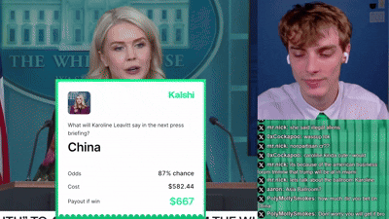
Mention Market Extra:
IRL: At a White House Karoline Leavitt Press Briefing ‘China’ was a strike and @lockskybets on X/twitter.com had the ‘Yes’ side of the contract, and won a net of about $100
A reporter asked Caroline a China related question (only counts when she say’s it), and in her response back she mentioned ‘china’ resolving the market to yes.

