Slide 1
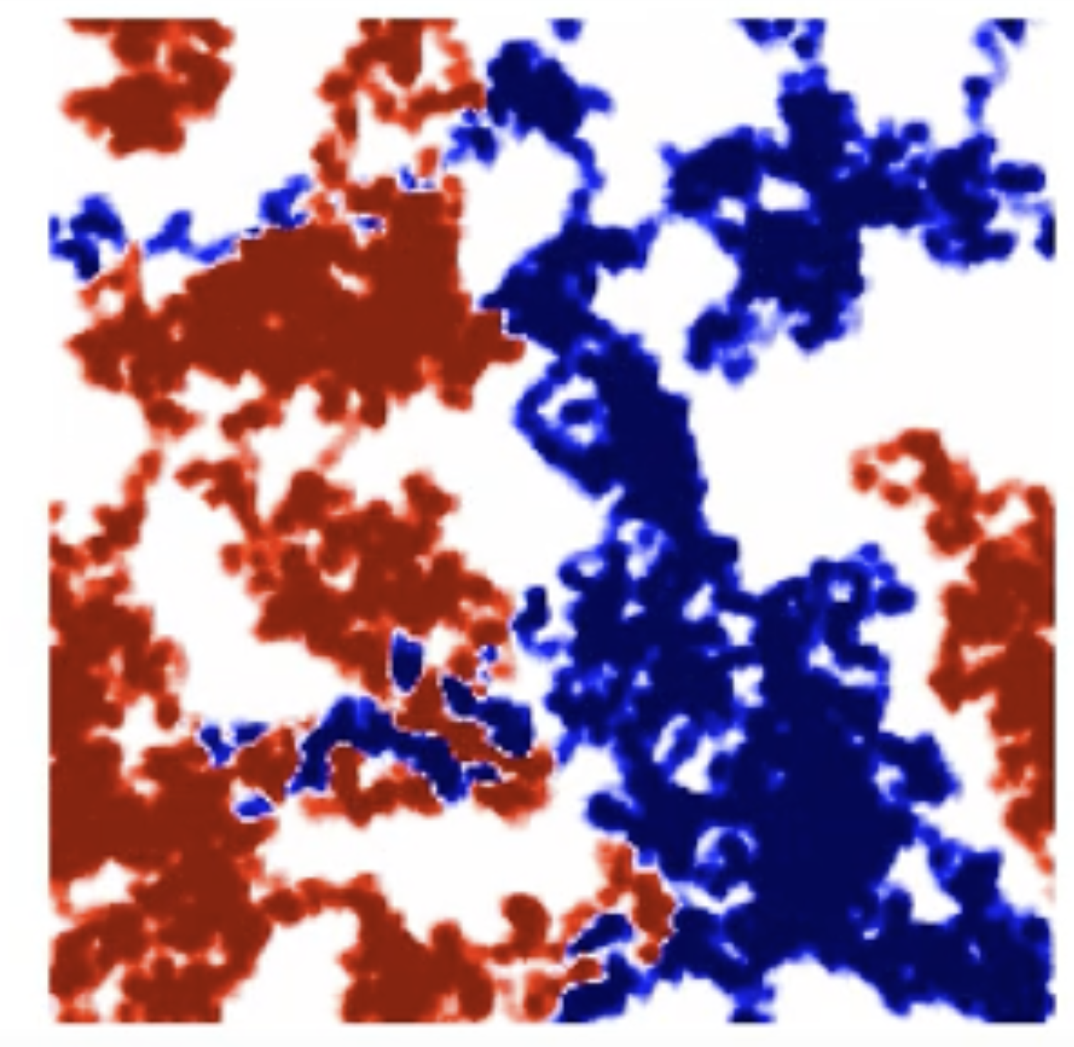
Competition Between Species Simulated by Random Walks
By: Dav Kneip

Slide 2
Topic and Methods
I used random walks to simulate two species moving around and competing for territory.
One of the species increases the value of the spaces in walks over, while the other one decreases.
This allows for them to interact with each other on the graph.}
I also introduced some evolutionary factors like making the species increase their size faster the more they already have
Another evolutionary trait I tested was making the growth slow down the further the species walked away from where it originated from to simulate needing to stay near a certain resource

Slide 3

Animations

Slide 4
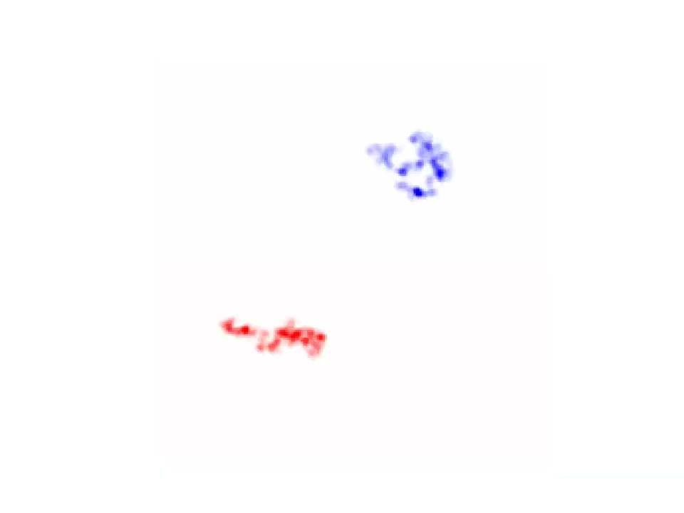
Animations

Slide 5
Animations

