Slide 1
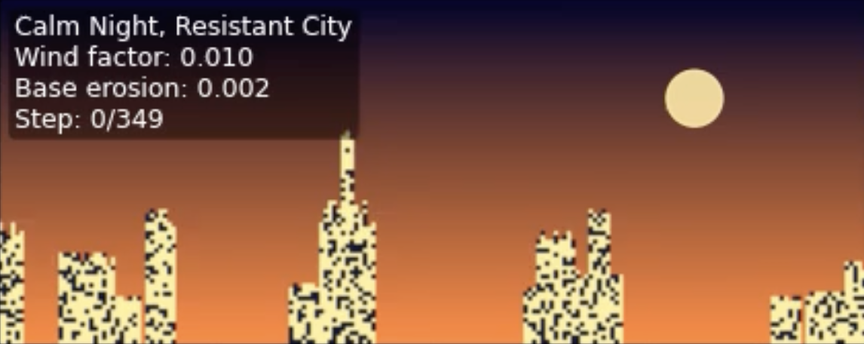
Vanishing Cities: A Stylized Erosion Simulation of Urban Skylines
Christy Huang
EPS 109

Slide 2

The Simulation
A 2D city skyline that gradually “weathers away” over time
Buildings are represented as a binary grid (1 = building, 0 = air)
Erosion is meant to mimic wind/rain preferentially removing exposed edges, corners, and tall structures
Goal: show how different “materials” and wind conditions change how the skyline decays, both visually and quantitatively

Slide 3
Method
Cellular Automation
Gravity
Lights & Environment
Visualization
At each time step, every building cell checks its 8 neighbors
Cells with more air neighbors (more exposed) erode with higher probability
Erosion probability increases with height (more exposed to weather)
Extra erosion probability to wind-facing sides
After erosion, columns “collapse” downward so there are no floating blocks
Separate grid for window lights that gradually turn off over time
Colored sky gradient + sun/moon added for a more interpretable visualization
Time series of grids rendered with matplotlib as an animation
Parallel plot of simple metrics over time to quantify the decay

Slide 4
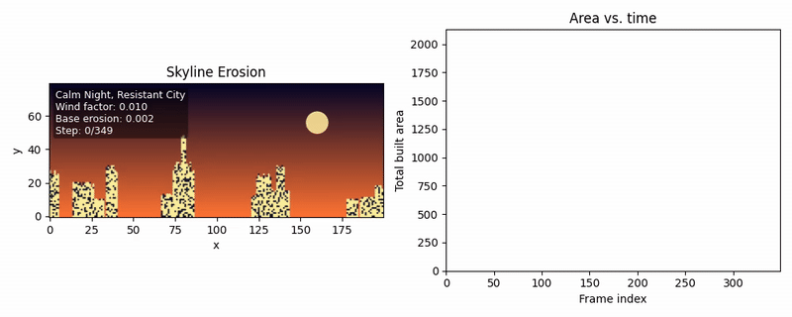


Animations
01
02
03
Calm Night, Resistant City
Windy Evening, Moderate Erosion
Brittle Skyline in Storm
Slower erosion
Many lights on, turn off slowly
Brittle material: edges erode aggressively
Many lights on initially, city empties quickly
Stronger wind-driven erosion
Fewer lights on, turn off faster

