Slide 1
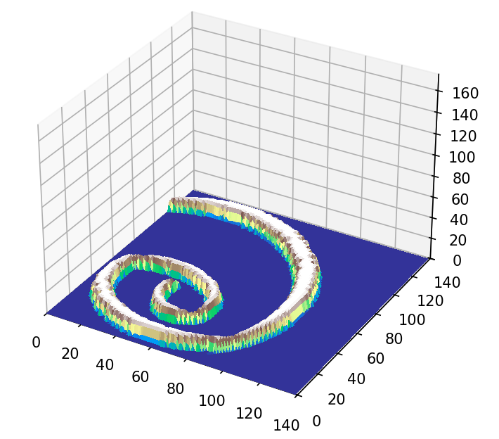
Erosion of the Spiral Jetty over time
Lillian Goerzen
12/3/25

Slide 2
Topic/Methods
Potential erosion model for the Spiral Jetty
Landscape art located in Great Salt Lake
Used erosion model from class
Adjusted to better fit landform
Also used previous methods of defining arrays

Slide 3
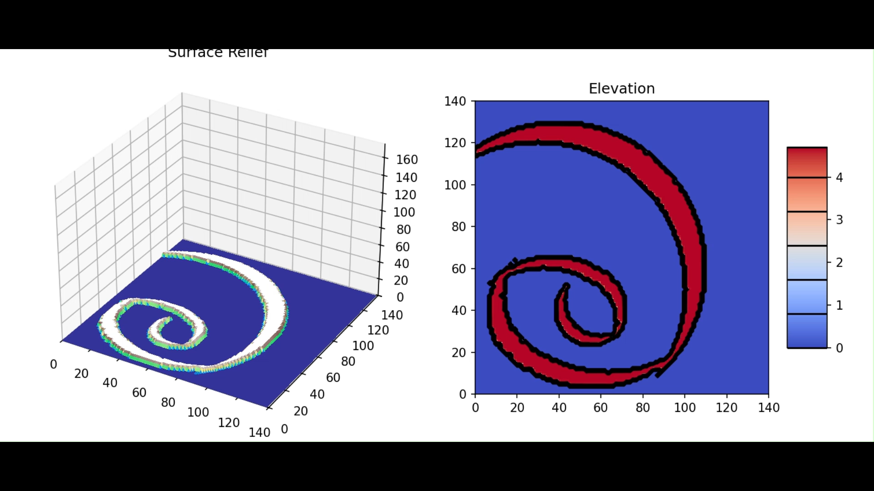
Animation

