Slide 1
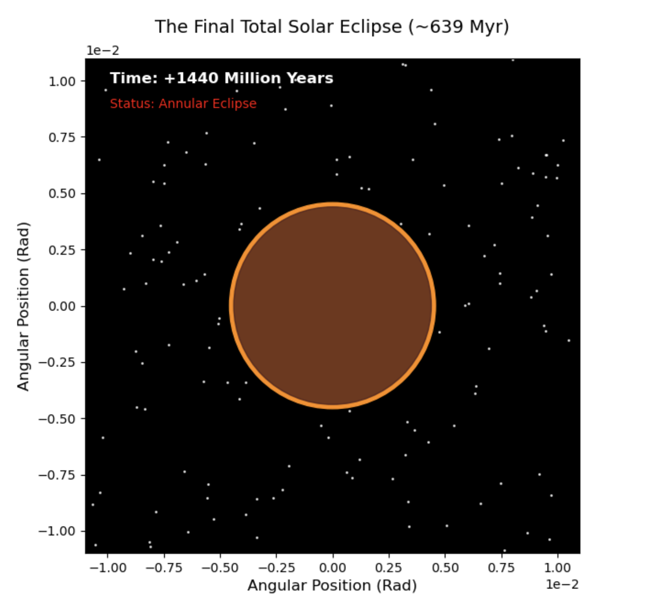
End of the Total Solar Eclipse
By Diego Gallardo

Slide 2
Topic:
In my simulation, I calculate the change in apparent size of the Moon in the sky in comparison to the Sun. Yearly, the Moon recedes from the Earth a few centimeters every year, causing it to appear smaller and smaller while the Sun remains relatively the same size. Using the distances of the Moon at perigee and the rate of recession, I can simulate the last Total Solar Eclipse where the Moon’s apparent size becomes small enough that it cannot fully cover the Sun anymore
Methods
For my simulation, I used:
The differential equation of da/dt = C * a^-5.5 which is the equation that demonstrates the Moon’s recession. C is the calibration constant and a is the orbital distance. As the distance increases, recession rate slows exponentially.
Initially I used the Euler Method as it allowed for taking easy straight line steps when accounting for the change in recession speed. It relied on building on the previous point (distance) of the Moon and the speed of recession at that distance. These steps however, added up and did not take into account for the exponential change in the recession curve as distance increased, causing it to overshoot the rate of recession and predict the rate of recession to be much quicker
I then switched to the Runge-Kutta (RK4) method, which measured the rate more carefully and made it more accurate by sampling the slope of recession at multiple points instead of only one, and taking the average which followed the actual recession curve rate. This method acknowledged how the Moon’s rate of recession doesn’t remain constant (changes exponentially) and used this to adjust itself to replicate a more accurate recession rate.

Slide 3
