Slide 1
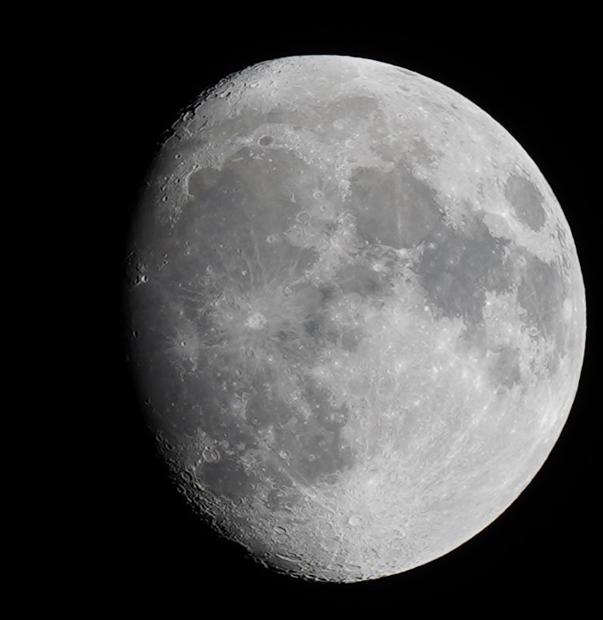
Simulating Lunar Recession
Modeling the changes in the Earth-Moon system
Sam Clayton

Slide 2
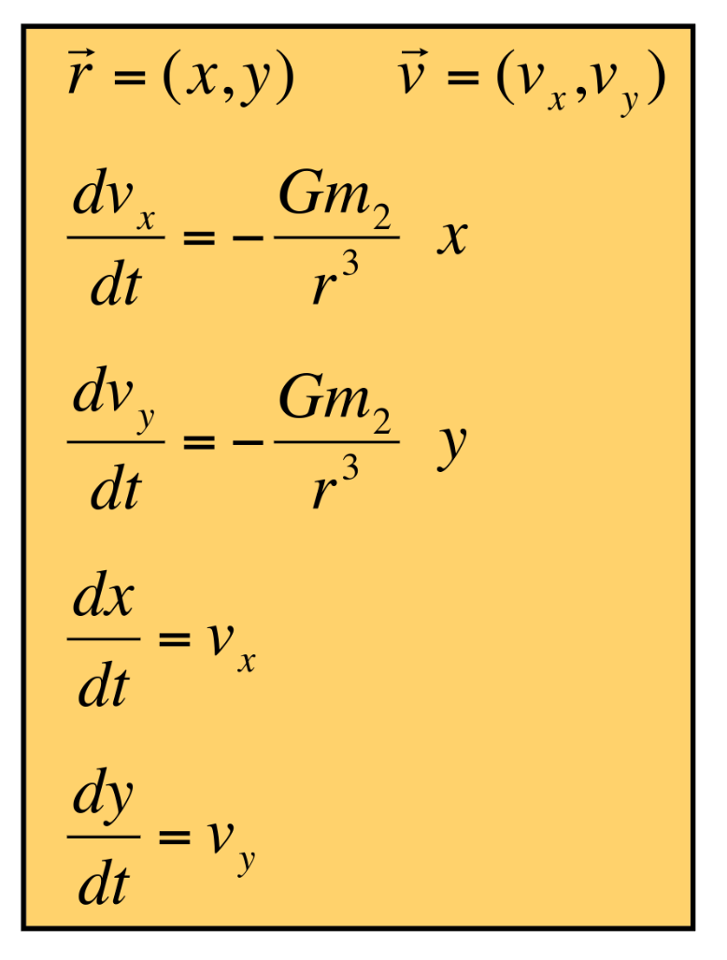
The Moon drifts 3.8cm away from the Earth every year!
This also causes the Earth to spin very slightly slower, due to conservation of angular momentum
I used the KeplerODE method to simulate the orbit, and adjusted the orbital distance + factored in the changes to angular momentum at each step
dL_{moon}+dL_{Earth} = 0

Slide 3
