Slide 1
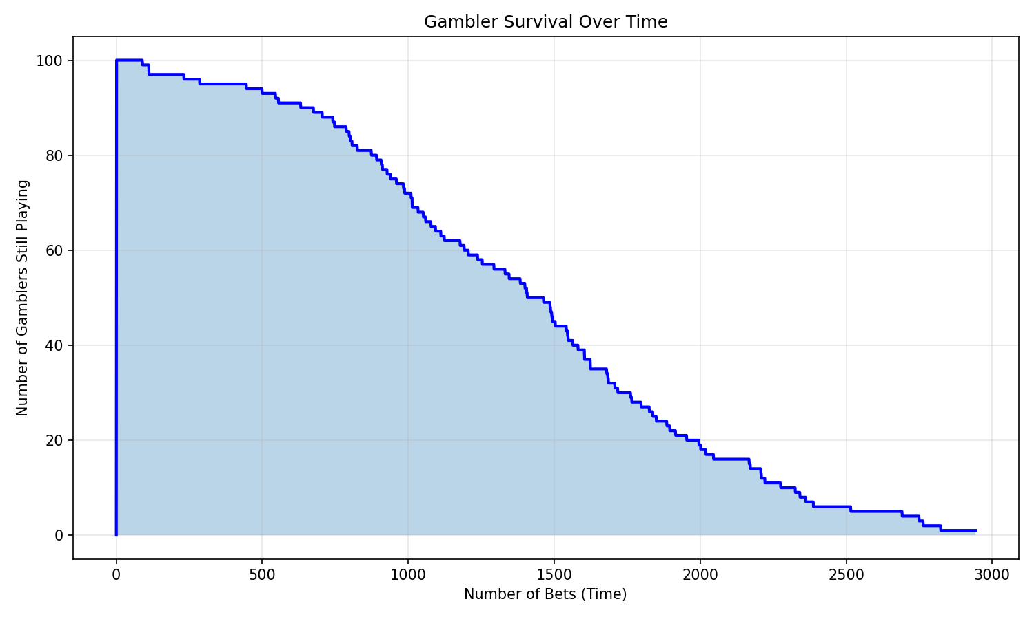
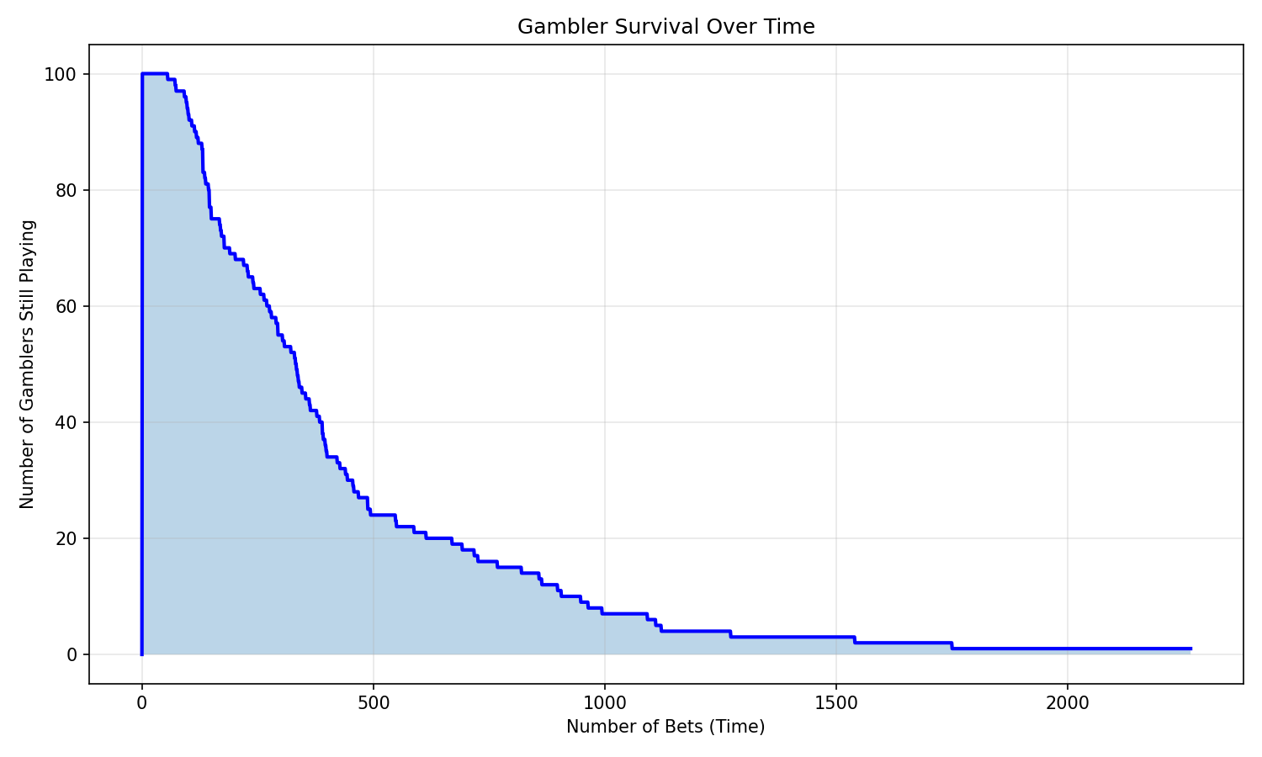
Gambler’s RUIN
Visualized Using Random Walks
Kat Cheng

Slide 2
THE GAMBLER’S ROAD TO RUIN
This code simulates the probability theory problem called Gambler's Ruin, which describes the likelihood that a gambler will lose all their money in a game, even if it's a fair one. Random walks visualize, the fact that a gambler playing a game with non-positive expected value will eventually go bankrupt, regardless of their betting system.
Each pixel represents a single gamber. The y=0 axis represents a gamber going broke. The x axis tracks movement over time. At each time step, each player makes a single bet corresponding to the chosen betting scheme and either wins or loses money, shifting their y position upwards or downwards. The vertical boundaries are set at y=0 (bankrupt) and y=T, which is a target amount at which the player will stop gambling.
PARAMETERS: nGamblers, startingBankroll, quittingAmount, betAmount, betScheme, winProb, maxTimesteps
RETURNED STATS: #stillPlaying, Winners:Bankruptcies, Avg/Med time to bankruptcy/quitting,
House Advantage
Kat Cheng

Slide 3
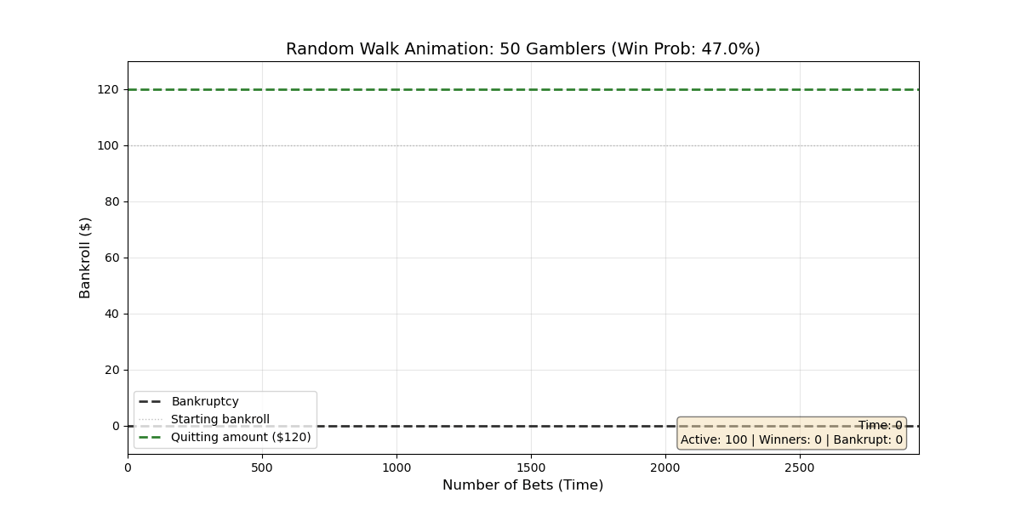
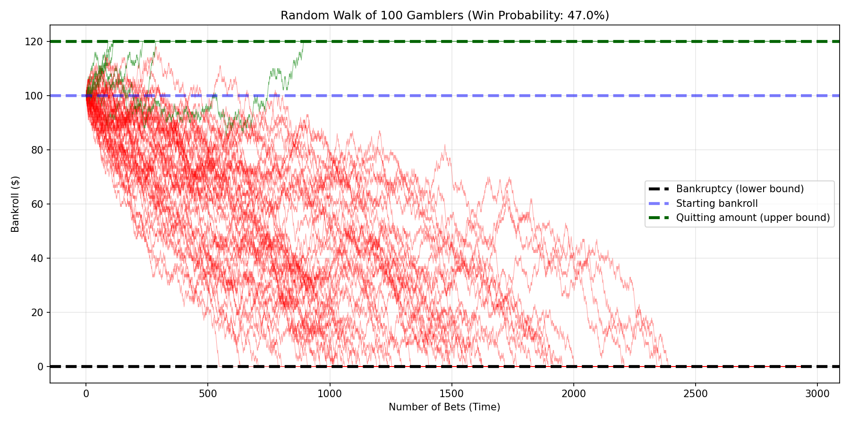
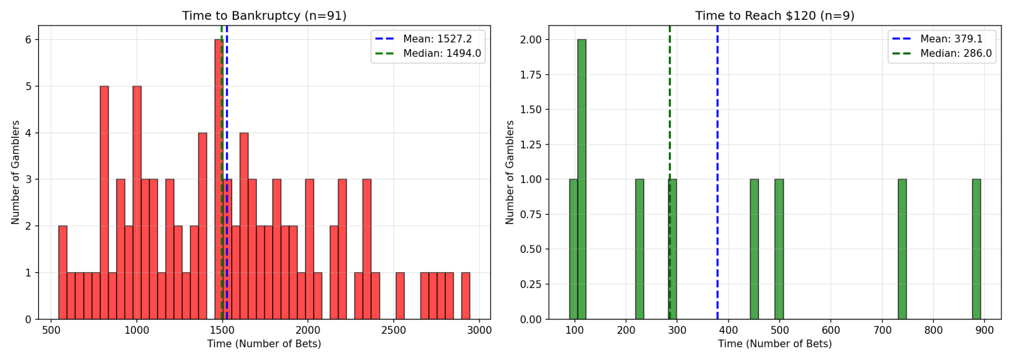
THE ROULETTE SIM 47%, $1, $120 ceiling
Kat Cheng

Slide 4
THE ROULETTE SIM 47%, $1, $120 ceiling
Kat Cheng

Slide 5
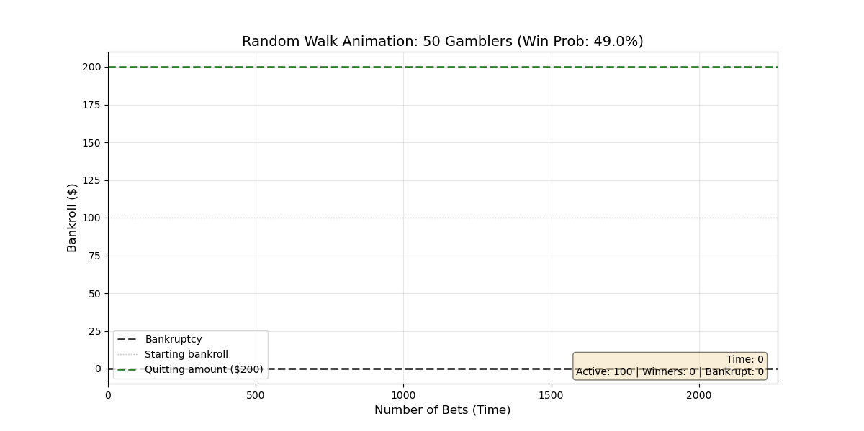
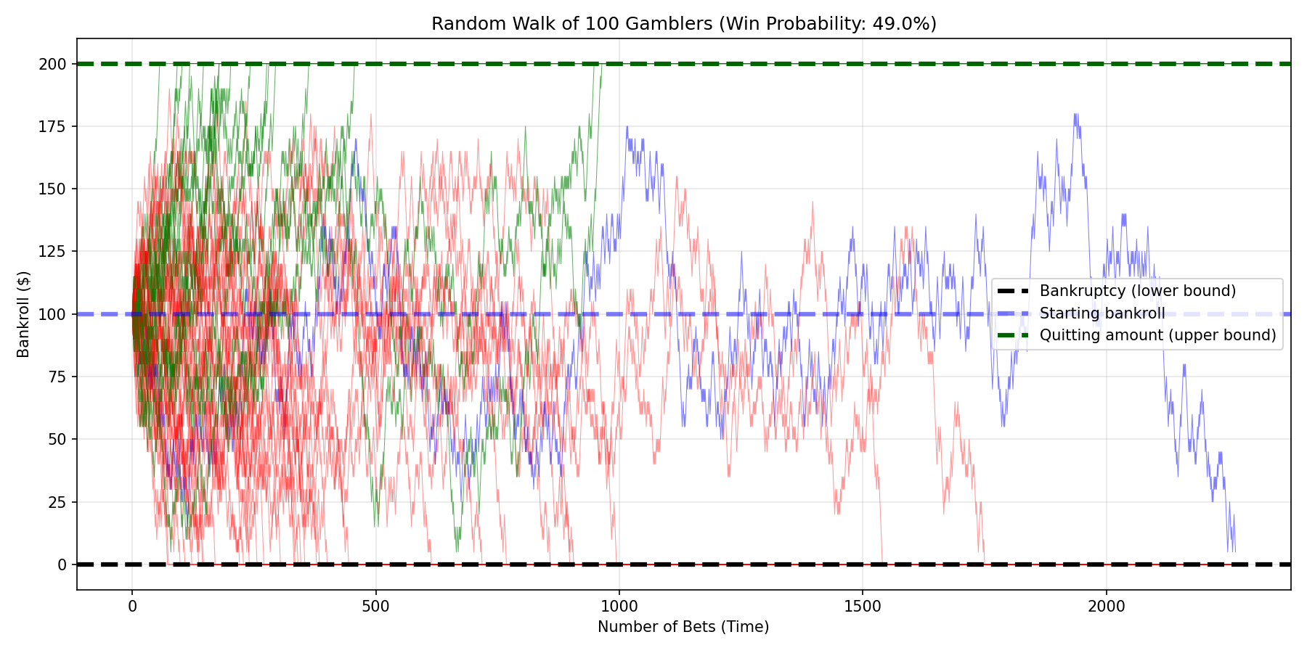
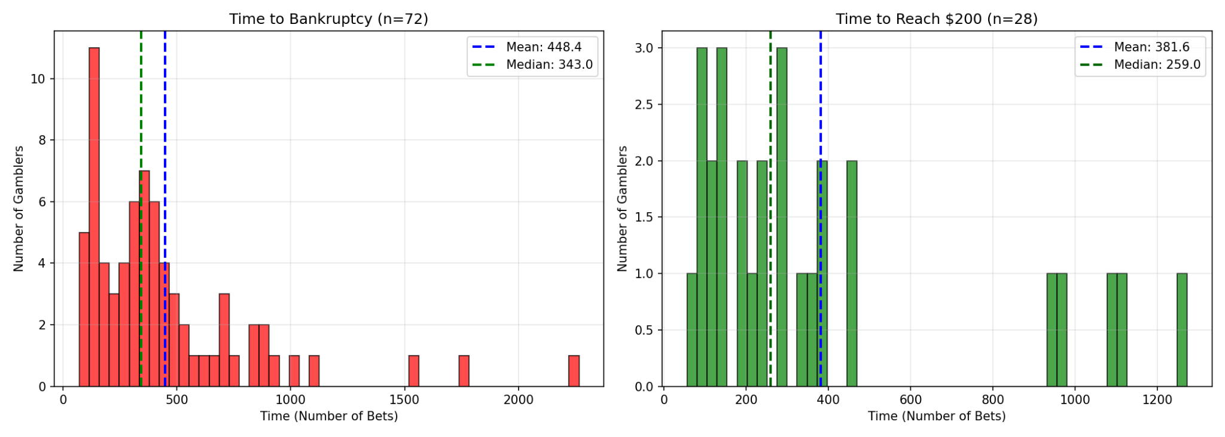
THE BLACKJACK SIM 49%, $5, $200 ceiling
Kat Cheng

Slide 6
THE BLACKJACK SIM 49%, $5, $200 ceiling
Kat Cheng

Slide 7
THANK YOU

