Slide 1
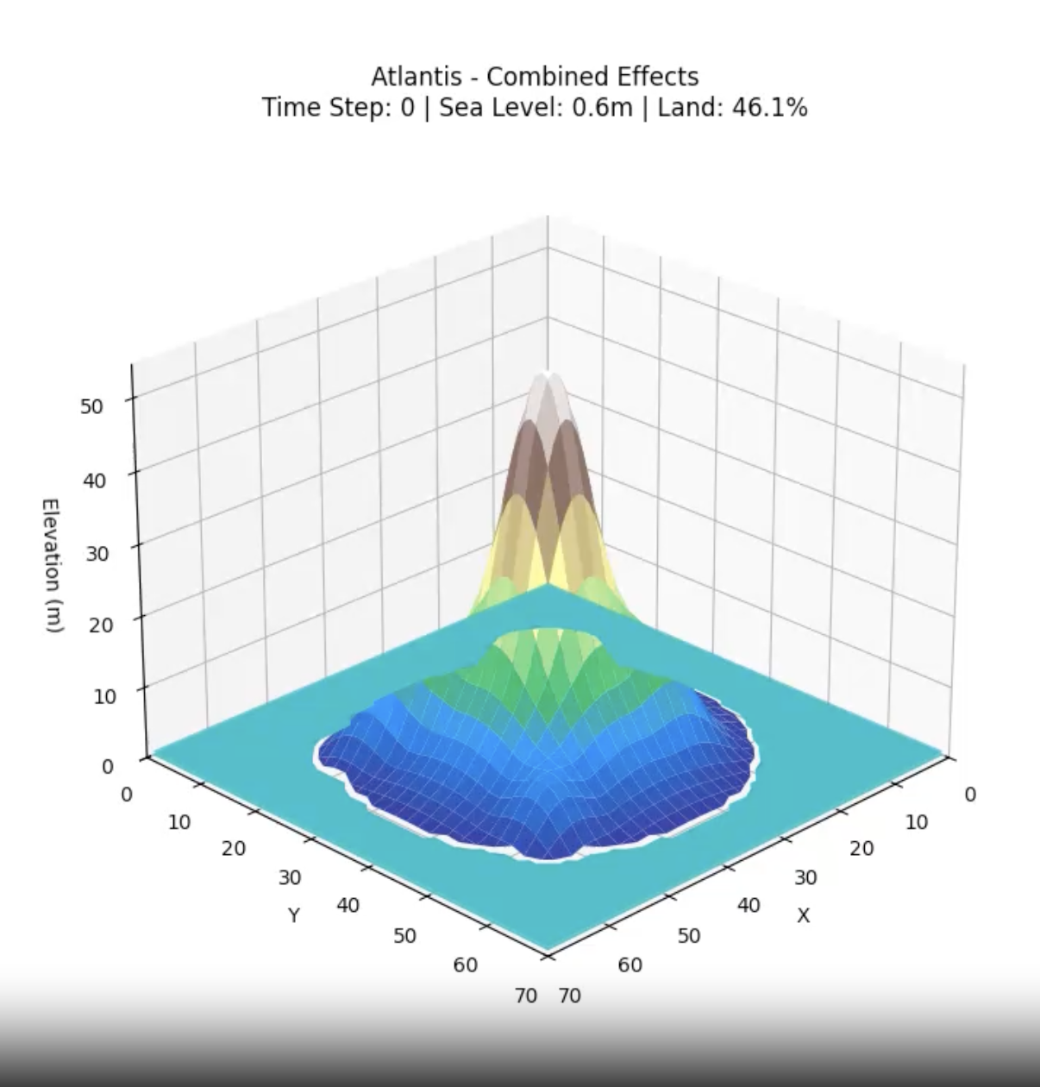


Downfall of Atlantis
Oindree Chatterjee
12/02/2025
EPS 109
LOGO HERE

Slide 2
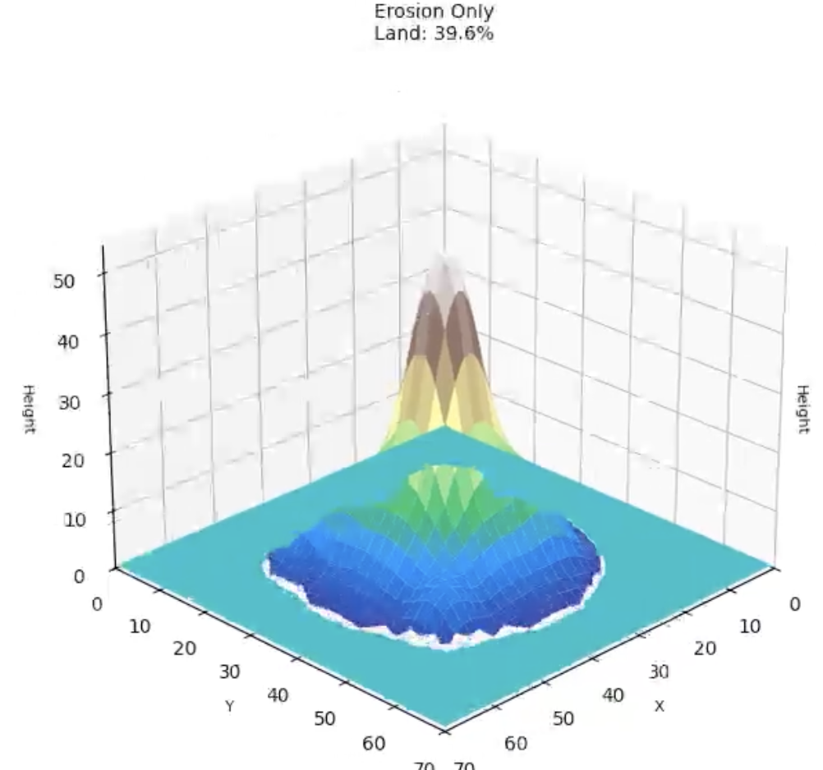
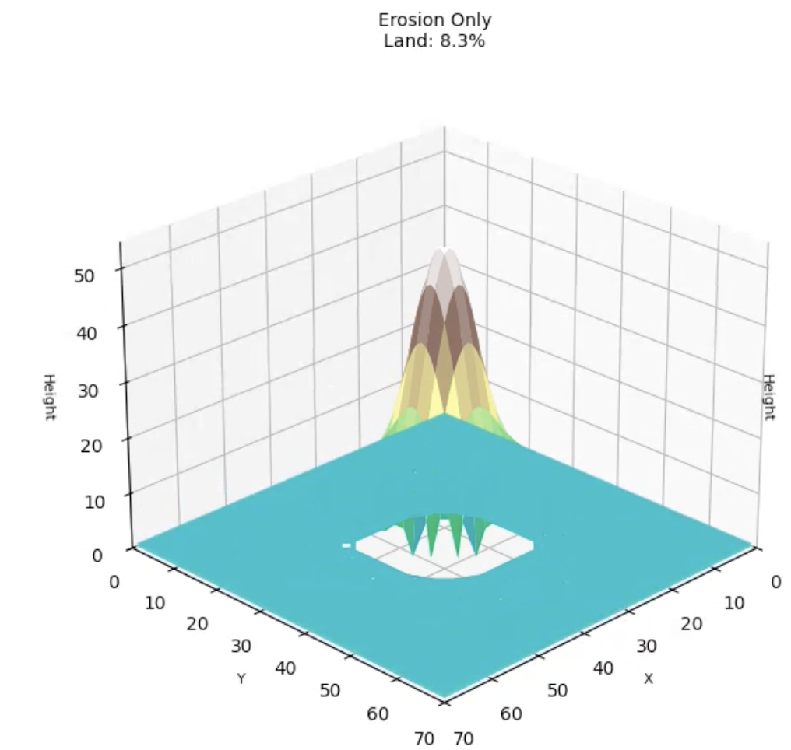
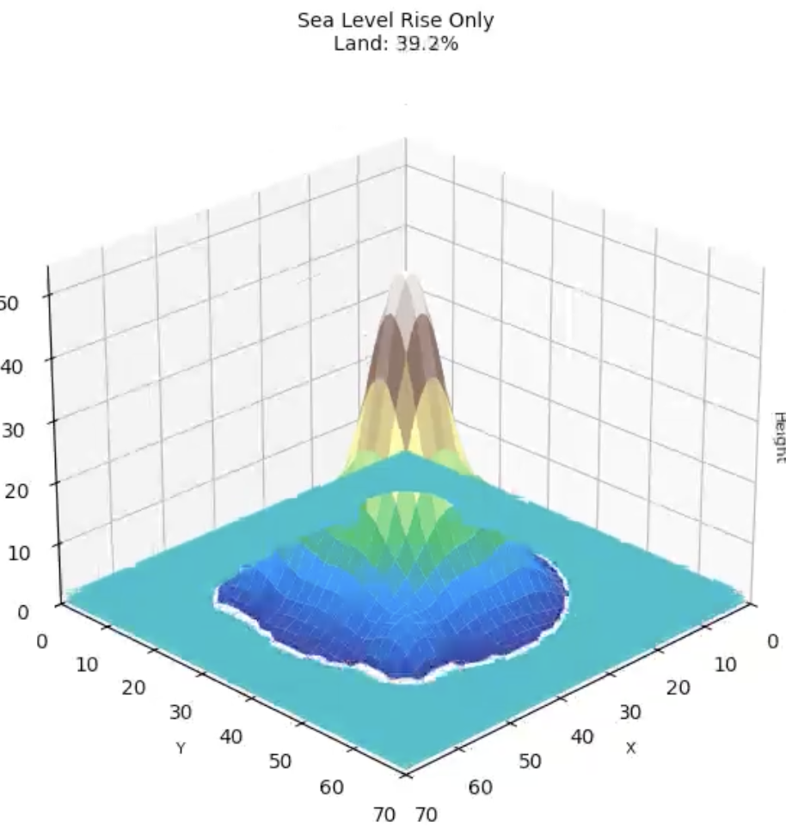
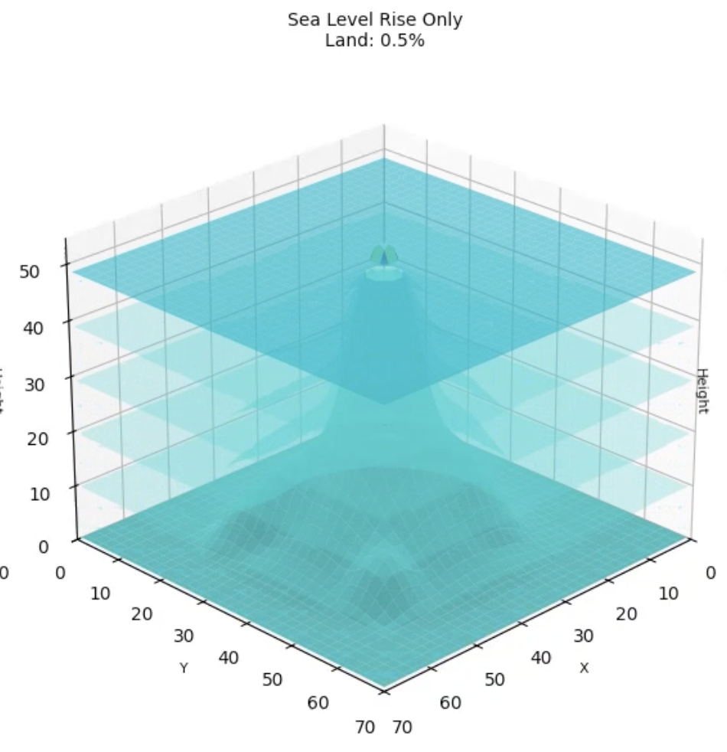
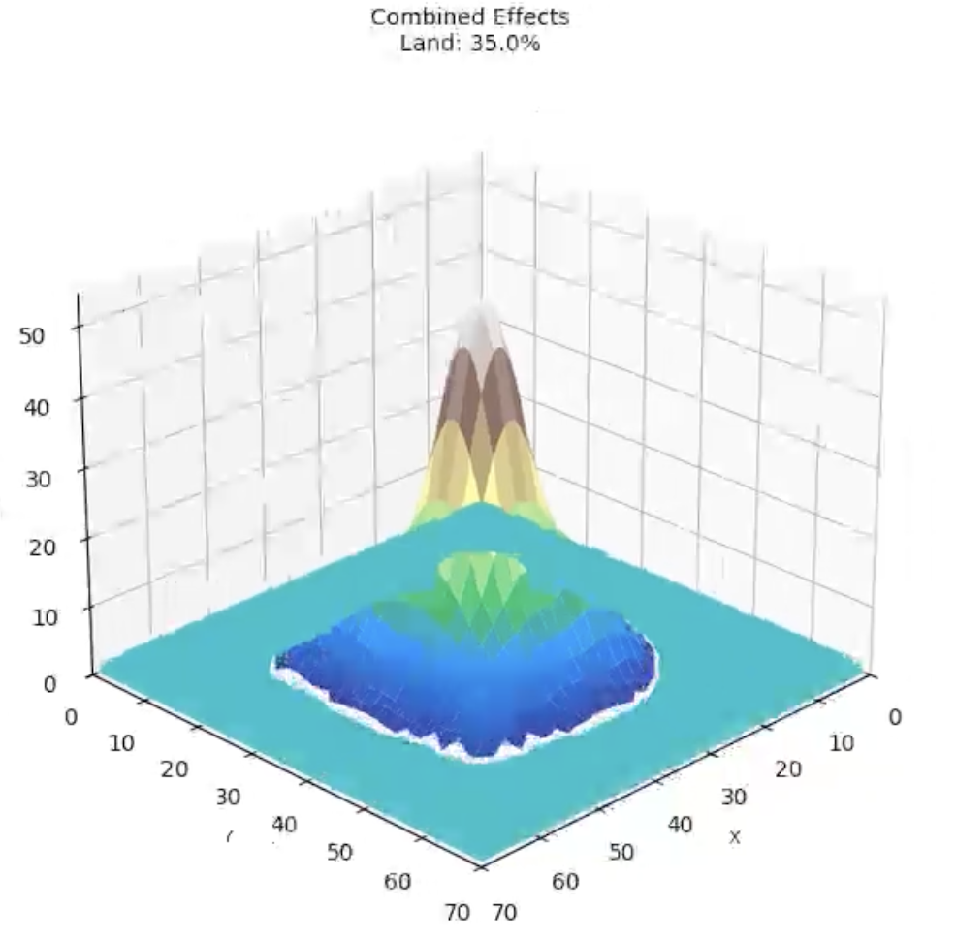
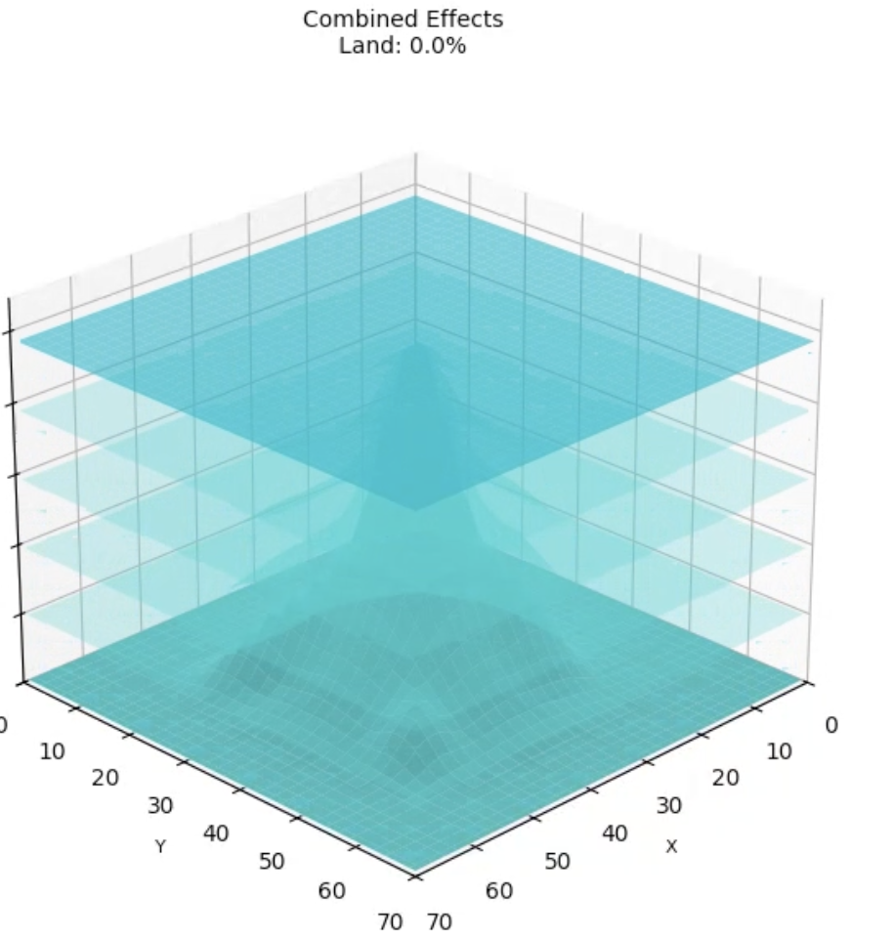

About Atlantis
& methods used
Simulating how erosion, sea level rise, and both at the same time affects an island and causes it to submerge
Using ODEs for time evolution
  Erosion over time
    dh_terrain/dt = -k, dh_water/dt = 0
  Sea level rise over time
    dh_terrain/dt = 0, dh_water/dt = C
  Erosion and Sea level rise over time
    dh_terrain/dt = -k, dh_water/dt = C

Slide 3
