Slide 1
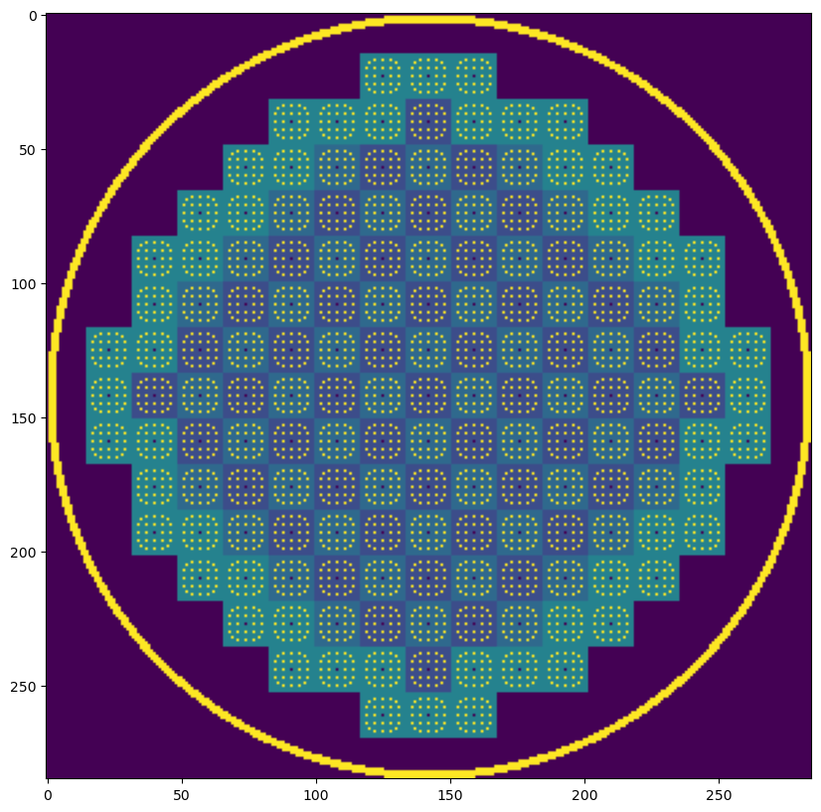
Neutron Movement in an AP1000 Reactor Core
Sam Wolf
EPS 109
12/2/2025

Slide 2
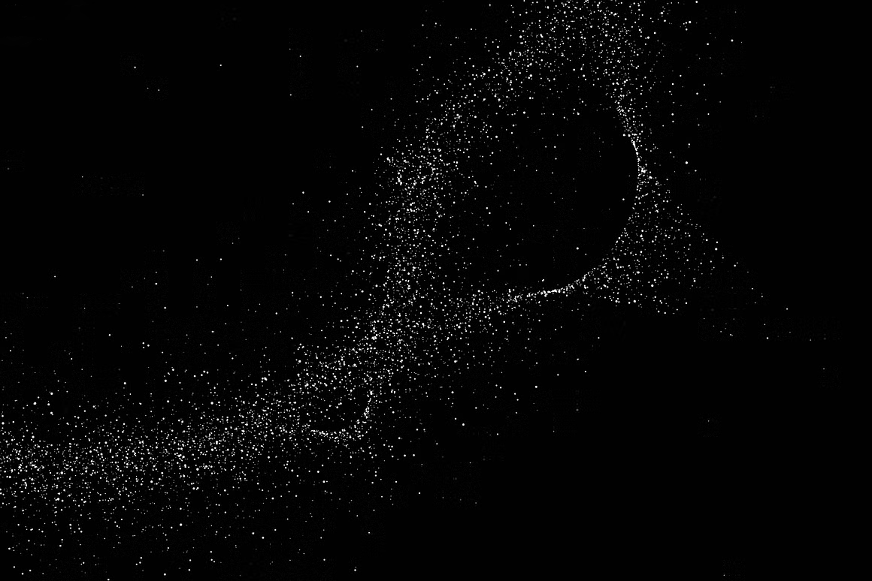
Topic & Methods
AP1000 reactors are nuclear reactors designed to produce 1,200 megawatts with 6 in operation. Power is produced through fission, where uranium releases neutrons and causes a chain reaction
Random Walks
Material Interactions
Neutrons are emitted in a random direction from fission
Travel in a straight path after emission
Neutrons interact with control rods, fuel rods, and the reactor vessel
Control rods can be made more or less effective
EPS 109
12/2/2025

Slide 3
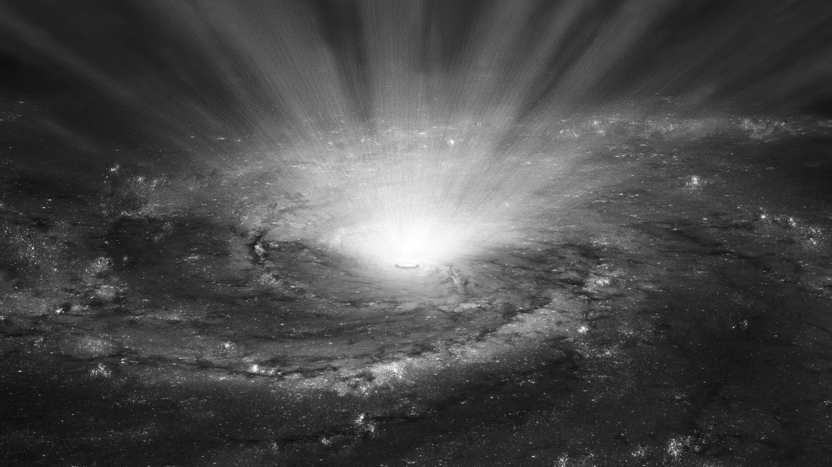

100% Inserted Control Rods
EPS 109
12/2/2025

Slide 4
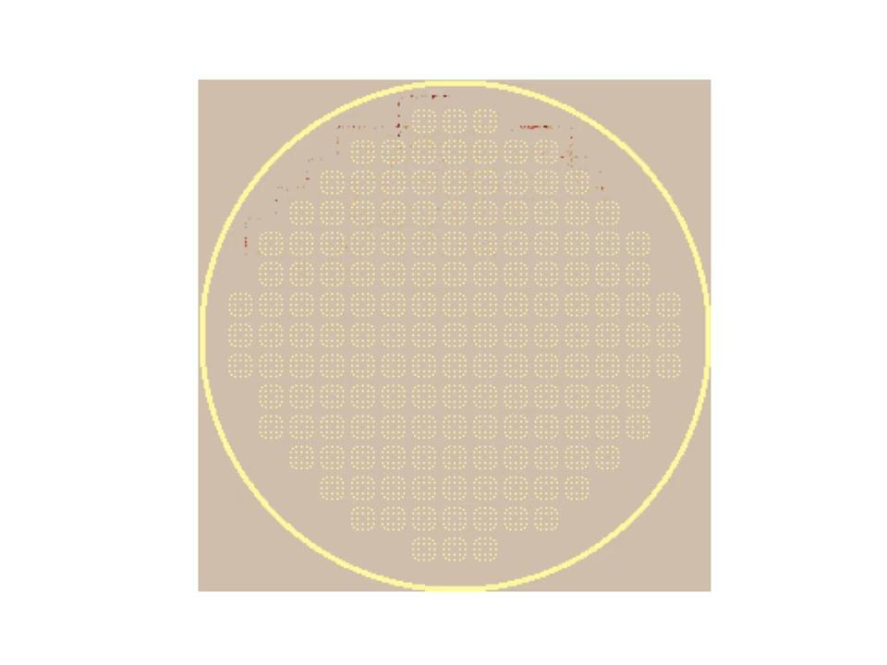
50% Inserted Control Rods
EPS 109
12/2/2025

Slide 5
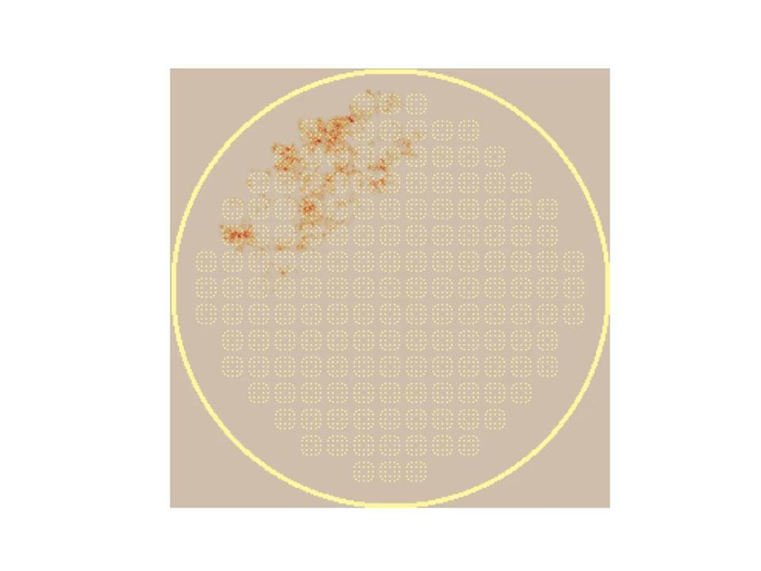
25% Inserted Control Rods
EPS 109
12/2/2025

