Slide 1

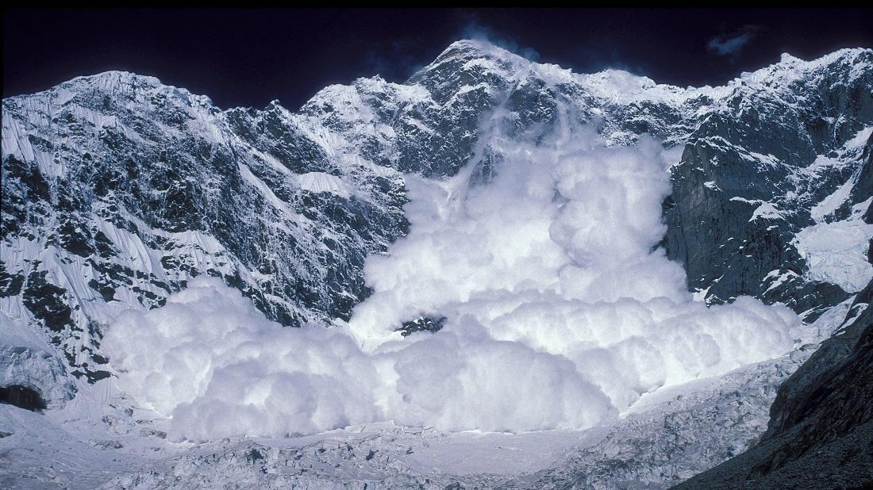
Avalanche Simulation
EPS 109
December 1, 2025
Crosby Soenen

Slide 2
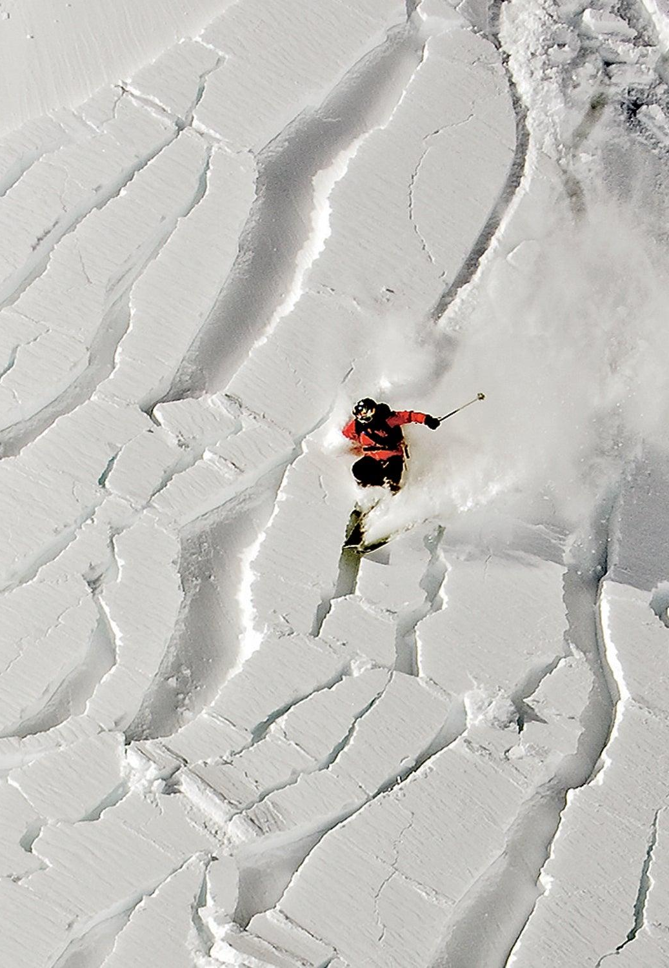
Content Overview
EPS 109
Simulating slab avalanche release on a mountain slope
Snowpack modeled as connected blocks sliding under gravity
obeys Newton’s laws with forces from gravity, friction, and spring-like cohesion.
Weak middle layer causes fracture and slab separation
Variable friction zones affect avalanche speed and runout
Upper slope, mid-slope, lower slope
35 degree pitch
Usually are between 30 degrees and 45 degrees for high risk avalanches.
Trigger pulse initiates motion
Skier
Earthquake
Debrie
ODE physics model with 3D visualization

Slide 3
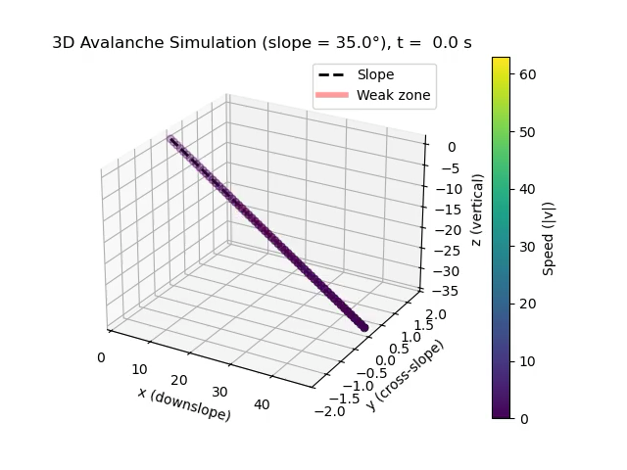
Animation
EPS 109
Three general waves
Friction varies among slope
Faster in the beginning due to the force being acted behind it
Terrain has a uniform slope
Modeled in 1D motion and only visualized in 3D
No air drag
Snow is represented as rigid blocks, not a flowing material

Slide 4
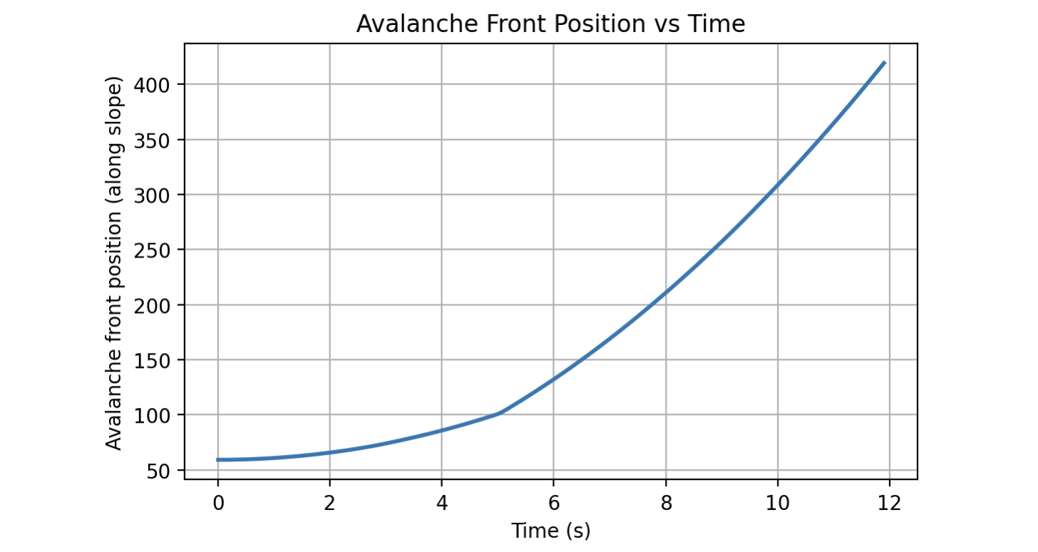
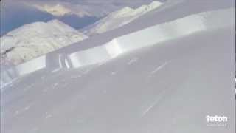
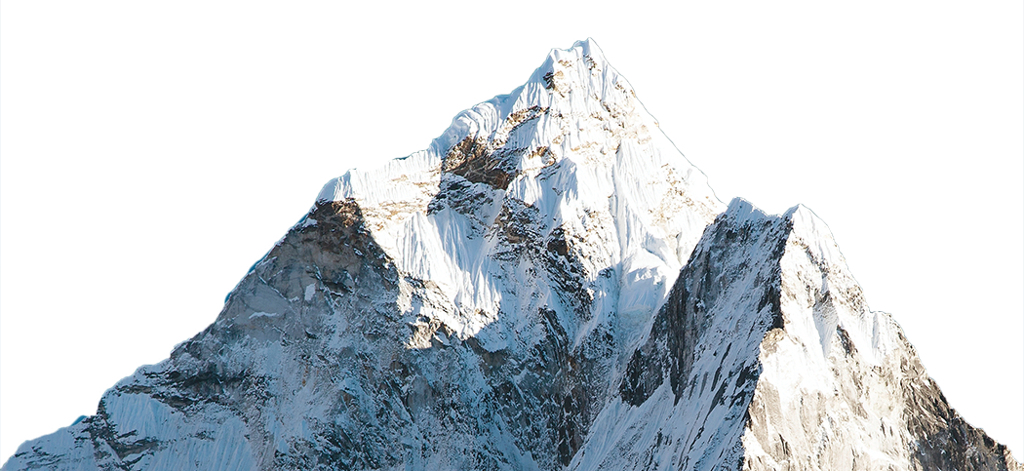
Reality
EPS 109

