Slide 1
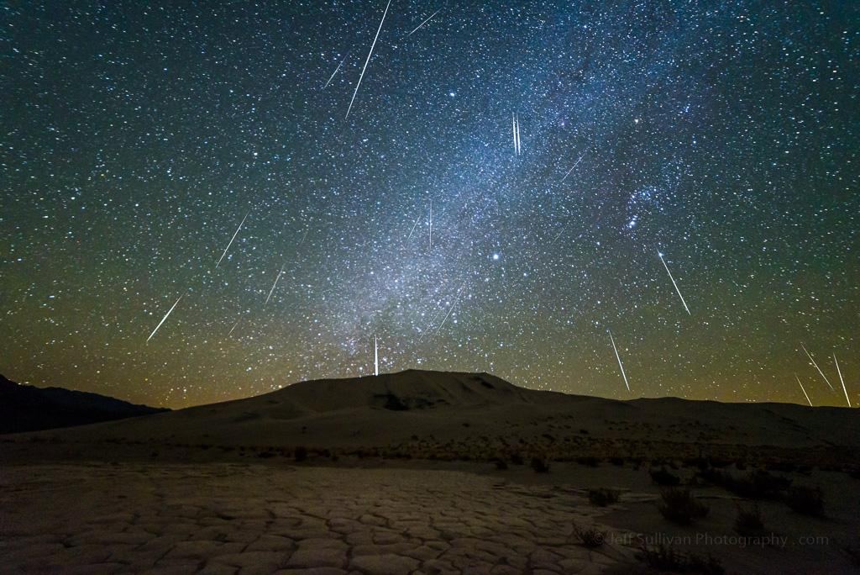
Meteor Showers Mapped:
Meteor Sightings through Space and Time

Slide 2
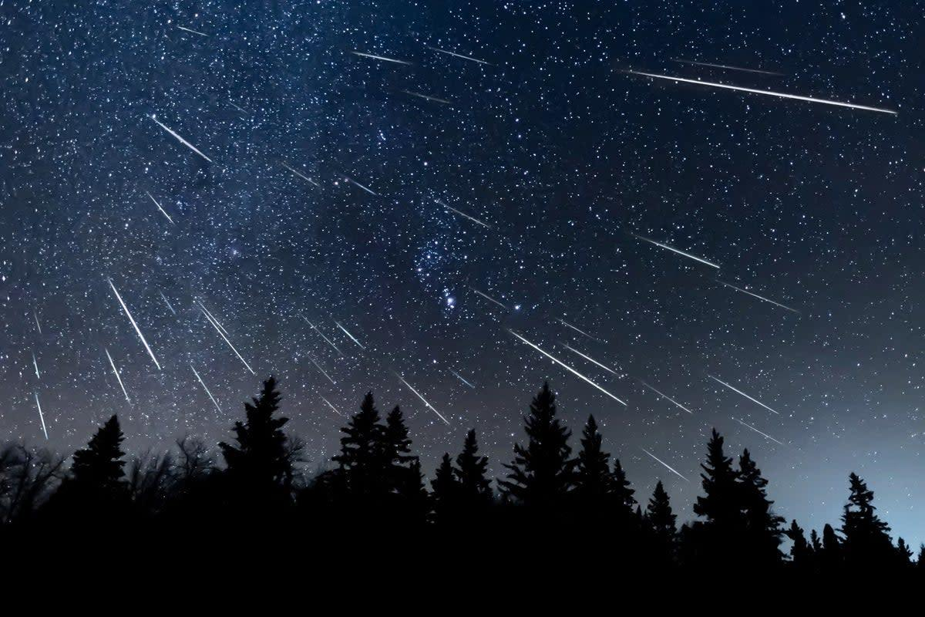
Short Bibliography
Lots of help from the matplotlib documentation (rgba values, updating the plot etc
https://matplotlib.org/stable/
Stack Overflow debugging tips
stackoverflow.com
The Meteor Databases
Nasa Jet Propulsion Laboratory: https://cneos.jpl.nasa.gov/
International Meteor Association: https://www.imo.net/

Slide 3

“Simulated” Meteor Strikes
Meteors are generally randomly distributed across the face of the Earth……...
Purpose is to show density …. . . ..
Randomized data when Longitude/Latitude was not known, or only localized .
A counter for possible meteor showers based on grouping .
Same map/method as Earthquakes lab, i.e. clusters! .

Slide 4
Flashing lights warning

Slide 5


Slide 6
All the Stack Overflow posts I got a semblance of code from
Newest Questions - Stack Overflow import - pyarrow.__version__ error when importing pandas on jupyter notebook - Stack Overflow ubuntu 14.04 - ImportError: cannot import name 'etree' on Python 3.6 - Stack Overflow python - How can you use the `Image.core` return from `ImageFont.getmask`? - Stack Overflow python - Could not install packages due to an EnvironmentError: [WinError 5] Access is denied: - Stack Overflow Cannot install, reinstall, or remove Matplotlib 3.9.1 (installation exists but cannot find files?) - Stack Overflow No module named 'matplotlib.backends.registry' - Stack Overflow python - pip how to remove incorrectly installed package with a leading dash: "-pkgname" - Stack Overflow python - Anaconda Error: Invalid Distribution -atplotlib When Updating/Installing Library with Pip - Stack Overflow python - Anaconda-Jupyter Doesn't open in browser - Stack Overflow python - UserWarning: FigureCanvasAgg is non-interactive, and thus cannot be shown plt.show() - Stack Overflow python - How do I convert these coordinates to real numbers? - Stack Overflow datetime - Strptime Error in Python - Stack Overflow python - "re.error: redefinition of group name" when using strptime - Stack Overflow python - AttributeError: 'datetime' module has no attribute 'strptime' - Stack Overflow python - Converting utc time string to datetime object - Stack Overflow c# - how to convert string to DateTime as UTC as simple as that - Stack Overflow

