Slide 1
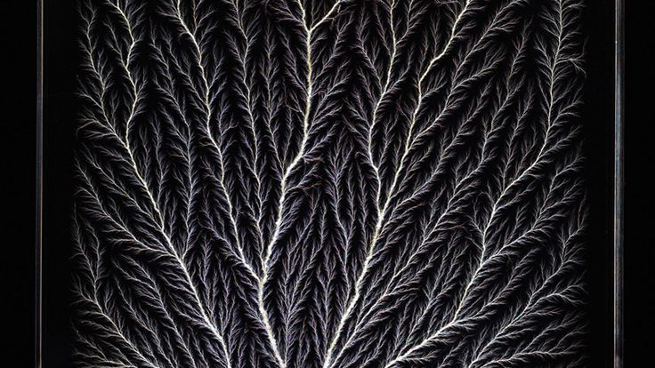
Lichtenberg figure
Gaspard Marcon

Slide 2
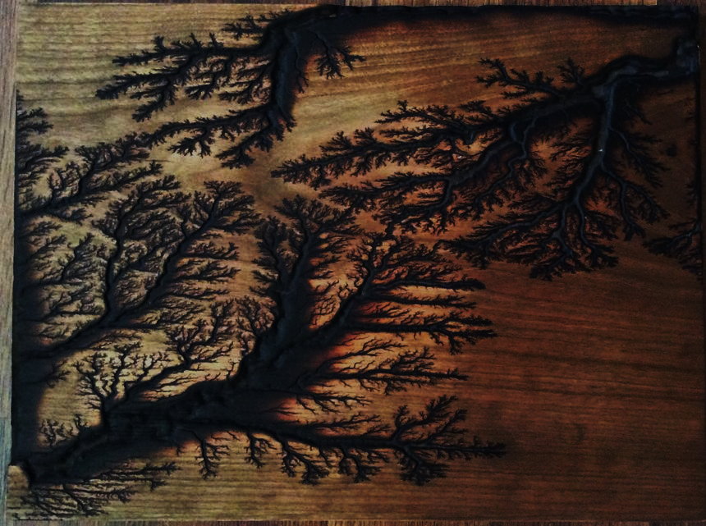
Lichtenberg-style electrical discharge growth
DLA:
3D 2D Grid-based Environment
Random Walk
Sticking/Attachment Probability
Iterative Growth
Visualization
Useful data:
Upward bias
Starting from the bottom
Sticking dependent on the material (100%, 30%, 5%)
From bottom to top: Metal, PVC, Ceramic

Slide 3
