Slide 1


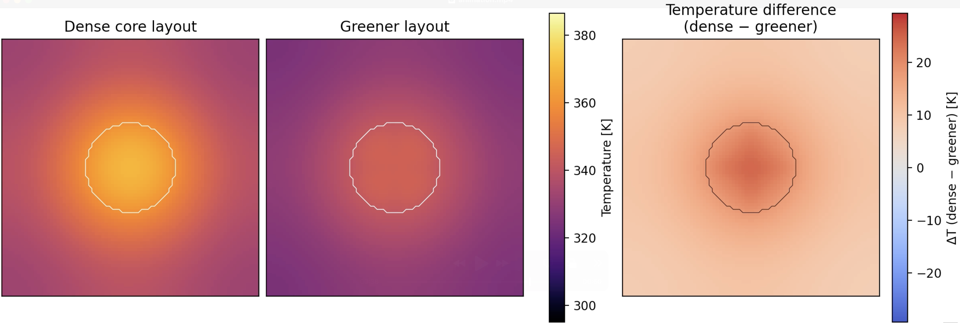

Modeling Urban Heat Island Formation in an Idealized 2D City
Prithvi Maddi

Slide 2
Topic and Methods
Simulated the development of urban heat islands using a 2D heat-diffusion model on a stylized city grid.
Different city layouts (dense urban core vs. greener layout) produce distinct heating patterns
Solved the 2D heat diffusion PDE
Sources:
T(x,y,t): temperature at location (x,y) and time t
k(x,y): thermal diffusivity (how fast heat spreads)
Q(x,y): heat input (ex: buildings, roads absorbing sunlight, waste heat)
Used spatially varying heat sources and diffusivity, different uses of land have different k and q
Finite timestepping for animation visibility

Slide 3
