Slide 1
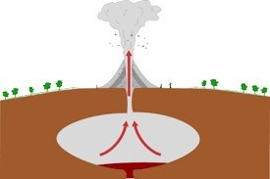
Volcanic Pressure Eruptions​
Lawrence Lu​

Slide 2
Topic: Pressure simulation in Volcanos ​
Background: ​
Eruptions occur when the pressure from Magma and gases trapped under rock and volcanic parts exceeds the weight and downward force of sediment resulting in an explosion when it does occur and I wanted to simulate it :) ​
Cliche​
Methods Used:​
DLA Pipelining repurposed to move vertically ​
Random walks​
Pressure modeling constants​
One for pressure build up ​
One for pressure threshold exceeding​

Slide 3
