Slide 1
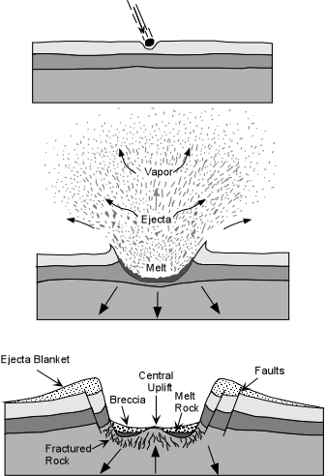
Asteroid Impact Ejecta Simulation
Eric Liang

Slide 2
Methods Used:
Simulate ejecta particles of an asteroid impact and their trajectory, modelling after a realistic asteroid collision on a surface
Utilize a Monte Carlo simulation to randomize parameters such as velocity and angle trajectory for each particle
Use simple physics for modeling the projectile trajectory

Slide 3
