Slide 1
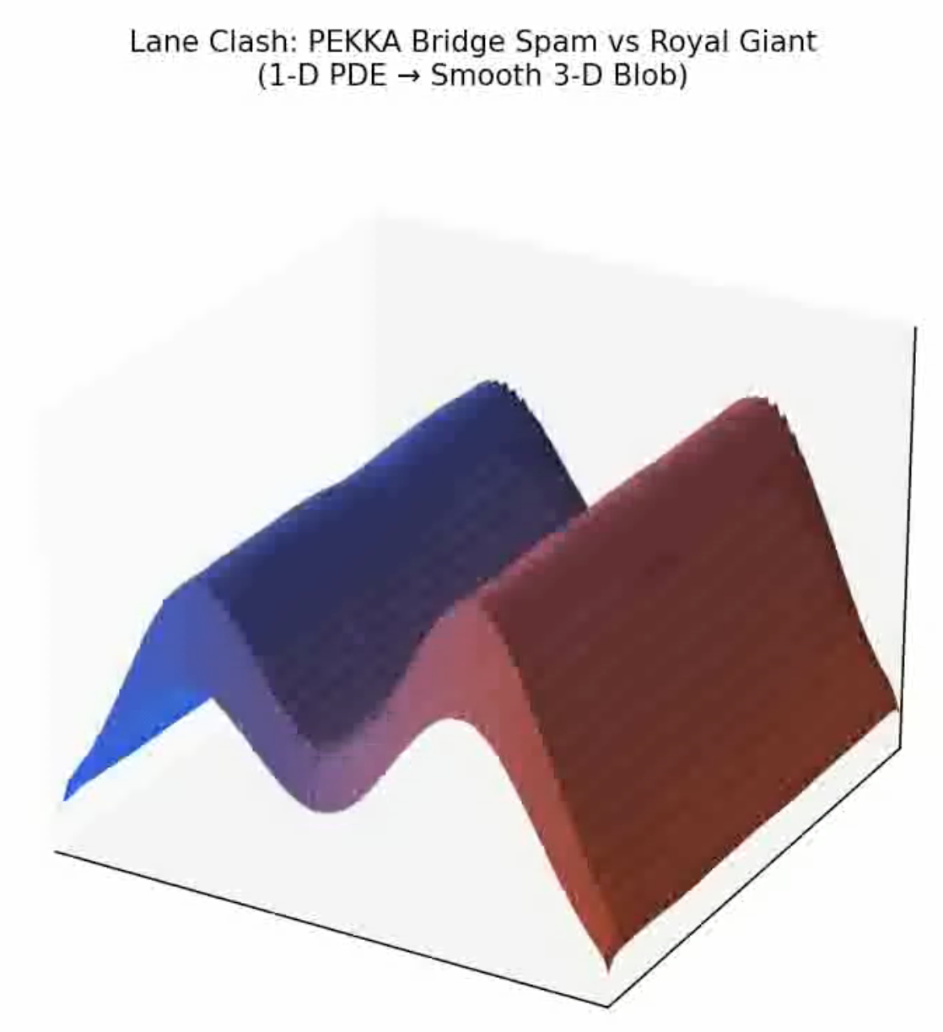
Lane Clash: A 1-D Reaction–Diffusion–Advection Model of Clash Royale Push Dynamics
Nicole Lee

Slide 2
Topic of Simulation
The goal of this project is to simulate how two opposing Clash Royale decks “push” and “counter-push” along a lane over time. Instead of discrete units, I model the battle as smooth continuous troop density fields, one for each team (Blue = PEKKA Bridge Spam, Red = Royal Giant), evolving under:
Diffusion (troops spreading)
Advection (troops marching forward)
Nonlinear annihilation (combat)
Continuous spawning driven by real Clash Royale card statistics
The output is a 3-D smooth blob animation that visualizes which side is winning control of the lane as time evolves.
This replaces the discrete mechanics of the game with a PDE framework, allowing us to study how relative unit strength, spawn pressure, and movement speed shape the front of battle.

Slide 3
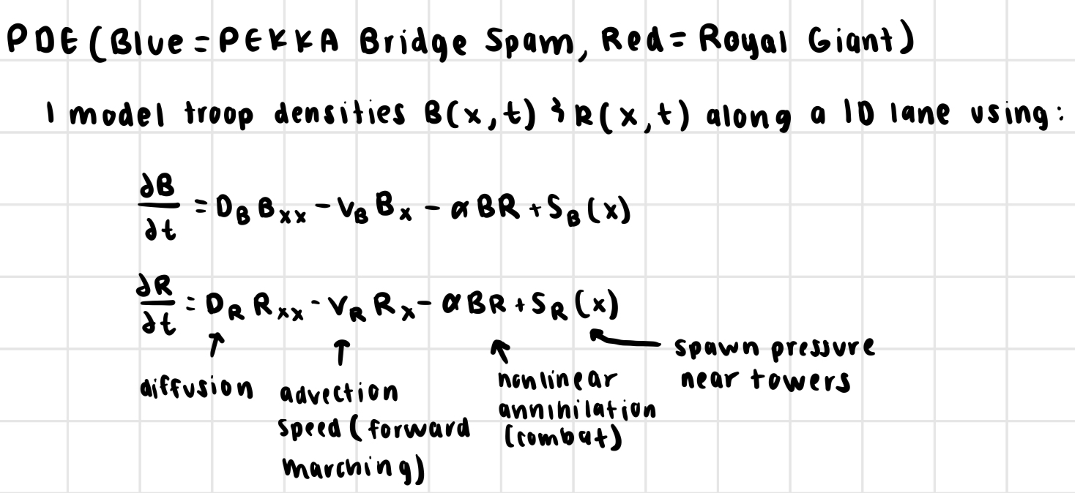
Methods Used: PDE

Slide 4
