Slide 1
Microwave Simulation: Molecular Oscillation
Water vs Ice

Slide 2
Background Physics
Microwaves create rapidly oscillating electric fields.
Liquid water molecules rotate freely → strong heating.
Ice molecules are locked in a rigid lattice → cannot rotate.
Energy absorbed by ice goes mainly into melting, not heating.
Result: Water heats quickly and ice warms very slowly.

Slide 3
Data Tables
Ice
Water
Time (s) | Initial Temp (°C) | Final Temp (°C)
5 | -4.9 | -4.7
10 | -4.9 | -3.9
15 | -4.9 | -2.9
20 | -4.9 | -2.0
25 | -4.9 | -1.2
30 | -4.9 | -0.6
35 | -4.9 | -0.3
40 | -4.9 | -0.1
45 | -4.9 | 0.0
50 | -4.9 | 0.0
55 | -4.9 | 0.2
60 | -4.9 | 0.6
Time (s) | Initial Temp (°C) | Final Temp (°C)
5 | 21.0 | 24.3
10 | 21.0 | 26.2
15 | 21.0 | 30.1
20 | 21.0 | 32.8
25 | 21.0 | 33.5
30 | 21.0 | 36.1
35 | 21.0 | 38.7
40 | 21.0 | 41.8
45 | 21.0 | 43.3
50 | 21.0 | 45.5
55 | 21.0 | 47.8
60 | 21.0 | 49.7

Slide 4
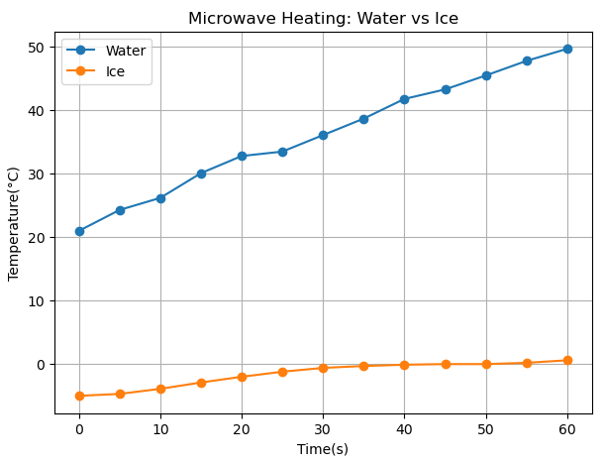
Microwave Heating Graph

Slide 5
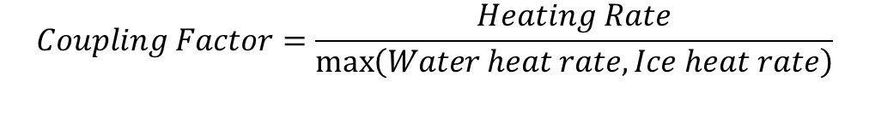



Formula Used
$$Heating Rate= \frac{T_{final}−T_{initial}}{t_{final}−t_{initial}}$$
$$Coupling Factor=\frac{Heating Rate}{\max\left(Water heat rate, Ice heat rate\right)}$$
$$E\left(t\right)=E_{0}sin\left(ωt\right), ω=2\text{π}f$$
$$τ=−pE\left(t\right)sin⁡(θ)$$

Slide 6
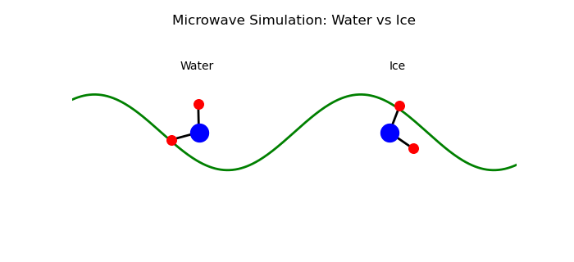
Simulation

