Slide 1
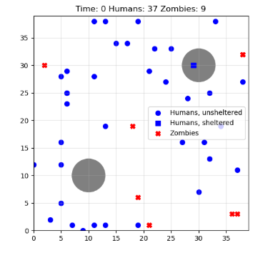
Simulating a Zombie Apocalypse
By: Michelle Duan, 3038933783

Slide 2
This presentation simulates a population of zombies and humans, utilizing a combination of random walks, path finding, and target chasing.
I used:
Random walks with individualized movements
Humans will: run from zombies, hide in shelters, and stay in place if in furthest location
Zombies will: chase nearby humans, not enter shelters, and die after 55 time steps
There’s also possibilities of humans being able to fight off zombies, resist infection, and also move in a random direction, rather than toward a shelter.
I was inspired by the project Ants Versus Some Bees and the Snake Game.

Slide 3
