Slide 1
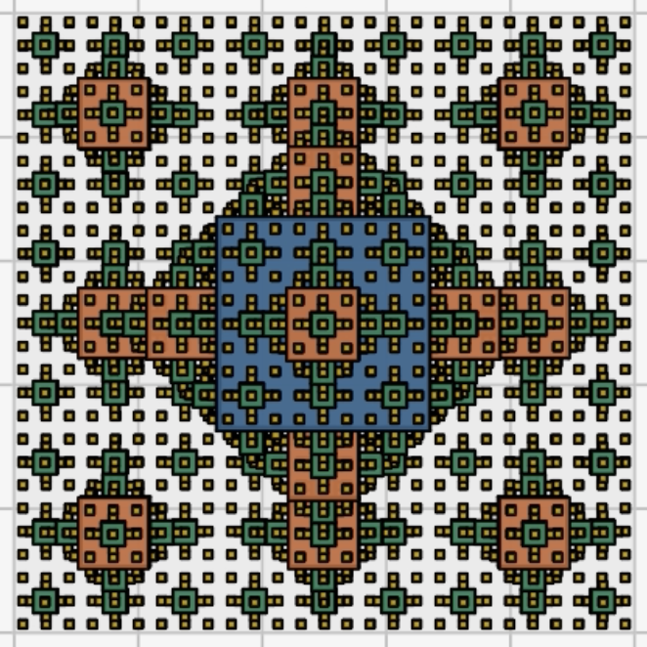
Koch Surfaces
By Kate Chier

Slide 2
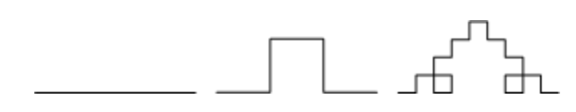
Topic & Methods​
Koch Surfaces
Koch surfaces are the 3-D fractal extension of Koch curves. I decided to replicate the below 2-D curve in 3D:
Credits: kochsurface.html
Fractal Method
Fractal Generation: recursive subdivision approach that divides each square face into a 3x3 grid
3D Rendering: Face class stores position, size, and normal vectors. Cubes rendered using matplotlib's bar3d()
Growing Animation: linear interpolation between base position and final position

Slide 3
