Slide 1
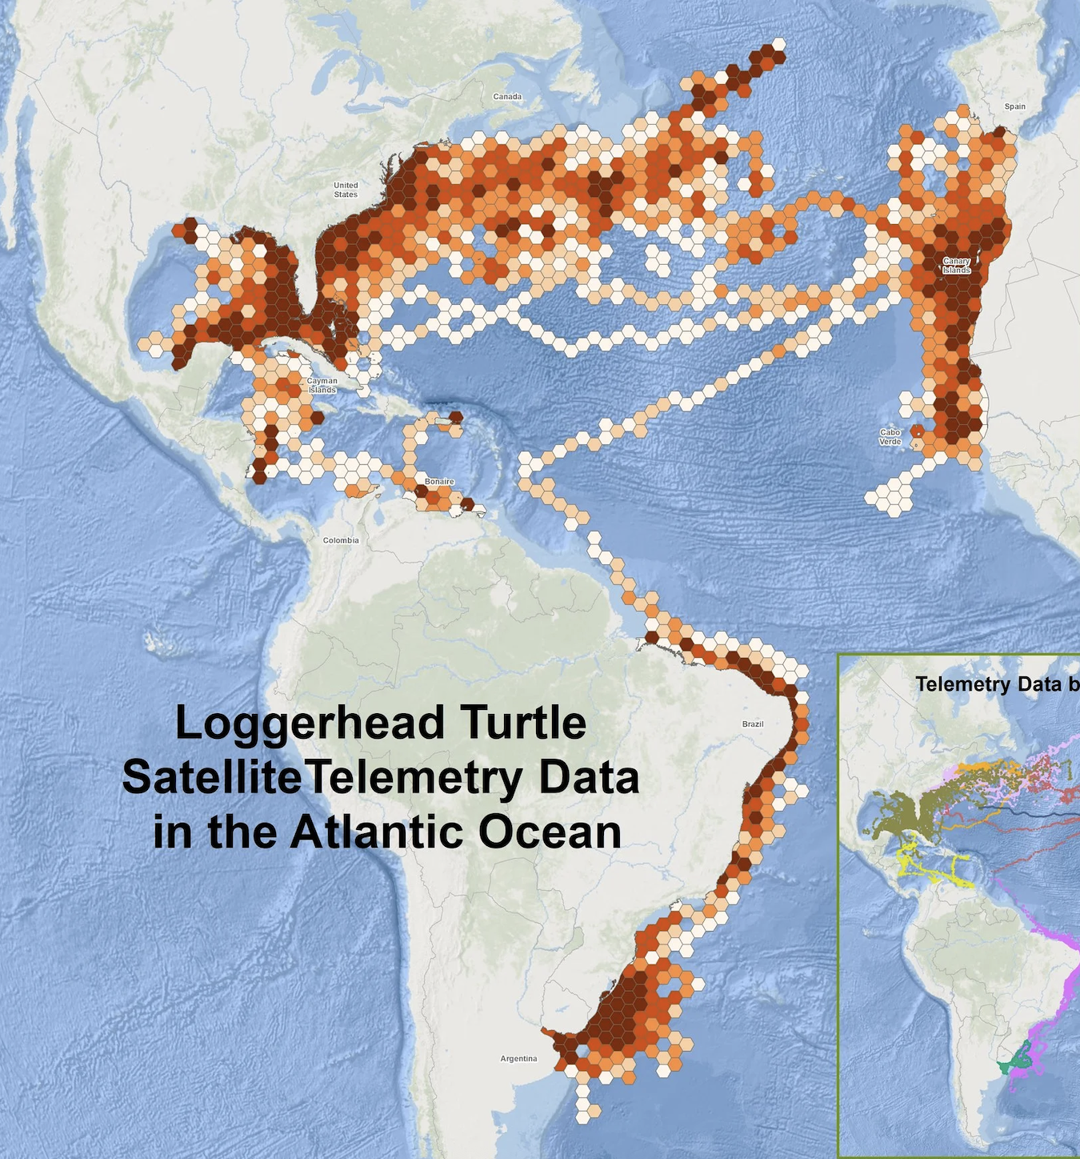
Turtle Path Migration
Nassib Chaya

Slide 2
Random Walk
Loggerhead Turtles
An inputed sequence of random length and order values of ‘ABC’, which determines the orientation that the turtle will face. Each paddle length is the same distance, and that sequence is reiterated to get to a desired location while avoiding a land mask to continue on its path in sea.
-My simulation preserves the sea turtles constant paddle distance travelled and orientation but not by how it navigates geomagnetically, its proprioception functions, and other natural abilities.
-Highly migratory, relying on the Earth's geomagnetic field for a positional sense.
-Turtles that were displaced in the north would navigate south and contrariwise.
-When light was removed, Turtles relied on a magnetic cues to develop their position.
-From climate change and its impact of coral ecosystems, under the ESA some Loggerhead populations are endangered.
Freas, C. A., & Cheng, K. (2022). The Basis of Navigation Across Species. Annual review of psychology, 73, 217–241. https://doi.org/10.1146/annurev-psych-020821-111311
https://www.fisheries.noaa.gov/species/loggerhead-turtle

Slide 3
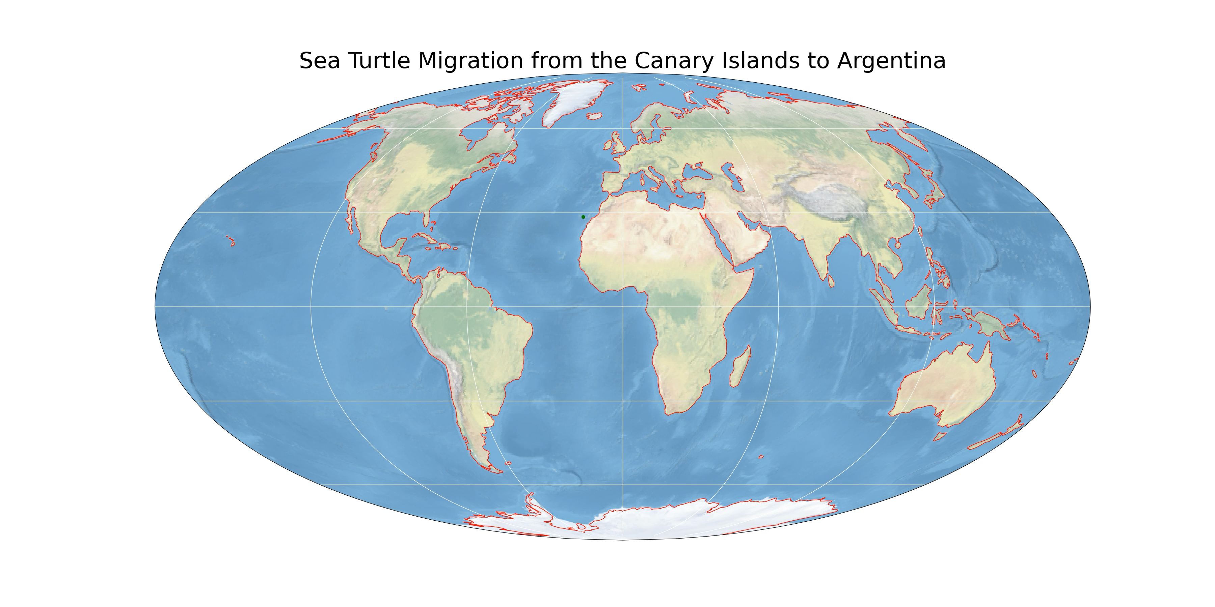
Animation of Sea Turtle Path Migration *Brazil not Argentina*

