Slide 1
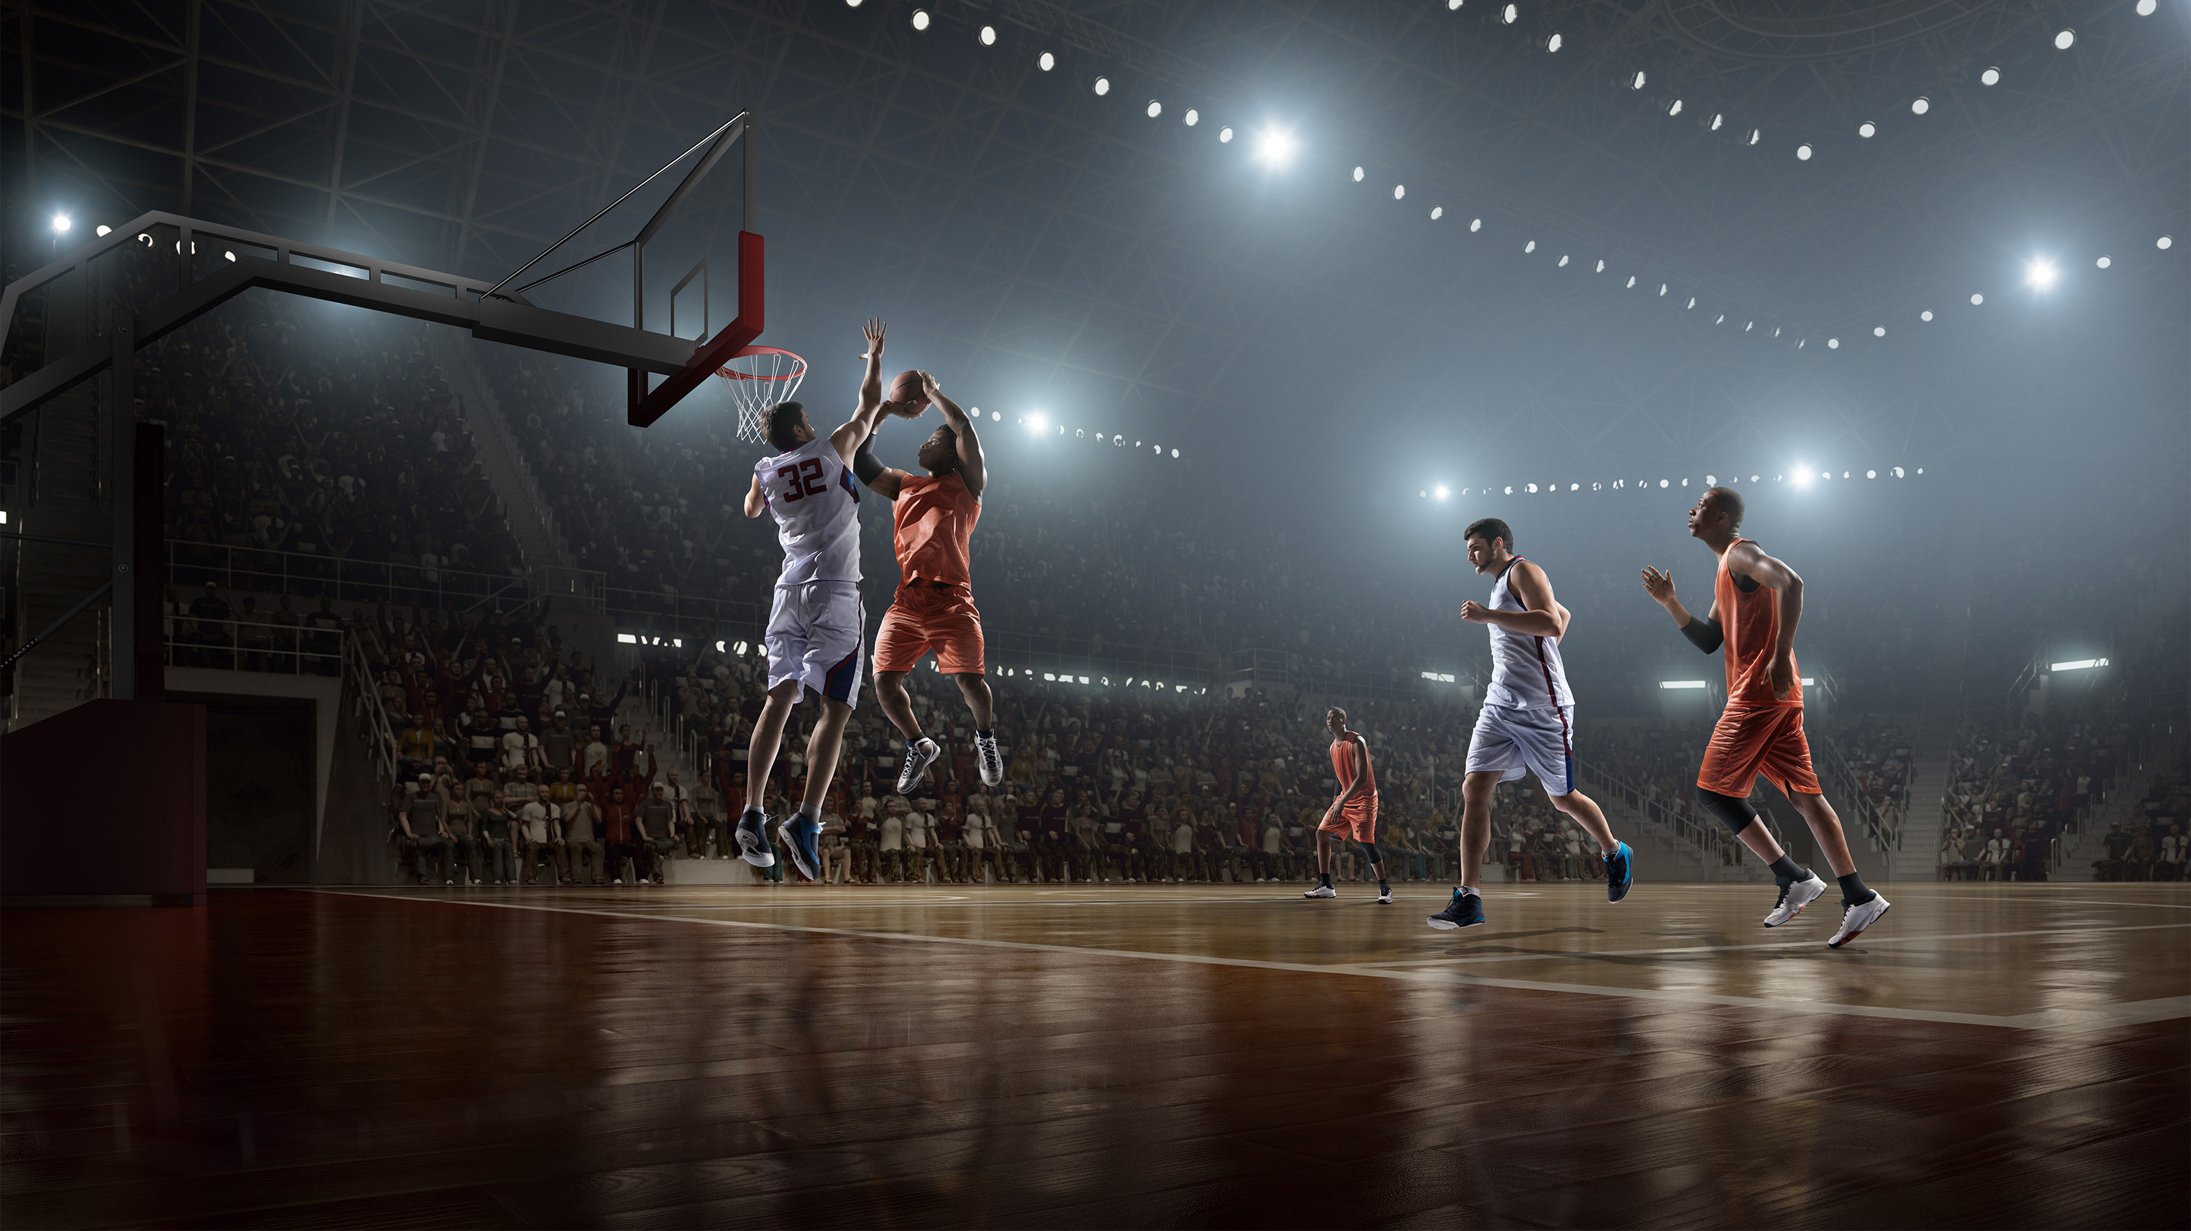
Simulating NBA Games
Simon Cha

Slide 2
Method: Random Walks & Markov Processes
Basketball scoring is highly volatile, so simulations often use random walks to capture the uncertainty and limited memory between sequential scoring events.
Limitations:
  Complete independence between events may be oversimplistic (ex. hot hand, fatigue)
  Used data from the ongoing 2025-26 NBA season
Notes:
I need to make the connection that the outcome of sports games are collectively created by many small events that build onto each other. For example, the state of a basketball game where there is little memory, there is a caveat to this, but generally, the game evolves like a random walk sort of like points being scored in a basketball game. Then say there are limiations Complete independence between events may be oversimplistic (ex. hot hand, fatigue)
Used data from the ongoing 2025-26 NBA season so there is a bias as there weren’t too many games left that probably can’t generaliz
Sports is extremely random and it’s fairly difficult to

Slide 3
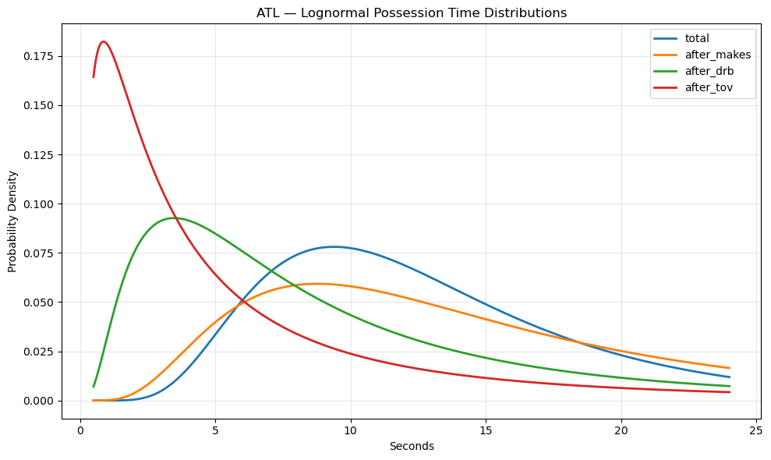
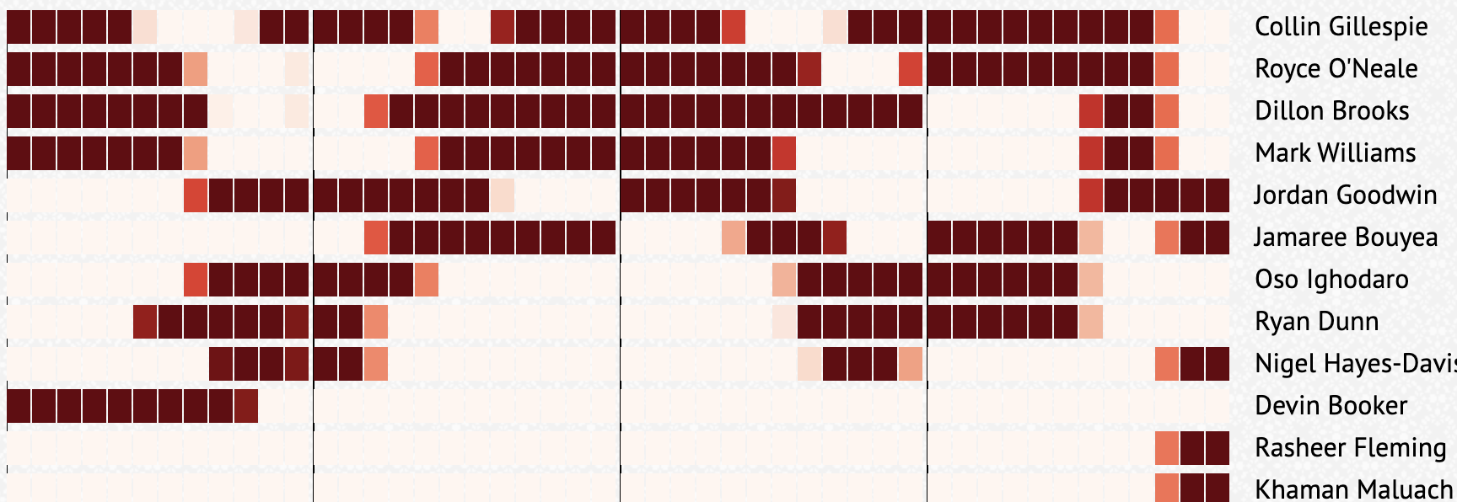
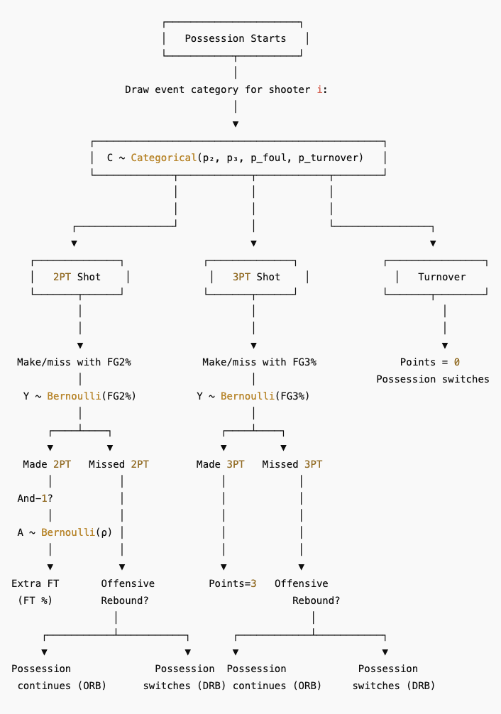
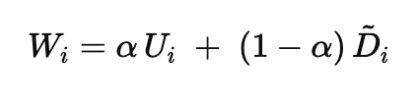
Logic
Get starter/bench rotations from a randomly sampled game earlier in season
2. Determine duration of play
t ~ Lognormal(μ, σ)
5. Repeat until clock expires
3. Determine who on team gets the ball based on usage
4. Determine outcome of play
U - Usage determined by avg. FGA
D - Deficit of target – current
*Now not completely independent but needed because FGA for players were blowing up unrealistically

Slide 4
