Slide 1
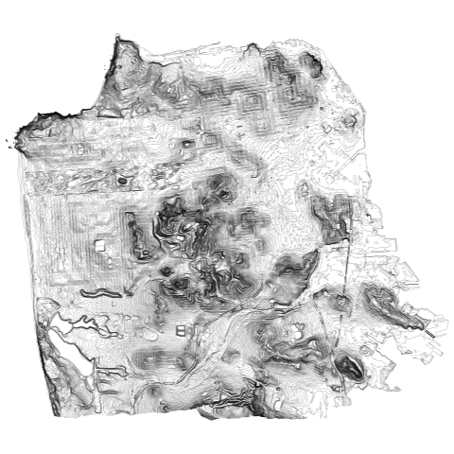
Storm simulation in San Francisco
Nico Zhang

Slide 2
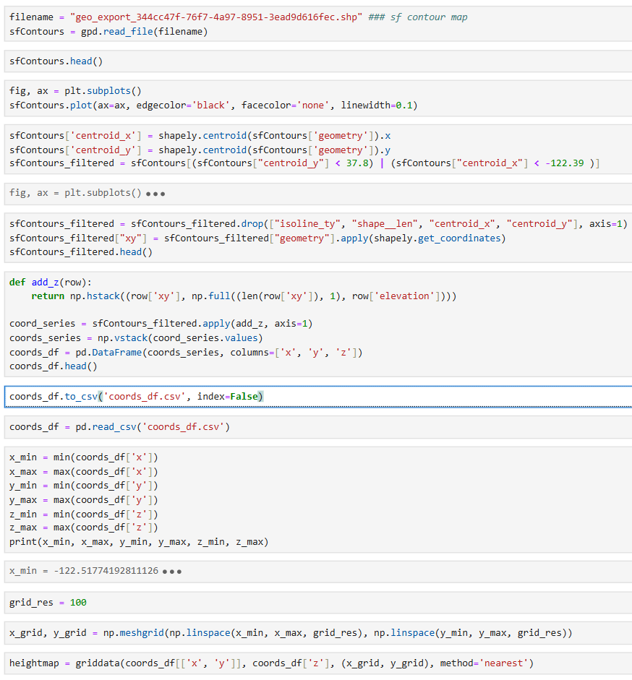
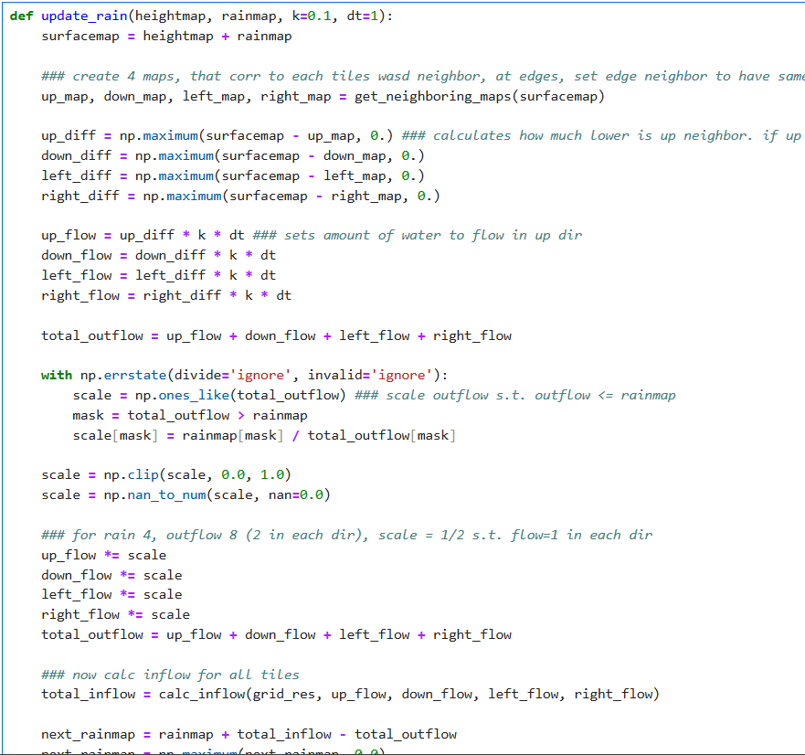
From DataSF: https://data.sfgov.org/Energy-and-Environment/Elevation-Contours/rnbg-2qxw
Format contour file into a usable heightmap 2) Write function for fluid flow

Slide 3
