Slide 1
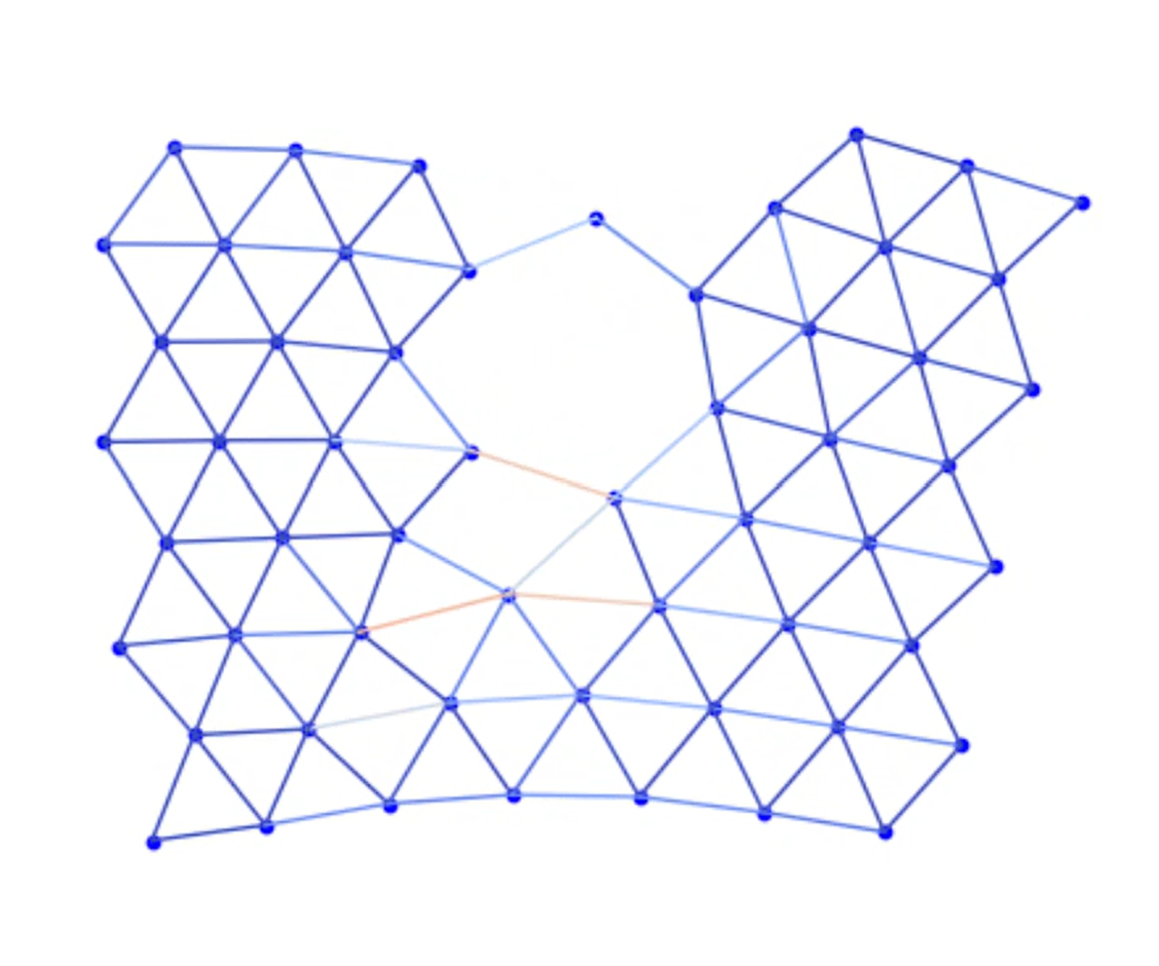
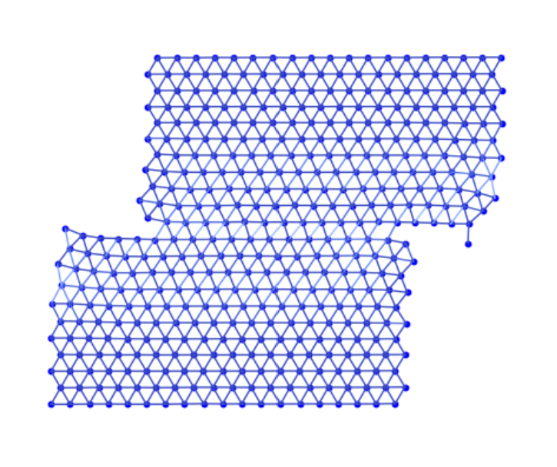
Deformation Simulator: Testing Simplified Stress Mechanics in 2D Using Molecular Dynamics
Aaron Zeng

Slide 2
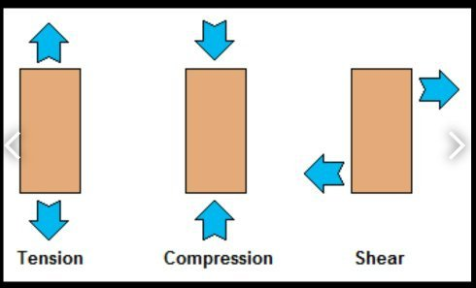
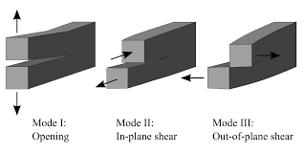
Topic:
Materials such as rock experience stress in different ways via the application of force in certain directions, leading to deformations such as fractures and dislocations.
In this project, I attempted to simulate a simplified 2D model of the deformation generation process using molecular dynamics.
Methods:
Using methods from HW 14, I utilized ChatGPT to generate the base code for an MD simulator of free particles based on Lennard-Jones potentials. Afterwards, I added my own code generating bonds between the particles, creating a lattice structure representing a solid in 2D. Lastly, I created a simplified method to first ‘relax’ the system using a damping/frictional force, causing the lattice to lose total energy and behave more like a solid, and then subsequently add force to the system, representing applied external force which generates deformations in materials.
How to run code:
EPS109FinalProject_tensile =
MD with tensile deformation
EPS109FinalProject_shear =
MD with shear deformation
For both: Alter starting
conditions in first and
second-to-last cell and
restart kernel and run all cells.
Focused on these two, it is a bit more difficult
to observe deformations using compressive force,
especially in a very simplified model
Code Sources:
ChatGPT for base code for MD
simulator (only as described in HW
14)

Slide 3
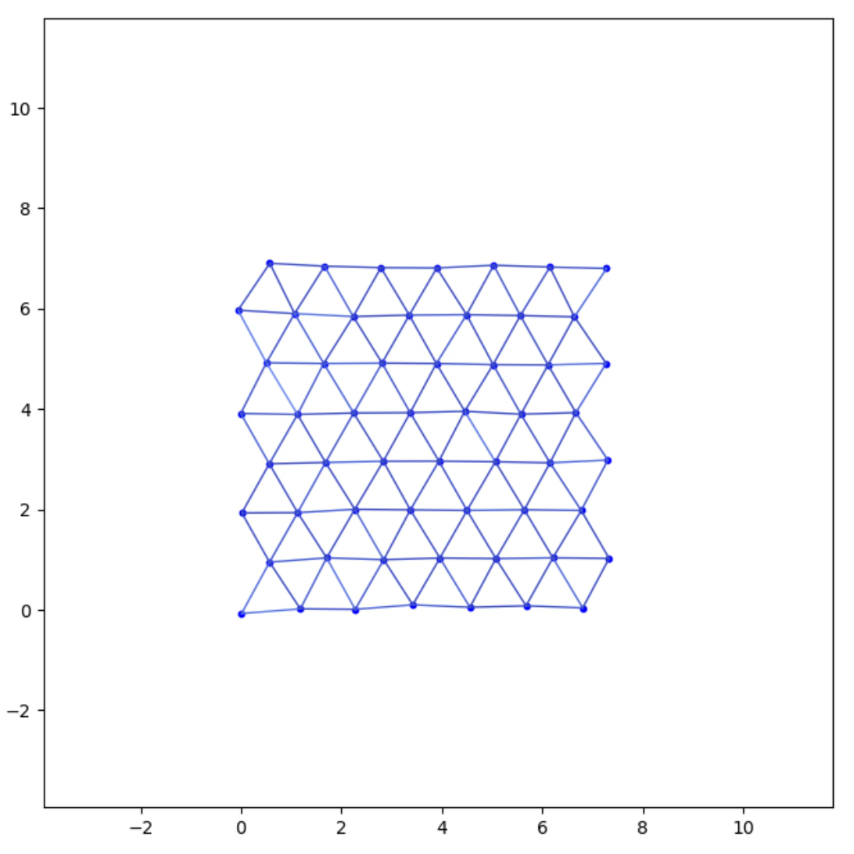
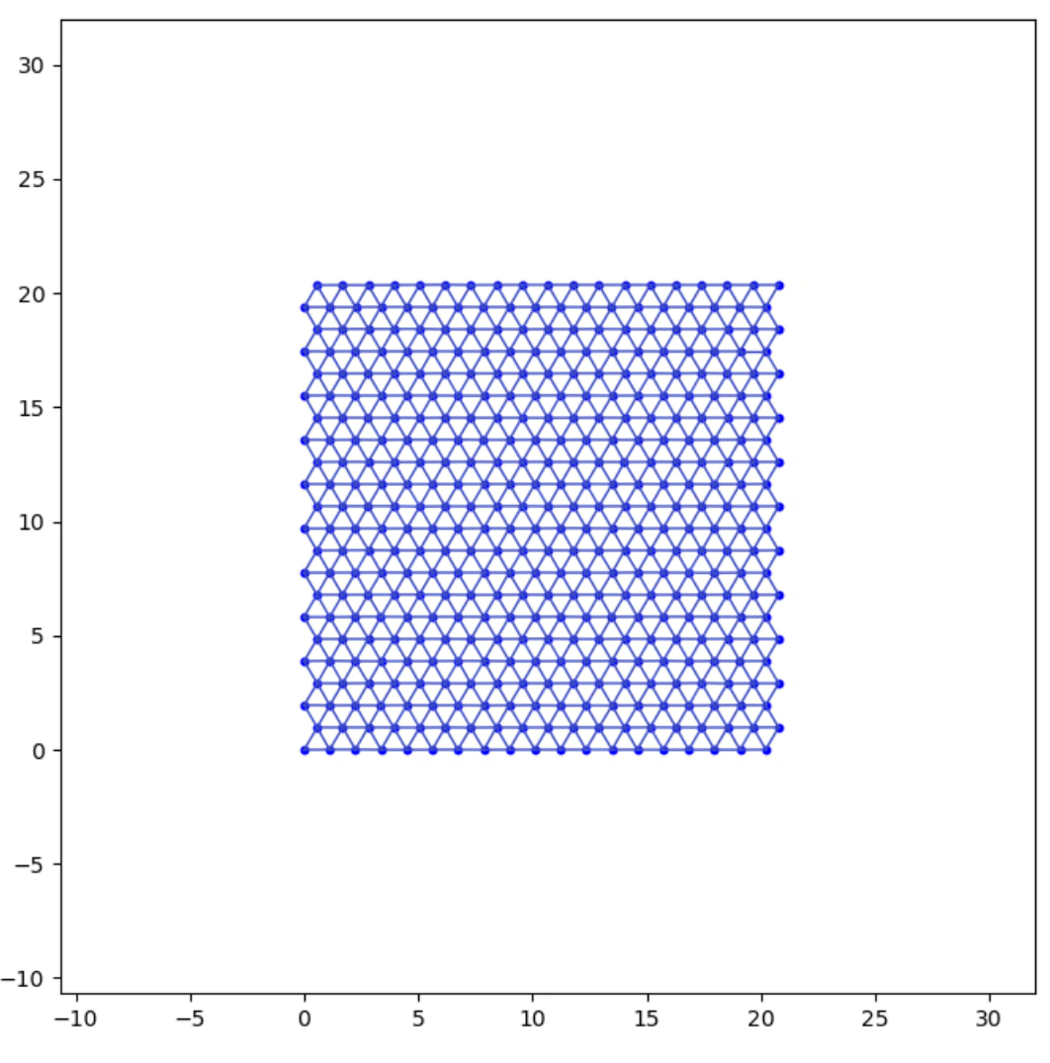
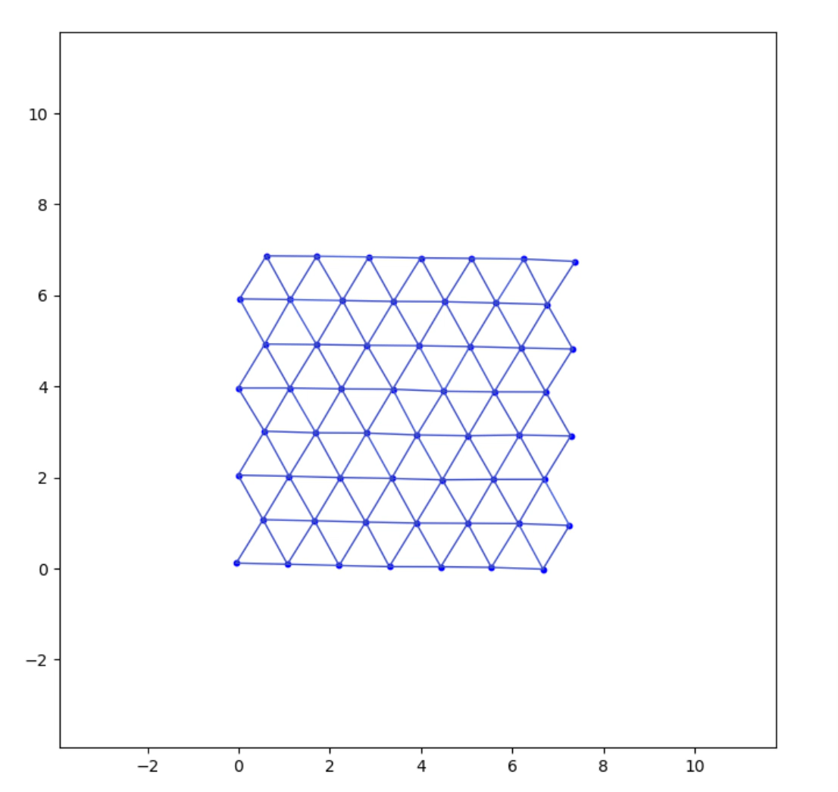
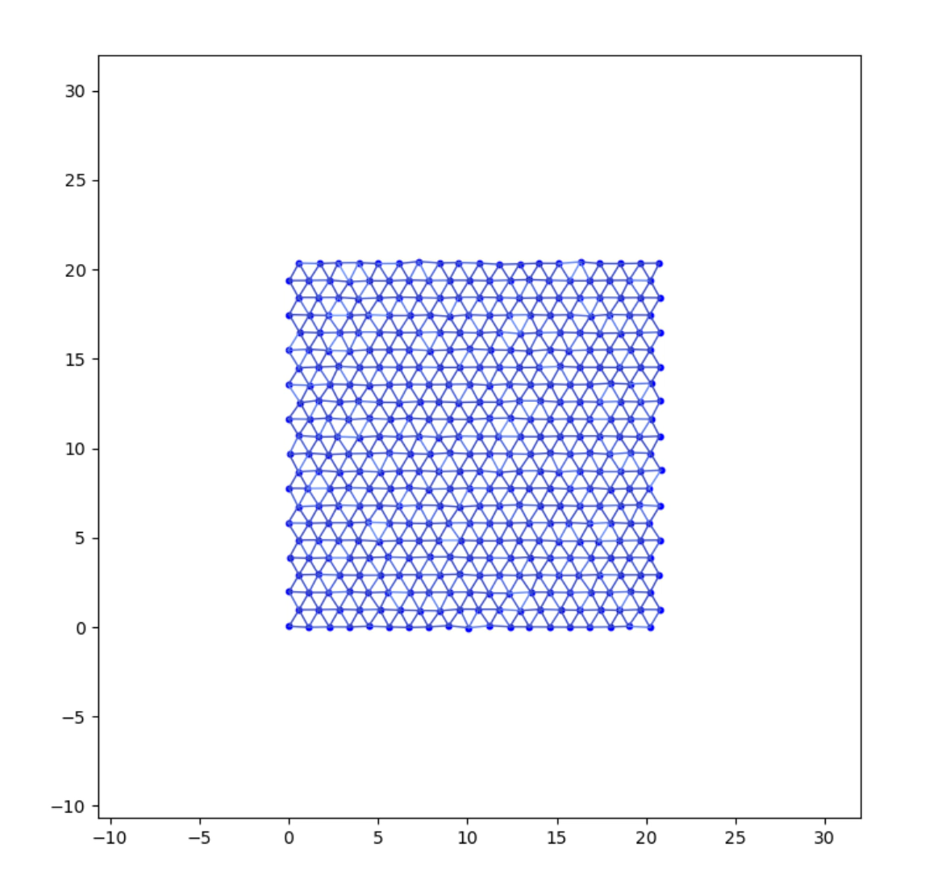
Animations
Tensile:
Shear:

