Slide 1
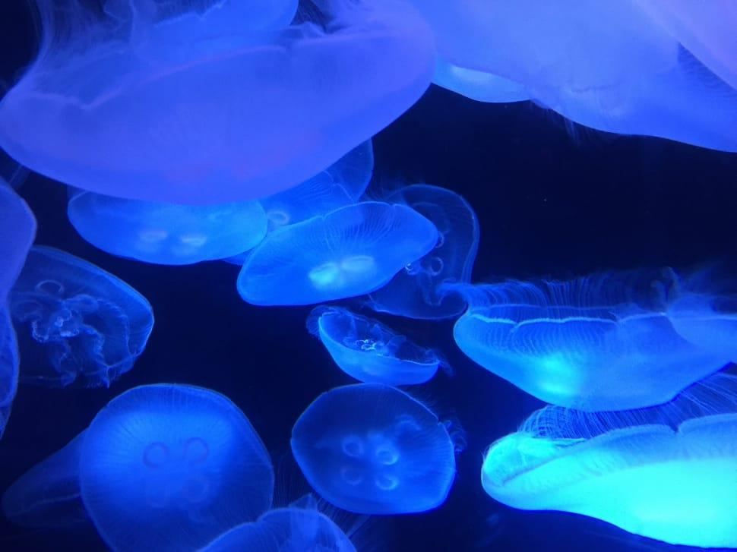
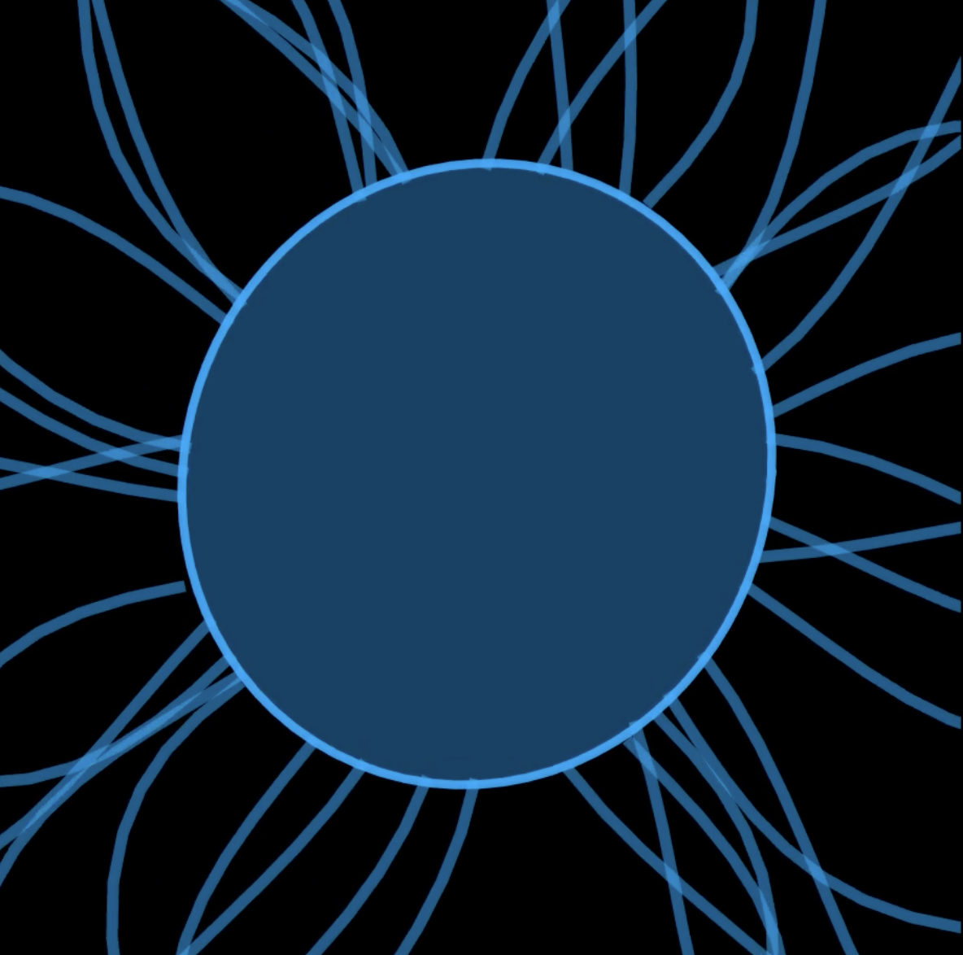
Resonant Oscillations of a Jellyfish Bell
Lauren Sandberg
EPS 109 Final Project

Slide 2
Topic: Resonant Oscillations of a Jellyfish Bell
Simulates the bell of a jellyfish → dome-shaped membrane that contracts and expands
Visualizes wave propagation across the bell and flowing tentacle motion
Methods
Mass-Spring Model
  Bell represented as a ring of masses connected by radial and circumferential springs.
  Springs obey Hooke’s law; damping added to simulate energy loss.
Time Integration:
  Updates positions and velocities using Euler method for the system of ODEs.
Driving Force:
  Simulates jellyfish muscular contractions to produce natural oscillation modes.
Tentacle Simulation:
  Tentacles modeled as segments attached to the bell, moving with combined sinusoidal waves for fluid, natural motion.

Slide 3


