Slide 1
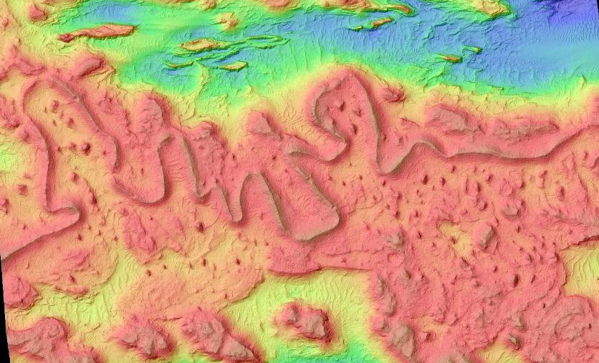
Martian Inverted Riverbed Formation
Hannes Rodriguez

Slide 2
Explanation
Process
Inverted channels on Mars are formations that indicate ancient riverbeds.
They are formed when a river that has made an incision on the landscape dries up, leaving the hard minerals of the riverbed. Over time the softer surrounding terrain erodes faster than the channel, so the channel becomes inverted.
This project illustrates the process by which these inverted channels are formed by recreating a meandering ridge found on the martian surface today.
Feature centered at 4.93° S, 154.6° E
Use DTM created from data from the HiRise HRSC on the MRO of a real feature on the martian surface that resembles an inverted channel.
Smooth the present day terrain using a gaussian filter to simulate a plausible previous state of the region.
Create a mask that defines the river pathway
Evolve the smoothed landscape using a simple PDE ∂t/∂z​=κ∇²z−I(x,y) with diffusion term κ∇²z for hillslope smoothing and incision term I(x,y) to erode along the river path. Solve using finite difference laplacian with discrete time stepping.
After channel is formed, add caprock (riverbed sediment) to the channel, then apply wind erosion at different rates to the caprock and surrounding sediment, resulting in the inversion of the channel.

Slide 3
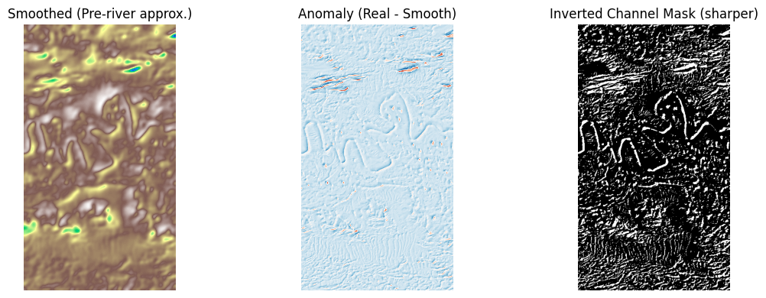
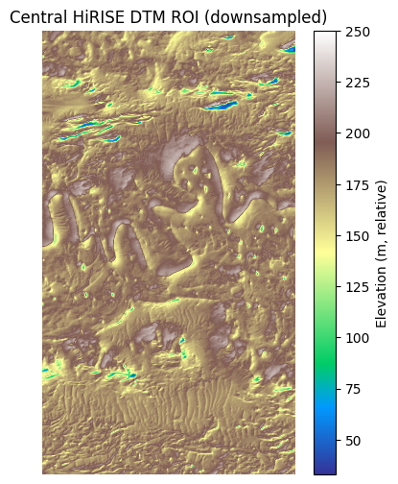
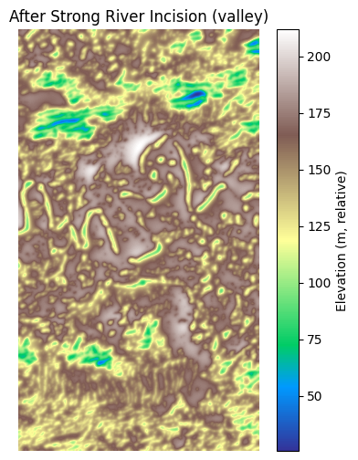
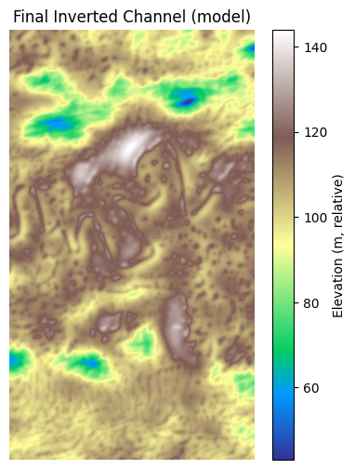
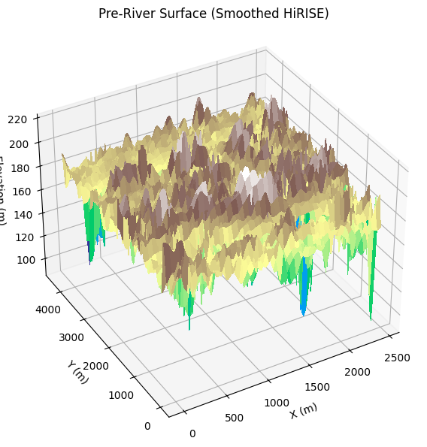
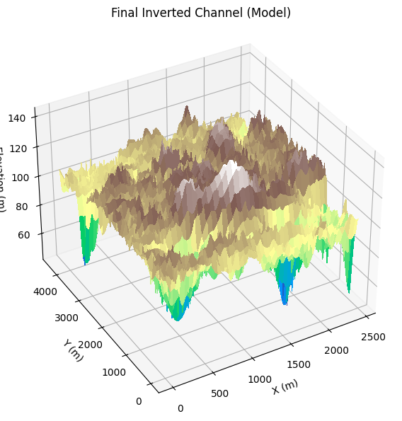
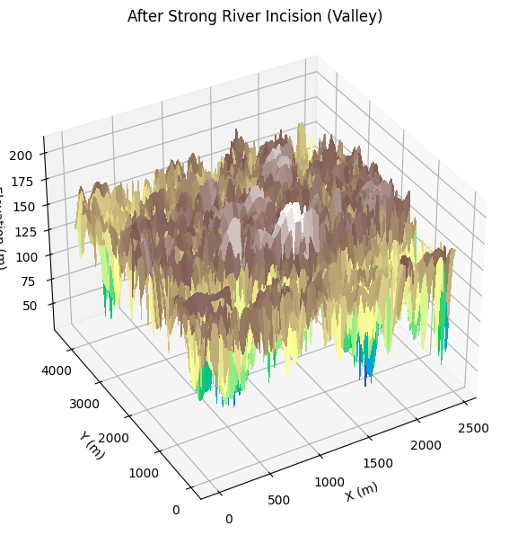
Still Images

Slide 4
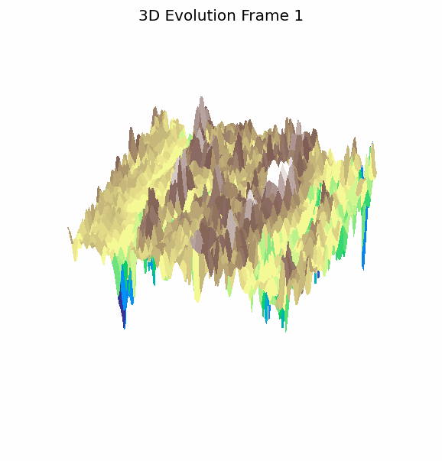
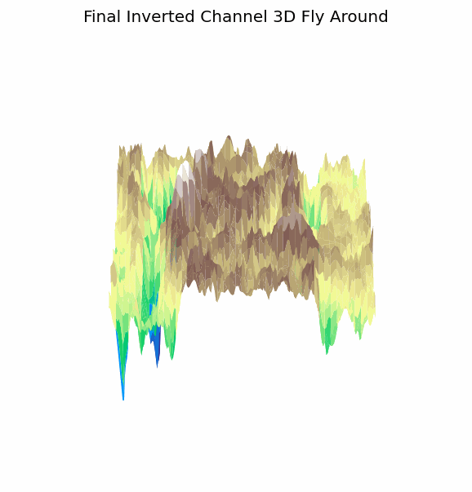
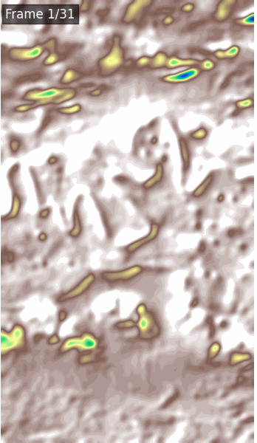
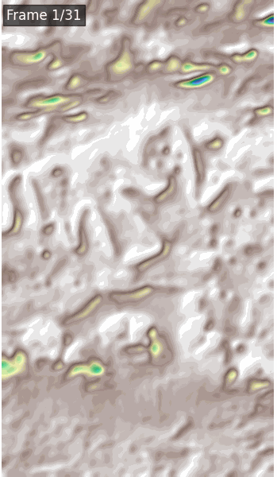
Animations

Slide 5
Link to download necessary files ESP_016269_1750_RED_A_01_ORTHO.JP2 and ESP_016269_1750_RED_A_01_ORTHO.LBL.txt
https://www.uahirise.org/PDS/DTM/PSP/ORB_008600_008699/PSP_008621_1750_ESP_016269_1750/
In order for code to work, first run finalproj.ipynb to create ESP_RED_A.tif, then simplified.ipynb will work.

