Slide 1
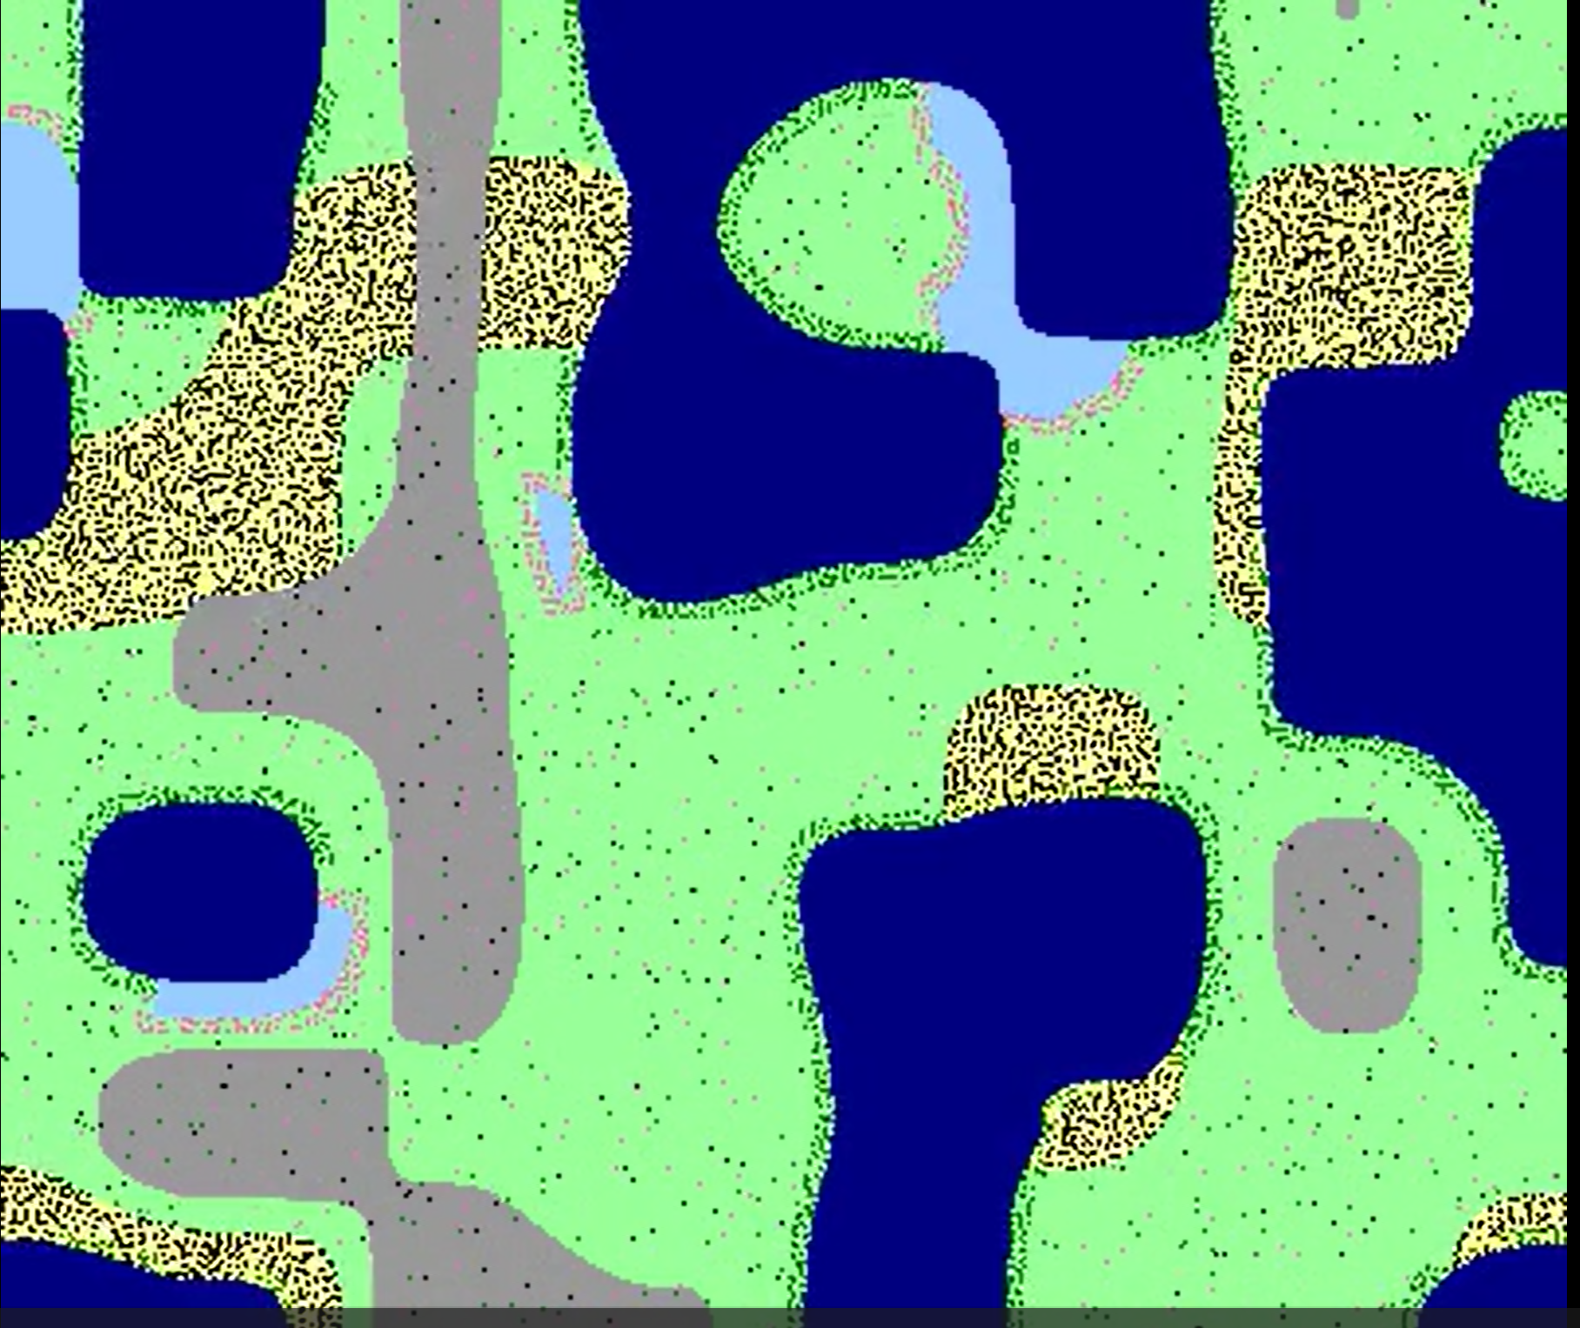
Flower Dynamics in a Multi-Biome Landscape
Jose Rendon

Slide 2

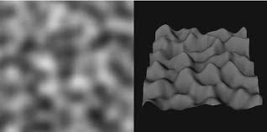
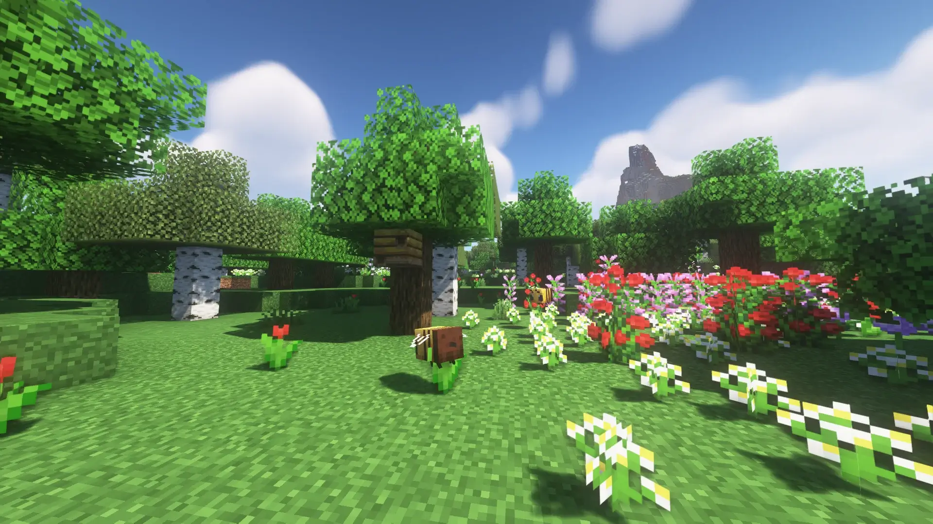
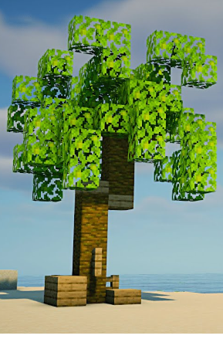
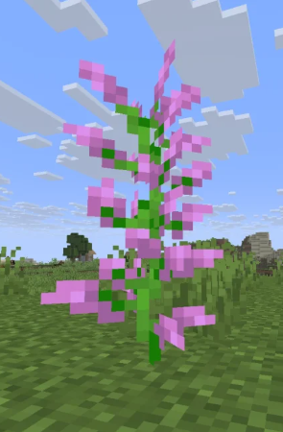
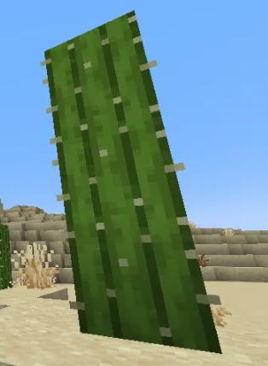
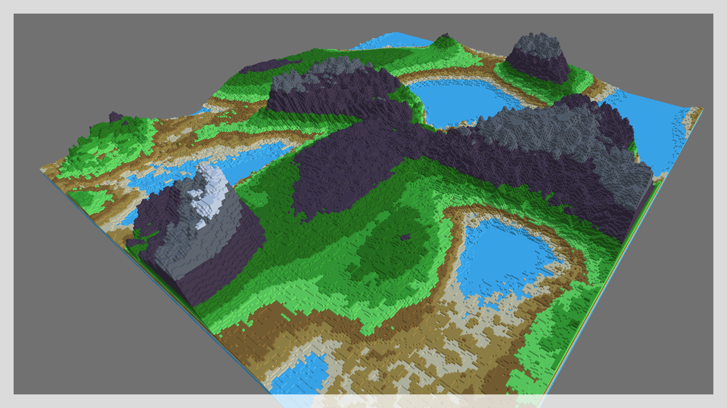
Topic
World Generation
“Flowers”
Needed to choose how to Generate
Perlin Noise (Good Terrain Texture)
  Easy Mathematically
  Has 2 layered Noise
    Height
    Moisture
On my 300 x 300 Grid:
Height noise = ocean, riverbeds, grass, mountains
Moisture noise = desert, river, grass
ocean = height < 0.32
mountain = height > 0.84
river = (~ocean) & (height < 0.58) & (moist > 0.80)
desert = (~ocean) & (~river) & (moist < 0.25)
grass = (~ocean) & (~river) & (~desert) & (~mountain) # Average/ Flat Biome
Needed to explore how simple plant rules create natural patterns
Flowers rely on biome conditions
Species will naturally spread, die, and cluster
Goal: see if each species finds its preferred biome
Simulation Environment
900 × 900 grid
Multiple biomes
3 Flower Types
Palm Tree (dark green)
  Prefers near-ocean areas
Pink Flower (pink)
  Prefers near-river areas
  Only grows in grass
Cactus (black)
  Grows in desert only
Density Limiter
Max of 3 plants allowed per 3×3 region
Prevents overgrowth
Notes:
I created the world using layered value noise, similar to Perlin noise. One noise field controls elevation, and one controls moisture. Combining them gives five biomes: ocean, river, grassland, desert, and mountains. This map is randomly generated each run.

Slide 3

Animation

