Slide 1
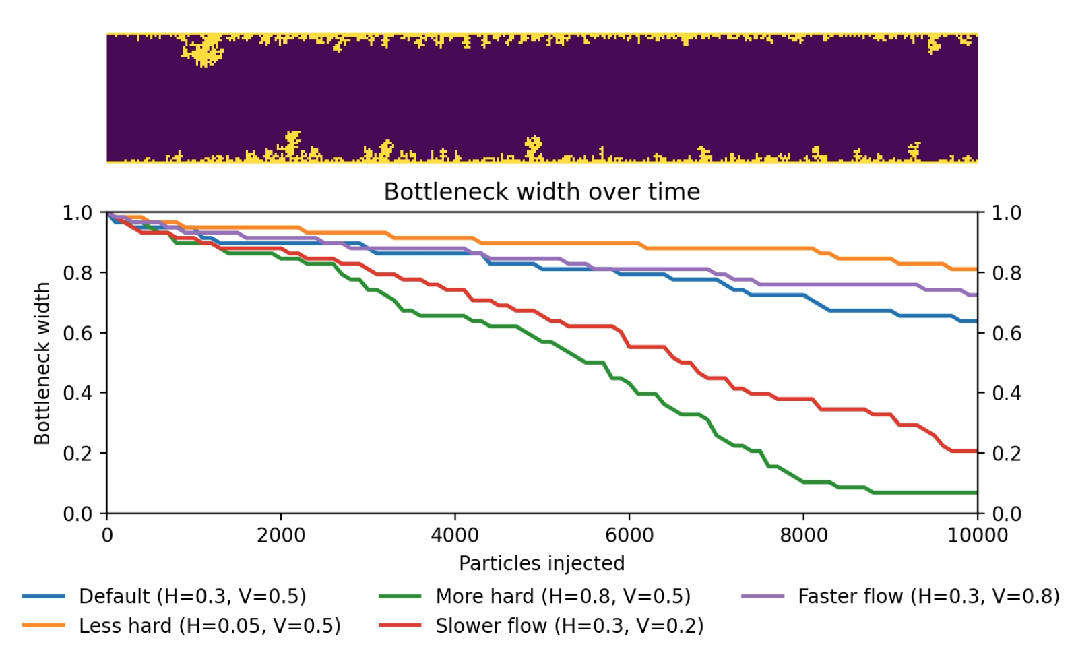
Mineral Scale Buildup in Water Pipes
Yixuan Qiao

Slide 2
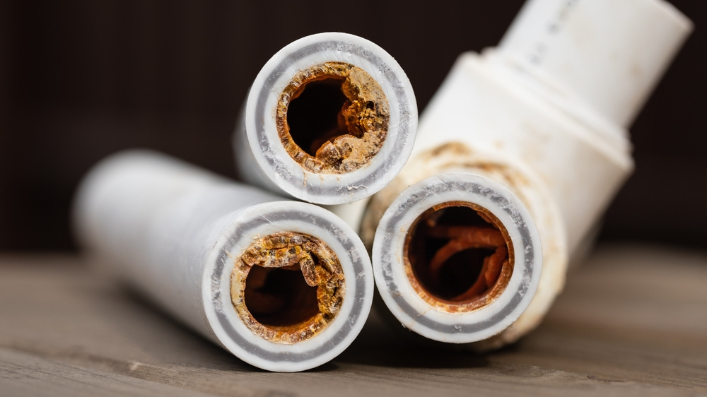
Topic and simulation
Topic
  Simulate calcium/mineral deposition in pipe
  Compare effects of water hardness, flow speed
  Track how scale buildup reduces efficiency
Method
  Diffusion-limited aggregation model
  Particles go from left to right, stick to walls based on hardness
  Visualize pipe bottleneck width over time to estimate efficiency
  Animation of scenarios one by one: default, less/more hard, slower/faster

Slide 3
