Slide 1
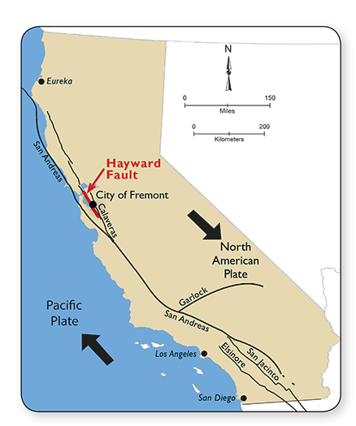
Earthquake Stress Simulation in the Berkeley Region
A Cellular Automaton Model of Rupture, Aftershocks, and Multi-Epicenter Interactions
By Raghav Nautiyal

Slide 2
Background Information
Background
Earthquakes occur when accumulated tectonic stress along faults is suddenly released.
The Berkeley city lies directly on top of the Hayward Fault, which is one of the most hazardous segments of the San Andreas Fault System.
Stress transfer between nearby fault patches can trigger aftershocks, cascading failures, or multi-epicenter events.
Project Goal
To build a simulation that shows:
How stress accumulates across a fault zone
How rupture begins at an epicenter
How earthquakes spread
How multiple earthquakes interact
Use real earthquake data from NCEDC to simulate realistic earthquakes
Simulation Method
Using cellular automaton (random walks) and Monte Carlo methods:
Fault is modelled as a 2D grid
Cells gain tectonic stress each timestep
If a cell passes a stress threshold, it fails
Failed stress drop to low stress and transfer their stress to neighbours
Stressed cells may rupture probabilistically

Slide 3
Simulation Process (Cellular Automata + Monte Carlo Methods)
Initialize Grid: A 200x200 grid represents the fault.
Seed with real data: Real earthquake coordinates and magnitudes from the NCEDC catalog are mapped onto the grid. Each real epicenter creates a high-stress patch whose location comes from its latitude/longitude and whose stress level and radius come from its magnitude (Mw). This forms the initial stress field used to start each simulation.
Add Tectonic Stress: At each timestep, every cell gains a small amount of stress.
Check for Failure: If a cell’s stress exceeds a certain threshold, it ruptures.
Reset + Transfer Stress: The ruptured cell drops to low stress and sends part of its released stress to its four neighbours, which may also fail.
Aftershocks: Cells with high stress may rupture even below threshold (representing probabilistic aftershocks).
Stress Waves: Each rupture sends out a radial stress wave, giving nearby cells a bump that fades with distance.
Animate: These steps repeat over hundreds of timesteps, producing spreading ruptures and aftershocks.

Slide 4
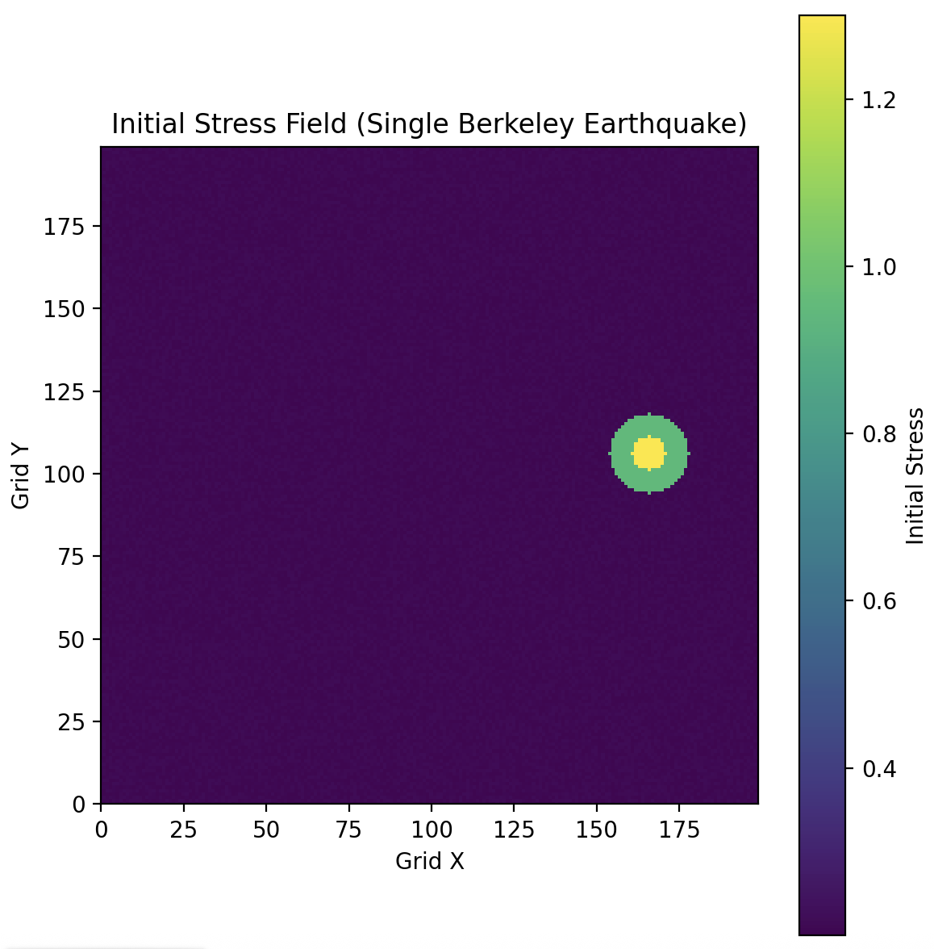
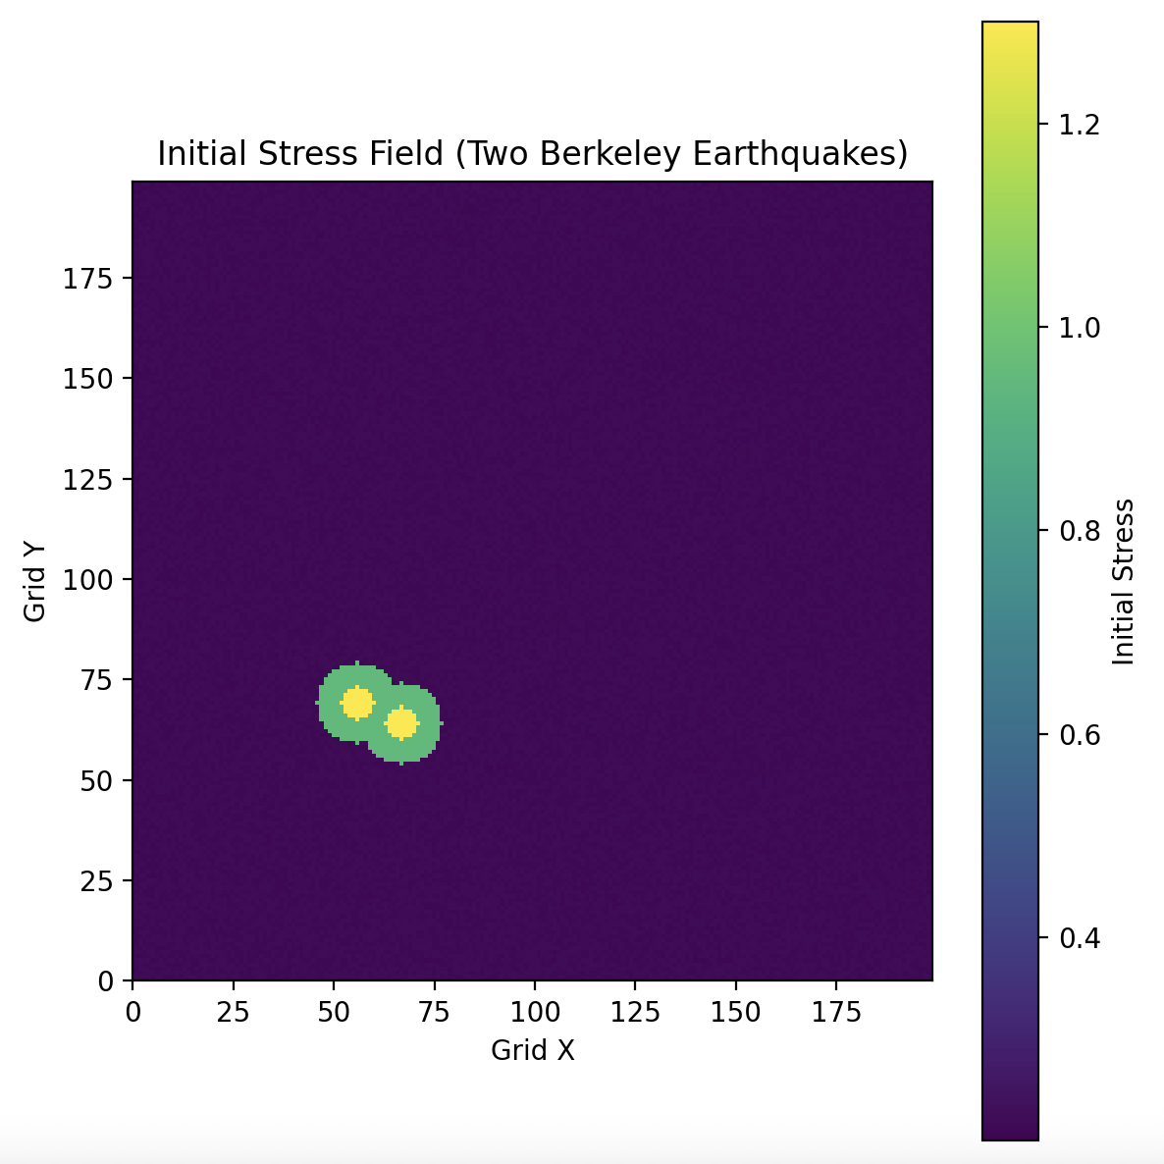
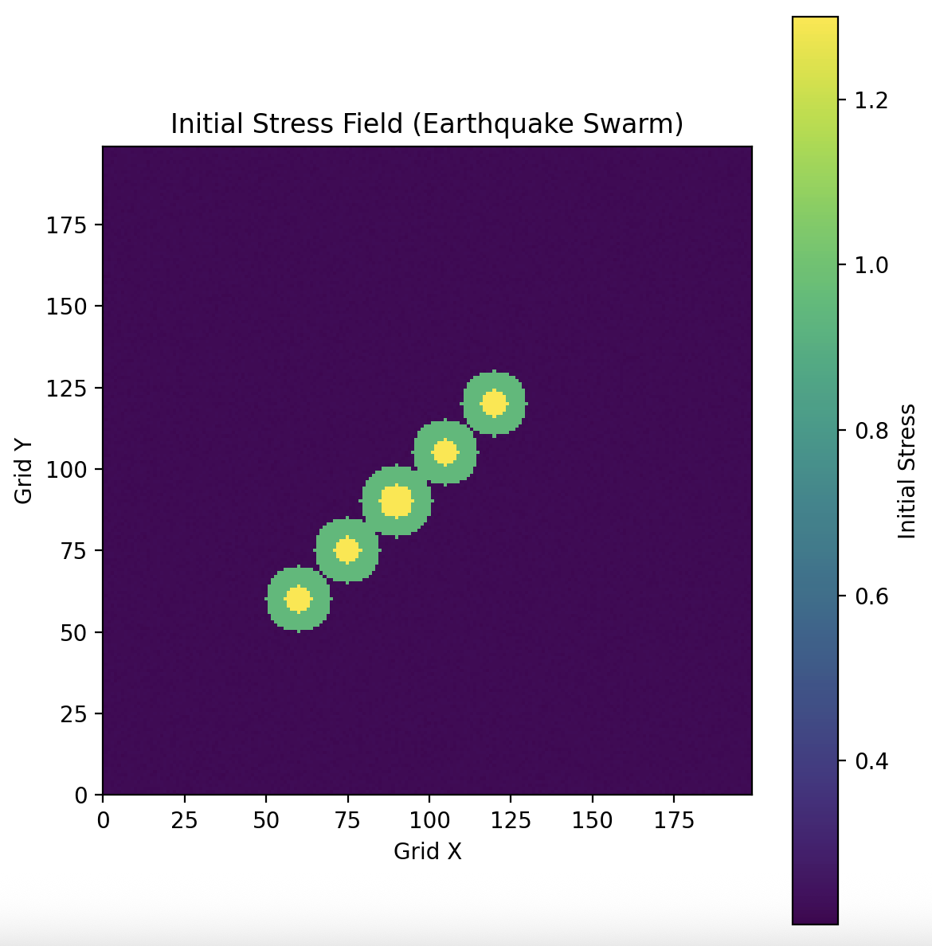
Simulation Scenarios
Each .ipynb file is a scenario, and all files need the earthquake_cellular_automata.py file to work.
Single Mainshock Event
Multi-Epicenter Event
Earthquake Swarm Event*
*The swarm example uses artificially placed epicenters for demonstration.

Slide 5
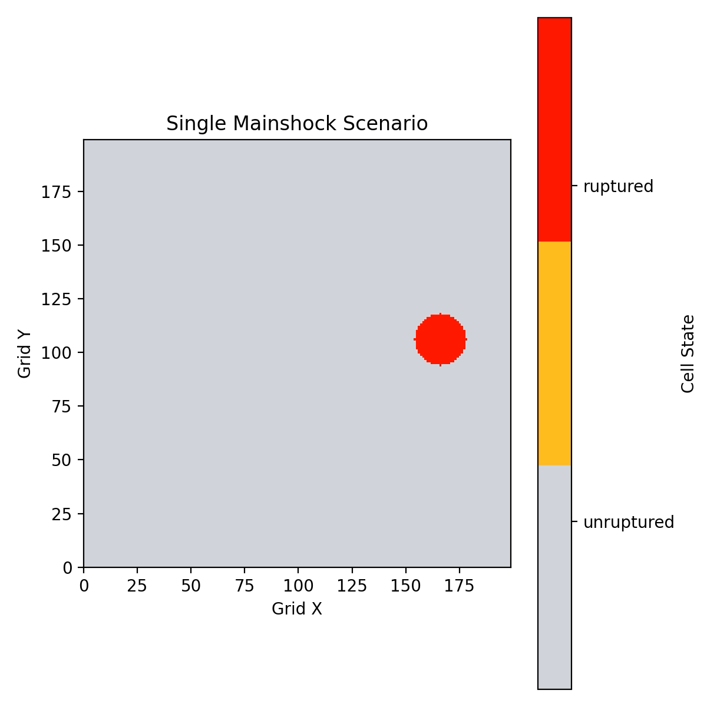
Animation 1

Slide 6
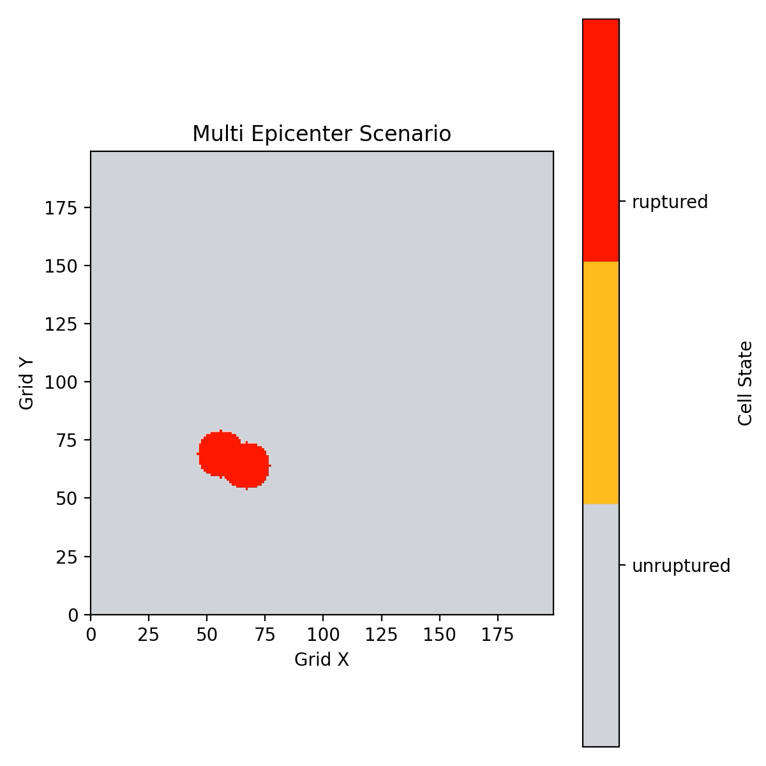
Animation 2

Slide 7
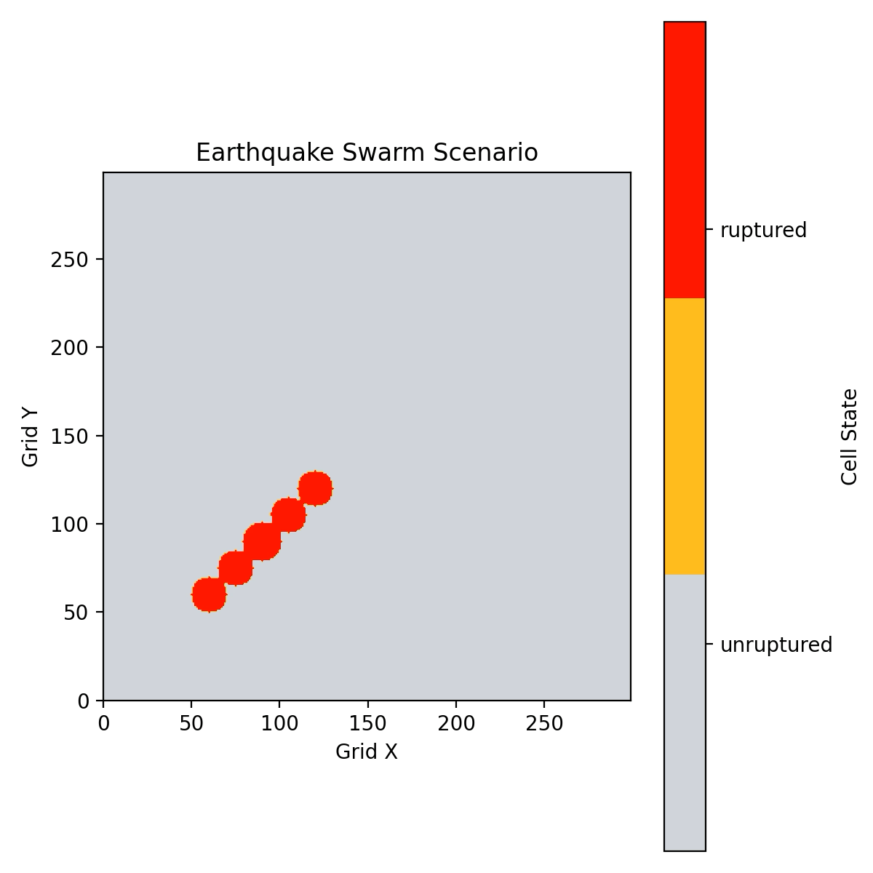
Animation 3

