Slide 1
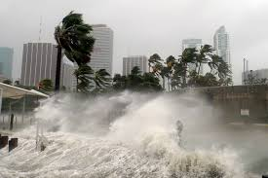
Numerical Simulation of Hurricane Storm Surge and Coastal Flooding for U.S. Cities
John Nalder

Slide 2
Methods
A physics-based storm surge simulation for cities and counties using real DEM elevation data and a moving hurricane pressure field.
Partial Differential Equations (PDEs)
Shallow-water equations modeled in 2D
A system of coupled PDEs governing fluid height and horizontal velocity.
Use of pressure-gradient forcing in momentum equation
Demonstrates how atmospheric pressure drives water motion.
Digital Elevation Models (DEMs) & Topography
Elevation data used as boundary conditions for water movement
Grid-based representation of Miami’s coastal terrain.
Land–water masking
Converts DEM heights into valid hydrodynamic domains.

Slide 3
