Slide 1
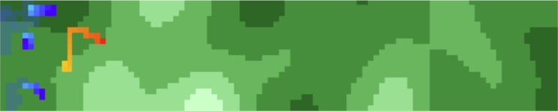
Simulating Drone Search Algorithms to Find a Lost Target
Alfonso Moreno Victoria

Slide 2
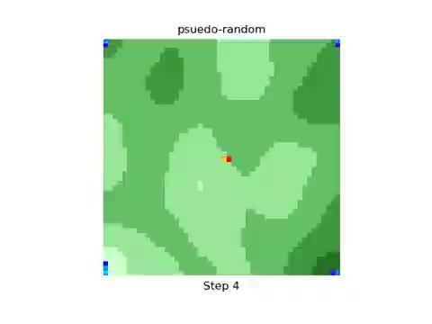
Task Description/Goal
Given 4 drones and an NxN grid, develop a drone algorithm to find a randomly moving target
Each tile has a varying cost value to traverse, varying from 1-5 timesteps
  generated by smoothing random noise with a Gaussian filter from scipy library
Mirrors real-world search and rescue missions

Slide 3
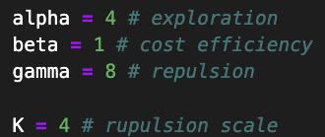

Drone Algorithms
Pseudo-random
  acts as a good baseline
Scoring algorithms
  encourage exploration and cost efficiency
lowest-score
  always picks the lowest scored tile
prob-score
  assigns probabilities to tiles based on score
  lower score = higher probability
prob-score-repulse
  introduces a repulse variable to prob-score

Slide 4
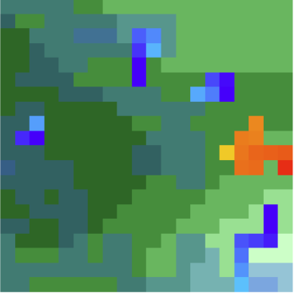
The drone-frontier algorithm
What is a “frontier” ?
  An unexplored tile that neighbors an explored one
Assign each drone a unique frontier to step towards
Of the tiles that bring it closer, probabilistically choose the one that has the lowest score
real-world search algorithm used in robotics

Slide 5
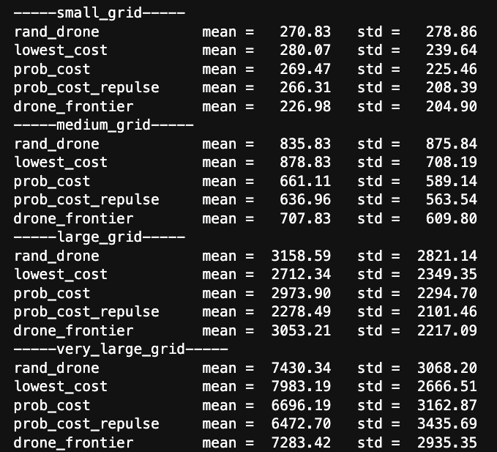
Performance

Slide 6
