Slide 1
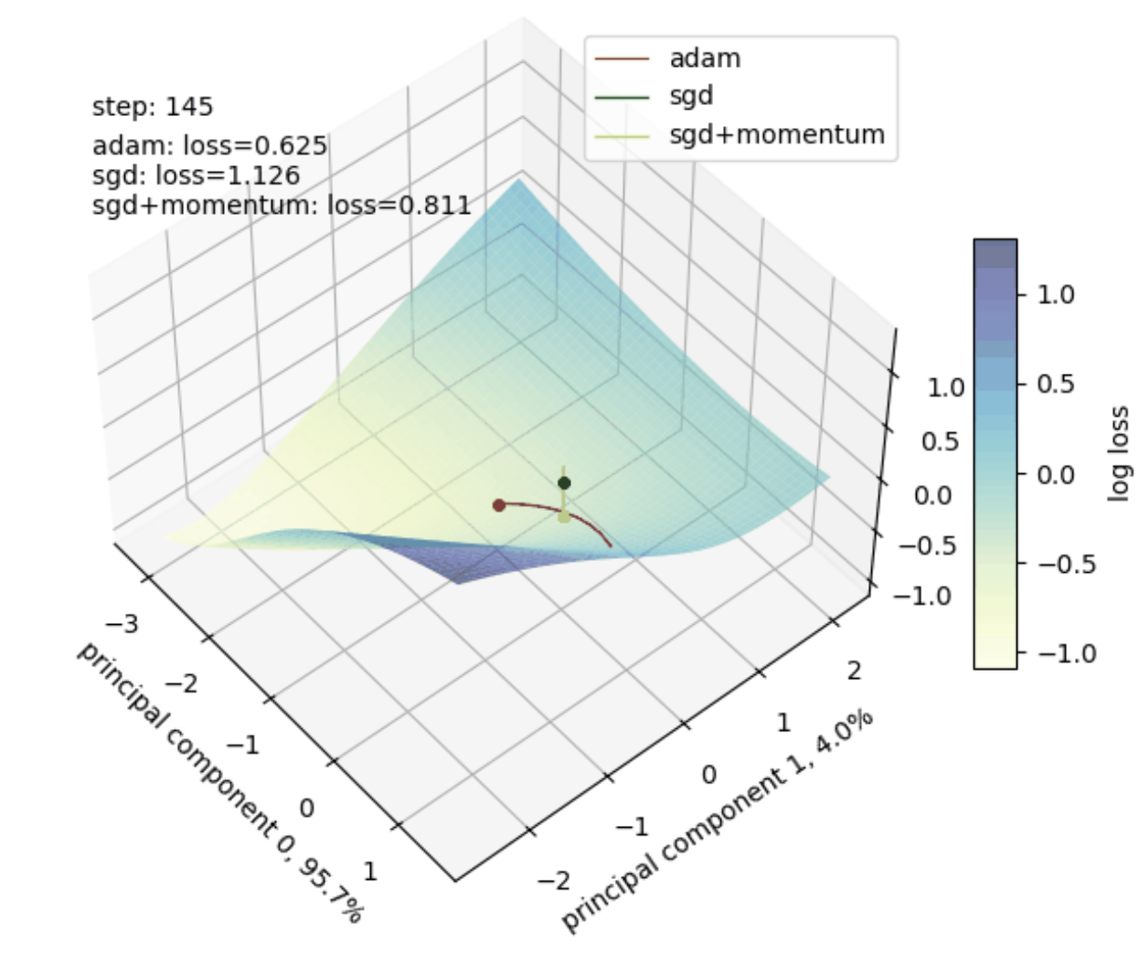
Visualizing Optimization Trajectories in Neural Network Loss Landscapes
Patrick Mendoza
EPS 109 Final Project – Patrick Mendoza 12/03/2025

Slide 2
TOPICS & METHODS
How Do Different Optimizers Navigate the Loss Landscape?
How I Did It
Dimensionality Reduction
PCA: Project parameter space → 2D
Use top 2 PCs (Principal Components)
Loss Surface Construction
Evaluate loss on a 2D grid in PCA Space
Visualize as a 3D surface (x=PC0, y=PC1, z=log loss)
Trajectory Visualization
Project optimizer paths onto same PCA basis
Interpolate z-values from grid
Trajectories lie exactly on the surface
Neural networks have trillions of parameters
Their loss landscape is therefore incredibly high-dimensional
We visualize a 2D slice using PCA
Why does could this even work? Manifold Hypothesis.
Compare optimizer trajectories on the same surface
EPS 109 Final Project – Patrick Mendoza 12/03/2025

Slide 3
TOPICS & METHODS
How Do Different Optimizers Navigate the Loss Landscape?
How I Did It
Dimensionality Reduction
Loss Surface Construction
Trajectory Visualization
Project optimizer paths onto same PCA basis
Interpolate z-values from grid
Trajectories lie exactly on the surface
Comparison
Same MLP, same initialization
Multiple optimizers: Adam, SGD, SGD+momentum
Overlay trajectories on shared landscape
Neural networks have trillions of parameters
Their loss landscape is therefore incredibly high-dimensional
We visualize a 2D slice using PCA
Why does could this even work? Manifold Hypothesis.
Compare optimizer trajectories on the same surface
EPS 109 Final Project – Patrick Mendoza 12/03/2025

Slide 4
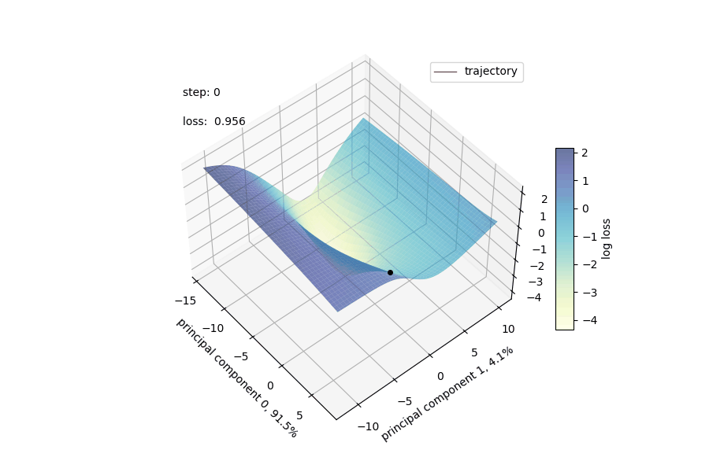
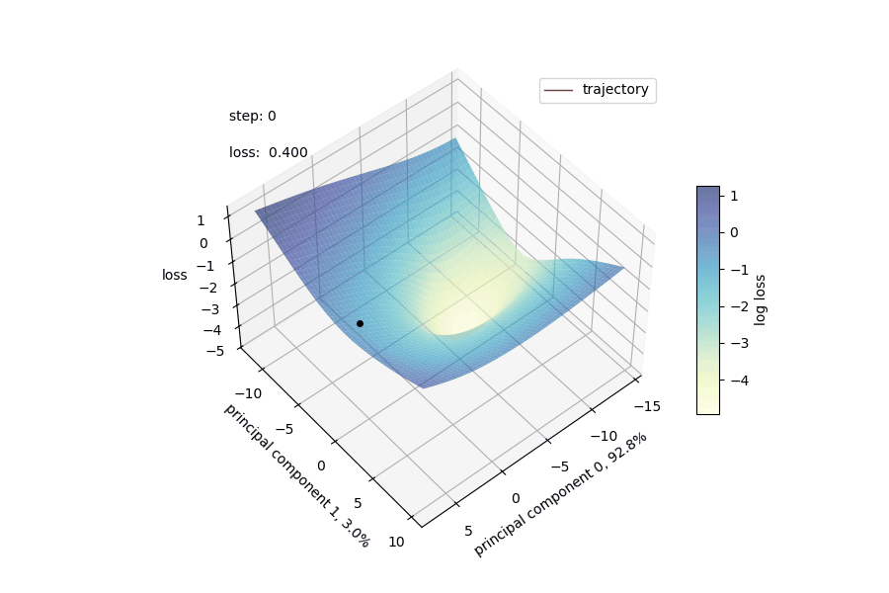
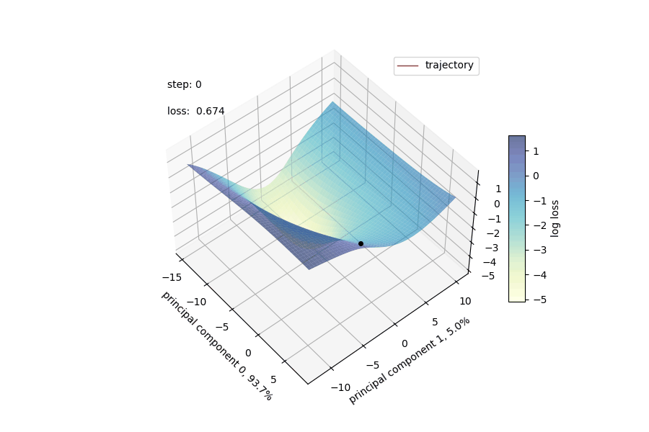
ANIMATIONS
SGD w/ Momentum
SGD
Adam
EPS 109 Final Project – Patrick Mendoza 12/03/2025

Slide 5
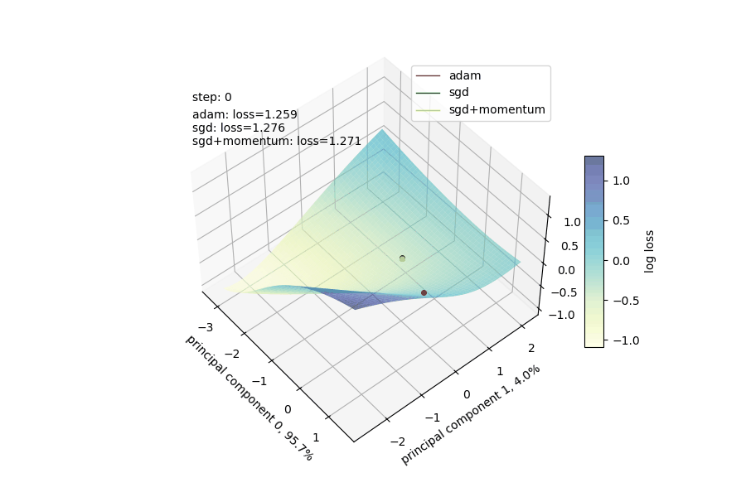
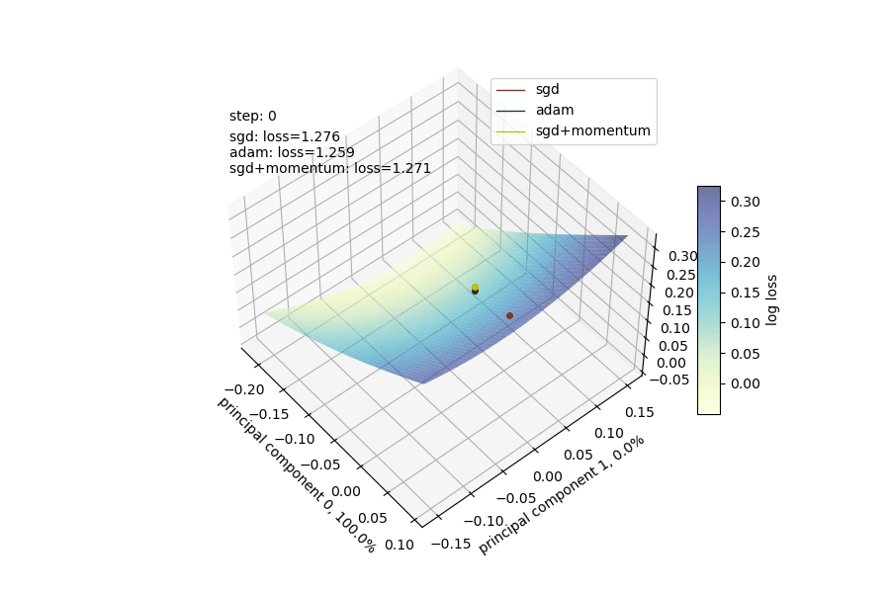
ANIMATIONS
Adam vs SGD vs SGD w/ Momentum but centered on Adam’s Path
Adam vs SGD vs SGD w/ Momentum but centered on SGD’s Path
EPS 109 Final Project – Patrick Mendoza 12/03/2025

Slide 6
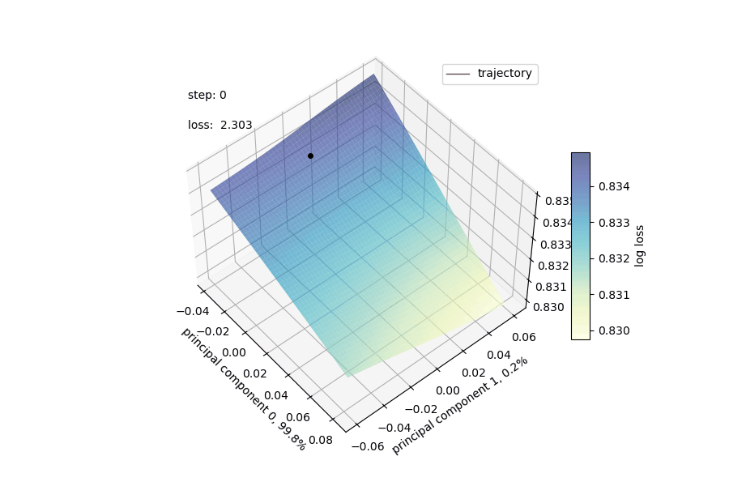
ANIMATIONS
LeNet-5 w/ SGD Optimizer on MNIST (Handwritten Digit Recognition)
EPS 109 Final Project – Patrick Mendoza 12/03/2025

Slide 7
NEXT STEPS
Where To Start?
This project is just scratching the surface… (no pun intended)
Batch size, learning rate, other hyperparameters, neural network architectures, data manifolds, …
EPS 109 Final Project – Patrick Mendoza 12/03/2025

Slide 8
Thank you!
EPS 109 Final Project – Patrick Mendoza 12/03/2025

