Slide 1
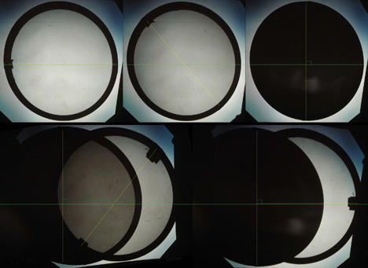
Simulating the Three-Polarizer Paradox
Alex Mehta
Source: https://sciencedemonstrations.fas.harvard.edu/presentations/malus-law

Slide 2
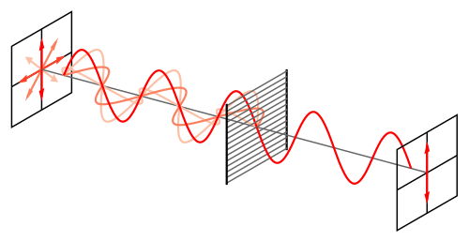

Project Details
Source: https://en.wikipedia.org/wiki/Polarizer
Physics
Polarizers block light waves that aren’t oscillating in a specific direction
Light can be viewed as an electric field, so we can use an ODE to represent it in space/time
$$\frac{dE_{x}}{dz}=α\sin\left(φ\right)\left(E_{y}\cos\left(φ\right)−E_{x}\sin\left(φ\right)\right)$$
$$\frac{dE_{y}}{dz}=−α\cos\left(φ\right)\left(E_{y}\cos\left(φ\right)−E_{x}\sin\left(φ\right)\right)$$
Simulation
To simulate a polarizer, use ODE to simulate decay the light that is absorbed rather than let through
This ODE represents the maximum amplitude of the light at each point
Use SciPy solve_ivp to solve ODE
Plot both modulated wave and polarizers using Matplotlib 3D
Having two polarizers that are orthogonal blocks all light, but a third polarizer lets light pass

Slide 3
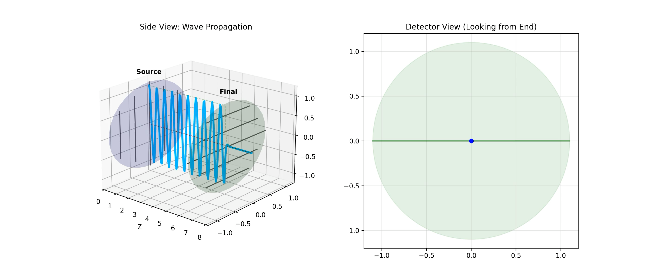
Two Polarizers

Slide 4
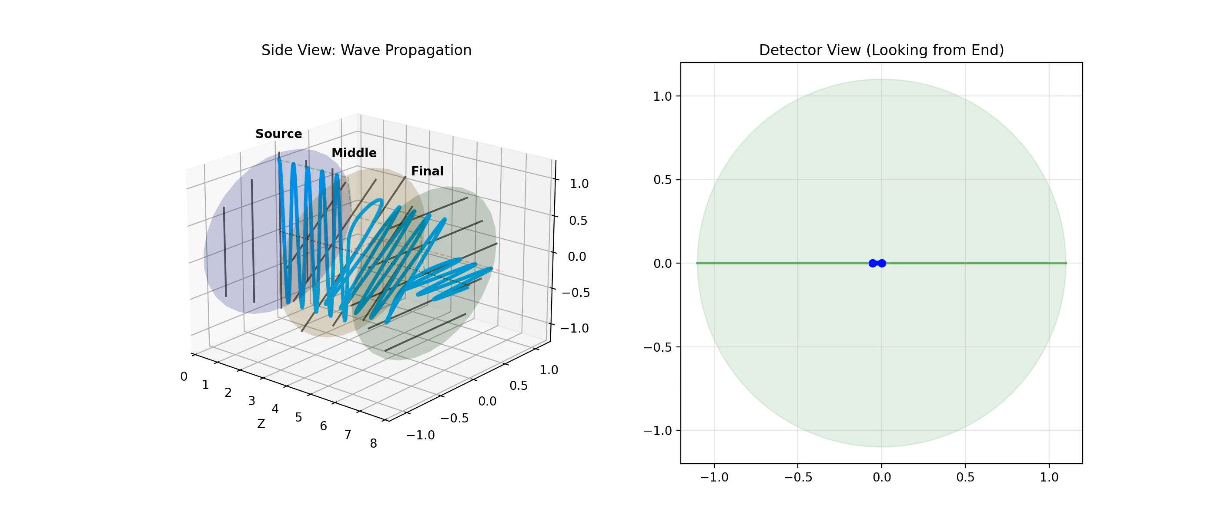
Three Polarizers

