Slide 1
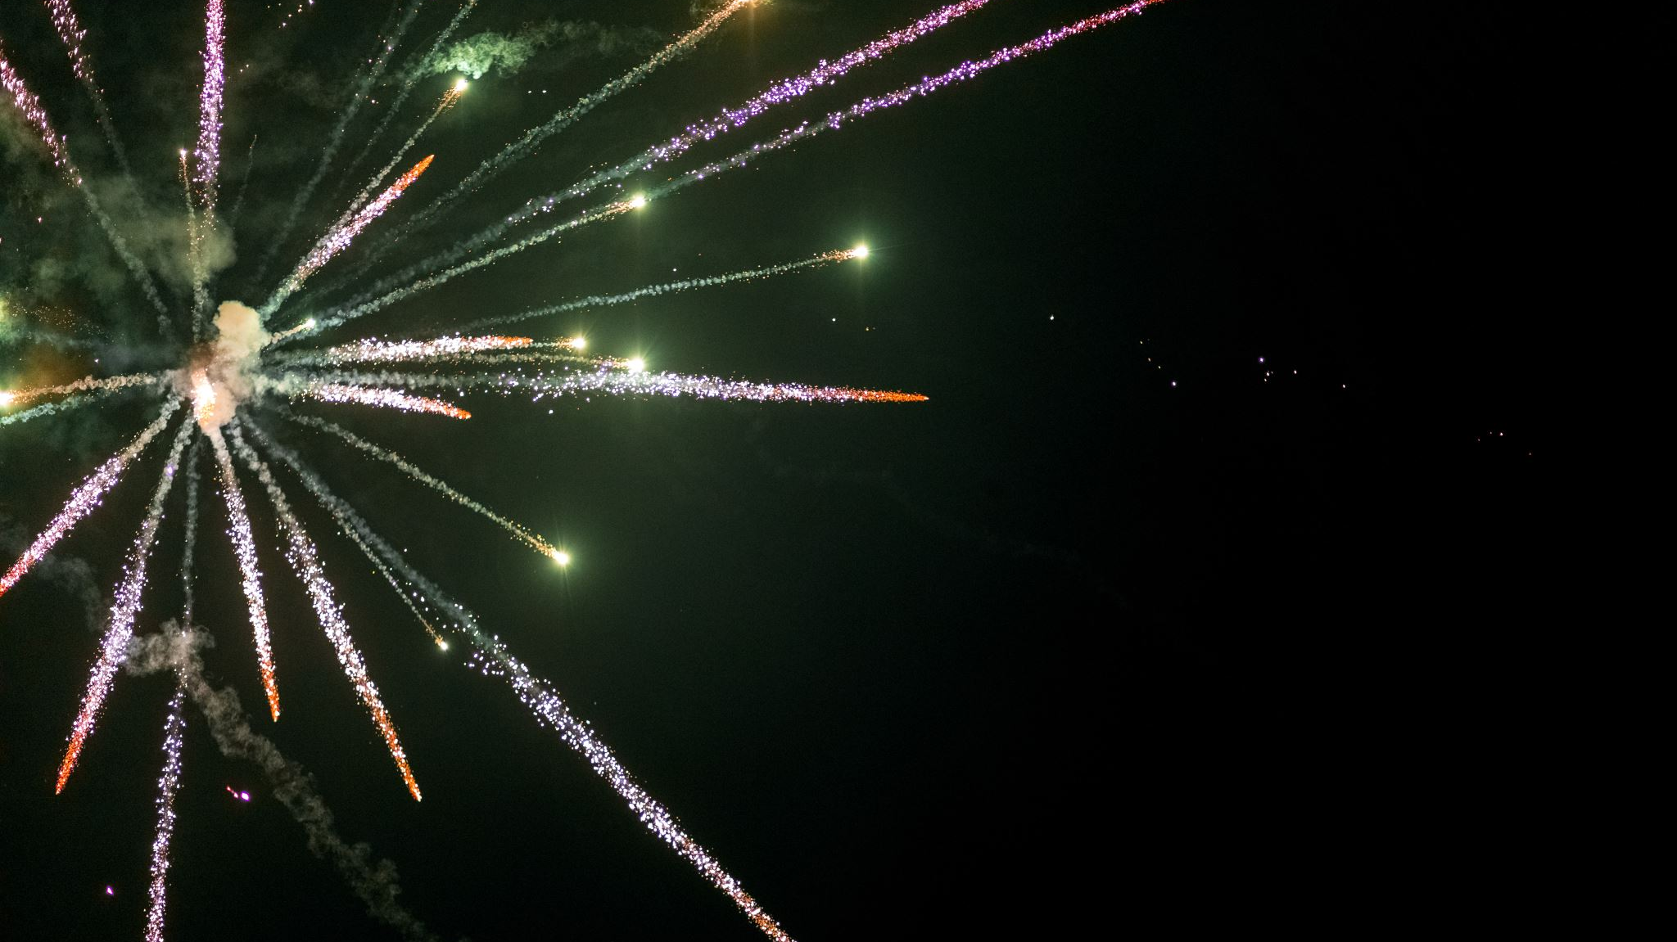
Fireworks in December
By Johnny Lin

Slide 2
My simulation and methods used
My simulation is of a firework display in December, aka a firework display in Christmas/winter-themed colors. Essentially, a rocket is shot into the air, then multiple particles of that rocket explode into multiple particles that move based on some arbitrary value of gravity and velocity that I set.
Methods used:
Monte Carlo Randomness demo in lecture to create randomness in where the rocket is launched, the speed at which it is launched, and the angle at which it explodes
FFMPEG Writer to create the animation into an MP4
Had to use some cos() and sin() to create random particles, but also formed a circle-like shape when the rocket exploded
Had to create multiple lists to keep track of the position, velocity, color, and length of time before a particle disappeared after exploding, which was a bit challenging because if I forgot to remove one particle from one of these lists, then things would break
  It was also challenging to make the particles disappear. Originally, I had used a for loop to try to accomplish this, but there was a difficult-to-find bug in the code where, when I removed a particle from a list, the whole list shifted and would break things. I had to use a while loop instead to fix this bug.

Slide 3
