Slide 1
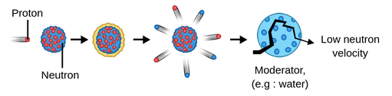
Slowing Down: Visualizing Neutron Moderation in Matter
Jocelyn Jimenez
EPS 109

Slide 2
Model + Methods
Neutron state
Update Steps
Boundaries & energy bands
Reflecting walls:
If x < 0 or x > Lx → bounce back in x and flip direction
If y < 0 or y > Ly → bounce back in y and flip direction
Energy bands (used for colors and statistics):
Fast: E > 0.6 * E0
Intermediate: 0.2 * E0 < E ≤ 0.6 * E0
Thermal / low: E ≤ 0.2 * E0
Position: (x, y)
Direction: theta
Energy: E
Initial conditions:
x = 0 (all start on the left)
y is random between 0 and Ly
Step length s depends on energy: s = k * sqrt(E)
Motion each step:
x ← x + s * cos(theta)
y ← y + s * sin(theta)
With probability p_coll (a collision happens):
E ← alpha * E (energy loss)
theta is reset to a random angle between 0 and 2*pi

Slide 3
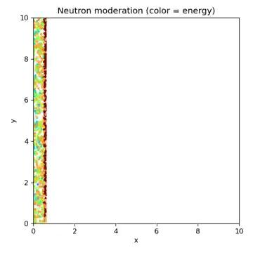
Animation
Key:
blue = fast,
green = intermediate,
red = thermal

