Slide 1
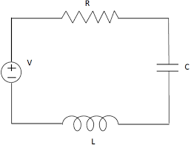
RLC Second Order Circuits
Jessica Fan

Slide 2
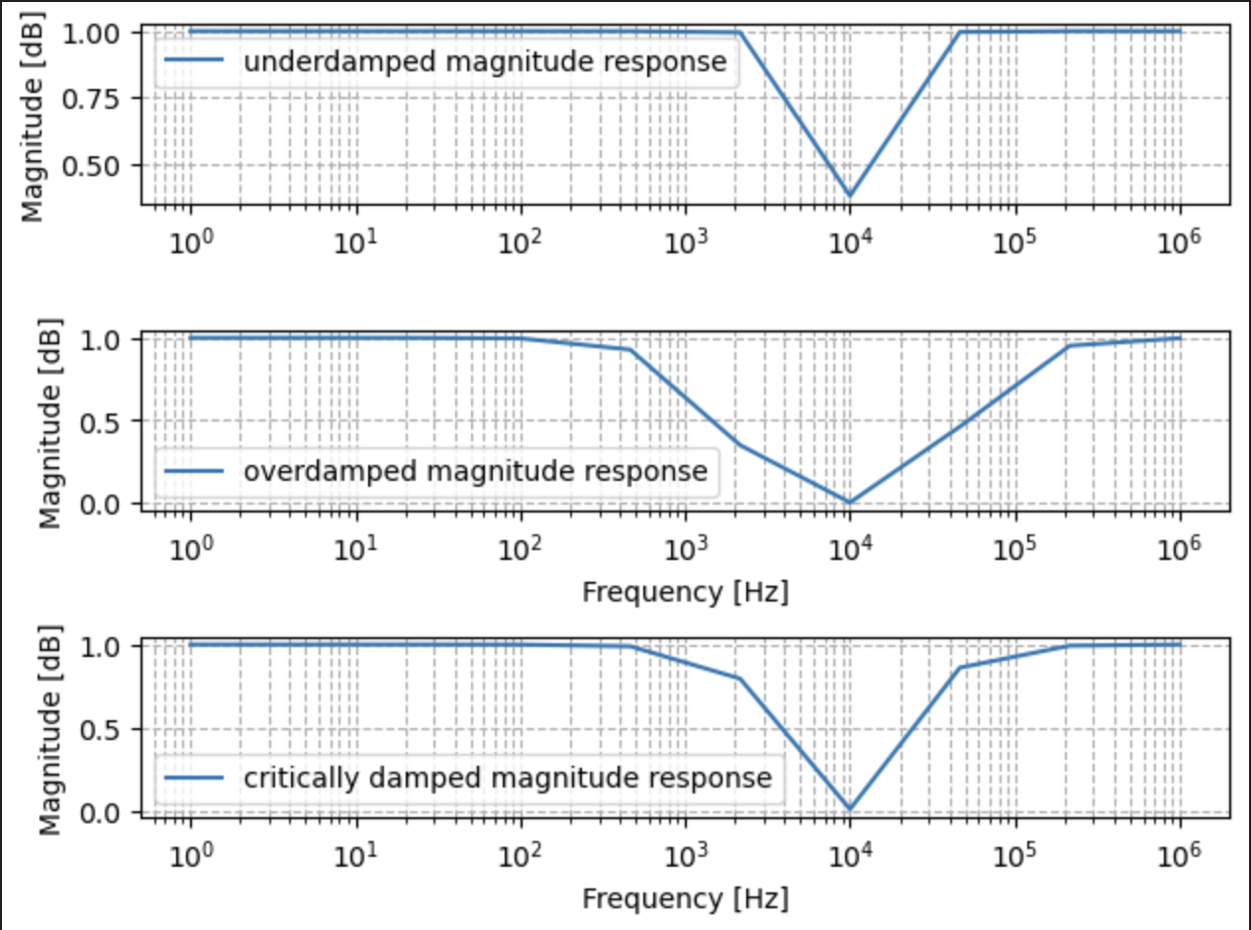
Animation Topic + Techniques Used
Topic:
An RLC circuit is inherently a second order system, and just like a mass-spring system, it can exhibit overdamping, underdamping, and critical damping based on the resistor value, as the resistor is where energy in the system is dissipated.
In this simulation, I have an RLC circuit in series, and probe the LC output, which will exhibit “notch” behavior at the resonant frequency (1/sqrt(LC)), and sweep through a series of frequencies over three resistor values that are underdamped, critically damped, and overdamped. I initially plot the magnitude response in a log-log plot to get a sense of frequencies to sweep
Techniques:
ODE integrator using Runge-Kutta

Slide 3
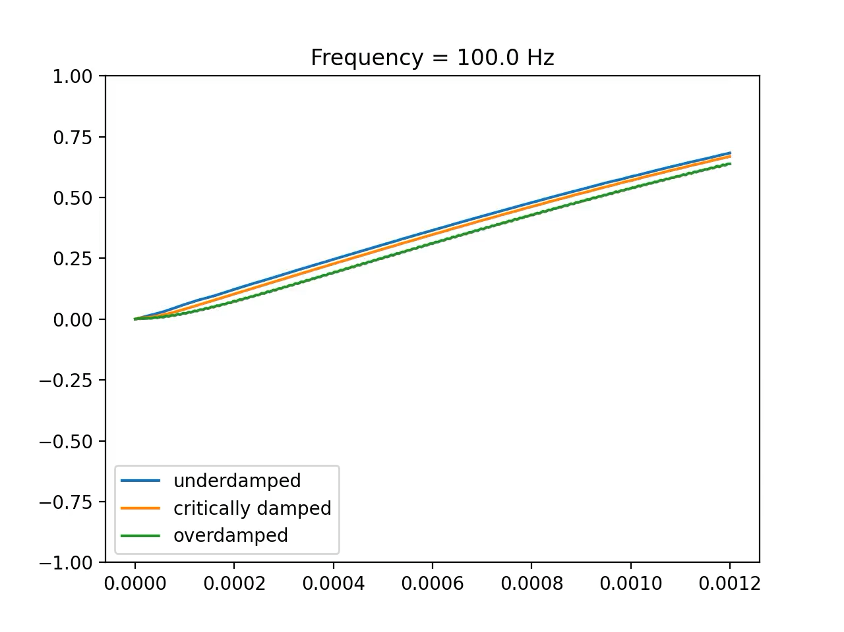
Animation(s)

Slide 4
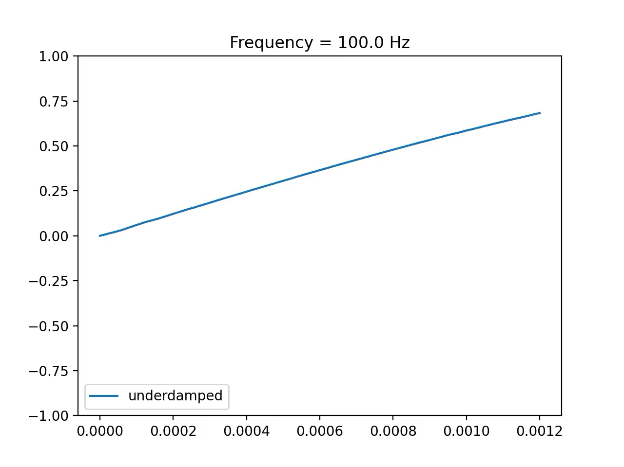
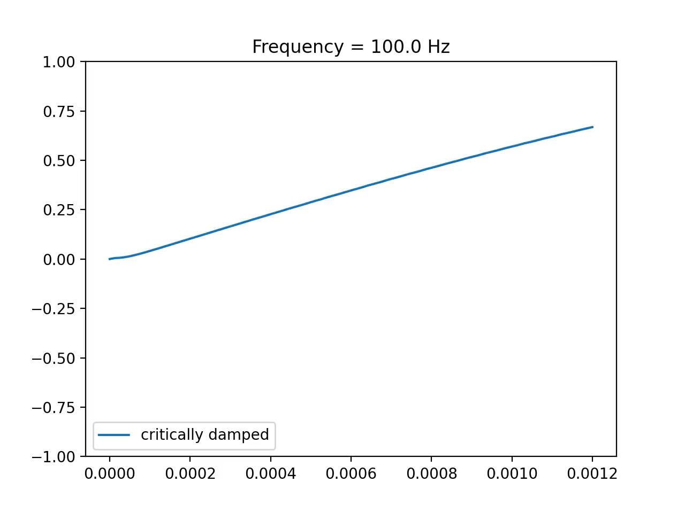

Animation(s)

