Slide 1
King Tides
Annie Devine

Slide 2
What are King Tides
King Tides are drastic tidal events that bring very and low tides
They occur about once or twice a year
My Project
I wanted to create an animation of tidal levels during both a King Tide event and normal tidal event to show the different in high and low tides

Slide 3
Methods and Data
November 6th, 2025
King Tide | Height (ft) | Time (PST)
Low Tide 1 | 1.68 | 2:21 AM
High Tide 1 | 7.51 | 8:39 AM
Low Tide 2 | -1.29 | 3:50 PM
High Tide 2 | 4.34 | 10:10 PM
I collected San Diego tidal data from NOAA for two days
  One day when a King Tide Occurred and one day with normal tidal activity
Because I could not collect tidal data for every minute of the day, only high and low tide levels and times, I created a cubic spline interpolation model to approximate tidal levels between the given points
I used the PchipInterpolator() function to ensure the given points matched the maxima and minima of the animated graph
November 11th, 2025
Normal Tide | Height (ft) | Time (PST)
High Tide 1 | 4.06 | 3:30 AM
Low Tide 1 | 3.35 | 7:40 AM
High Tide 2 | 5.14 | 1:34 PM
Low Tide 2 | 0.24 | 9:15 PM
Source:
https://tidesandcurrents.noaa.gov/noaatidepredictions.html?id=9410170&units=standard&bdate=20251106&edate=20251111&timezone=LST/LDT&clock=12hour&datum=MLLW&interval=hilo&action=dailychart

Slide 4
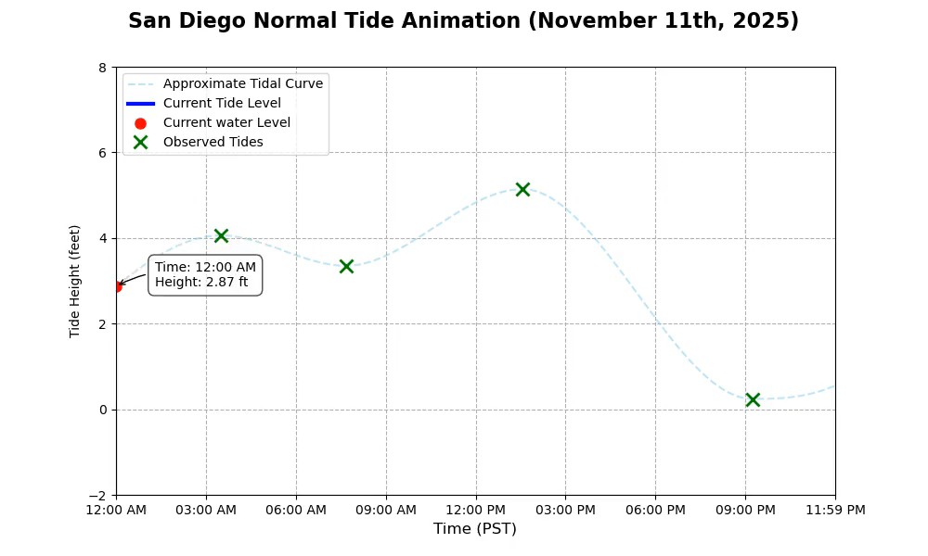
Normal Tide Animation

Slide 5
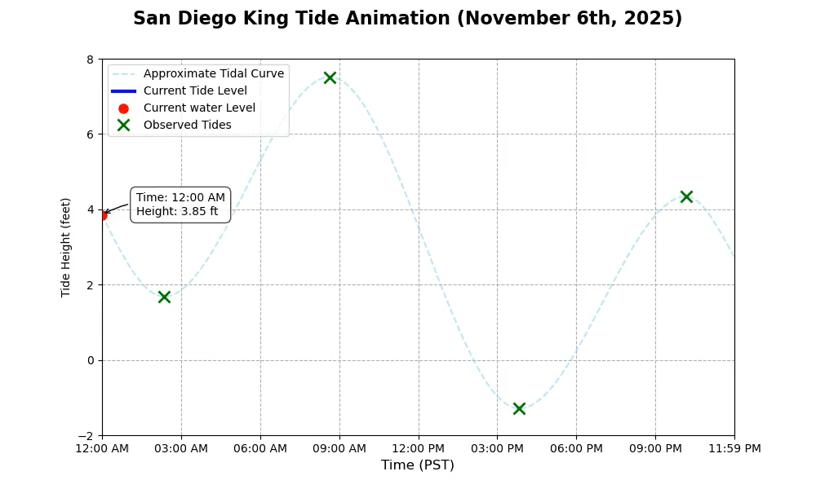
King Tide Animation

Slide 6
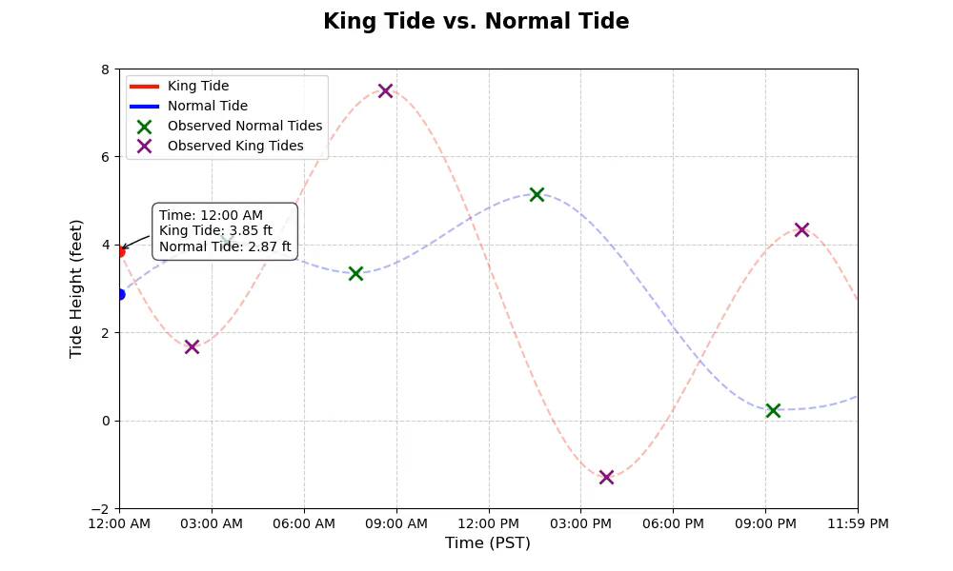
Comparison
The high and low tides on November 6th, the King Tide day, are shown to be significantly higher and lower (respectively) than the high and low tides on November 11th, the normal tide day
A change of only five days results in drastic changes in high and low tides

