Slide 1

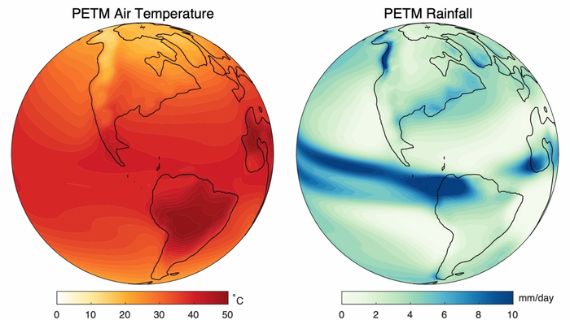
Modeling the Effects of the Paleocene-Eocene Thermal Maximum
Allison Davis

Slide 2
Goals and How
Context:
- Late Paleocene-early Eocene experienced a sudden global warming event, which is recognized by the ddsudden decrease in δ13C found in rock samples and ocean sediments during this time period
- The flux of 12C in the system led to a 5-8˚C increase in temperature, which led to a more rapid hydrological ddcycle process that caused intense flooding and erosion of the continental surface
- The increased flooding led to a higher percent of continental bodies being covered by shallow bodies of ddwater
How I Modelled Water Overtaking a Continental Landmass:
Randomly generated terrain (np.random.seed)
Defined terrain by creating random corners for the terrain grid and building off them using the diamond-square algorithm
Created a coastline and defined a difference between land and water (True- land, False- water) + color
Created a function that calculated the total land mass over time
Created three plots (initial state, changing state, graphical evidence)
Animated the sea level rising on land from .3 to .8 and plot 3 to update simultaneously
Defining a stopping threshold so the sea level doesn’t overtake the whole landmass
Save as a gif (mp4 wasn’t working with VS Code?)

Slide 3
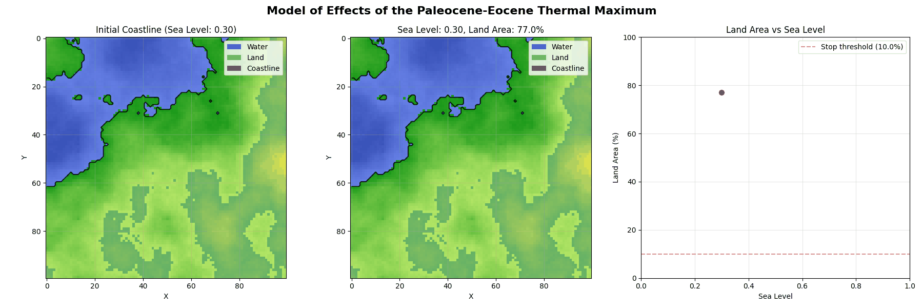
Final Animation

