Slide 1
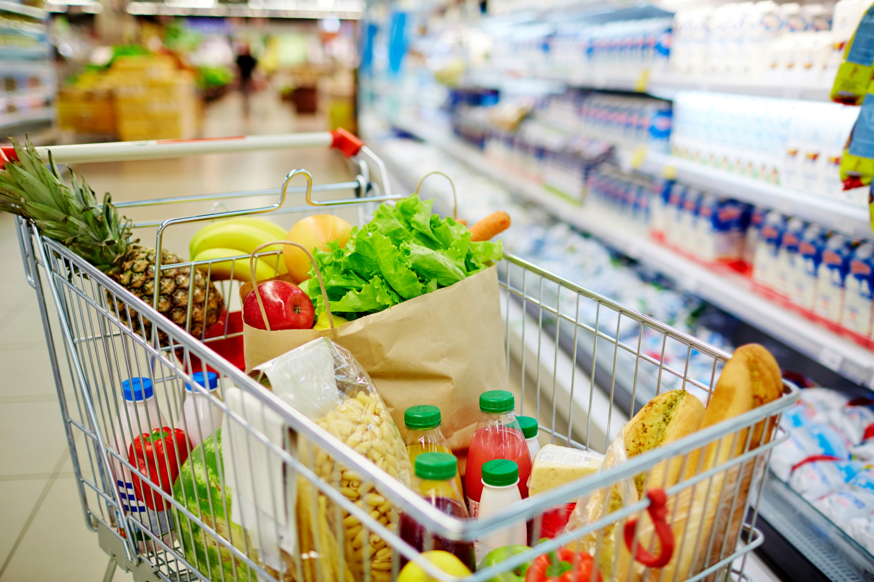
Grocery Shopper Simulation
Satvik Dasari

Slide 2
Topic: Simulating Shoppers in a Grocery Store
Model: 2D grid grocery store with n aisles, top and bottom walkways, exit at bottom left and entrance at bottom right
Goal: Understand how layout + shopper behavior creates congestion, affects path lengths, and time in store
Shoppers: 3 Types: 1. Single (Very Short Trip), 2. Basket (Medium), 3. Cart (Big Trip) | protein shoppers = visit meat aisle
Directed/Random Walks: Receives certain order of items and determines shortest path to get to that spot | Randomized: Item Locations, Shopper Type, Congestion Solve
Rules: Cannot cross aisle walls, All Shoppers must visit milk position, and Collect all their items in random order | Aisle 2 (from right) = meat aisle
Movement/Traffic: Timestep: 15 seconds, Single Fastest and Cart Shoppers Slowest, Collision: Cannot occupy same cell but may swap if moving past each other, Traffic Stop: Shopper wants to move into a spot but it is occupied so must wait

Slide 3
