Slide 1
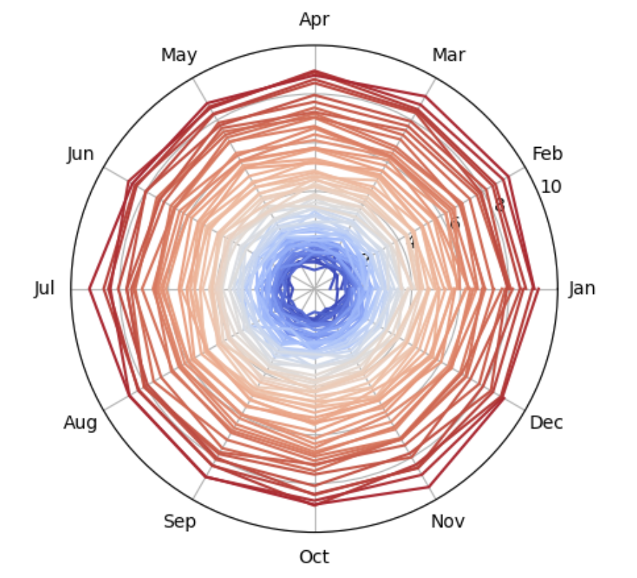
Climate Change Visualization
Ellie Bucher

Slide 2
Topic & Methods
Note: Numbers in brackets correspond to references on final slide
How does the mean increase?
Increase in global temperatures is accelerating due to human emissions; it has been debated how this relationship is best modeled [4] [6] [7] [8]
So I wanted to compare exponential regression and linear regression (cubic fit)
How I did this:
Calculated the next year’s mean temperature anomaly based on exponential or linear regression (on mean yearly temperature anomaly)
Generated a new temperature anomaly distribution for each year, and generated 12 random values from this distribution (also added some Gaussian noise) [9]
Graphed the average of the 100 simulations as a spiral, inspired by Ed Hawkins’ temperature spiral [3] [10]
Data
Used GISTEMP from NASA Goddard Institute for Space Studies [1] [2]
  Global temperature anomalies, or deviations from baseline mean temperature from years 1951-1980
Methods & Simulation
Monte Carlo simulation (100 runs) to predict next 75 years of temperature anomalies based on a distribution of temperature anomalies that shifts each year
Distribution of temperature anomaly for a given year is roughly normal, but due to climate change, it changes every year [5]
  Mean increases, standard deviation is different

Slide 3
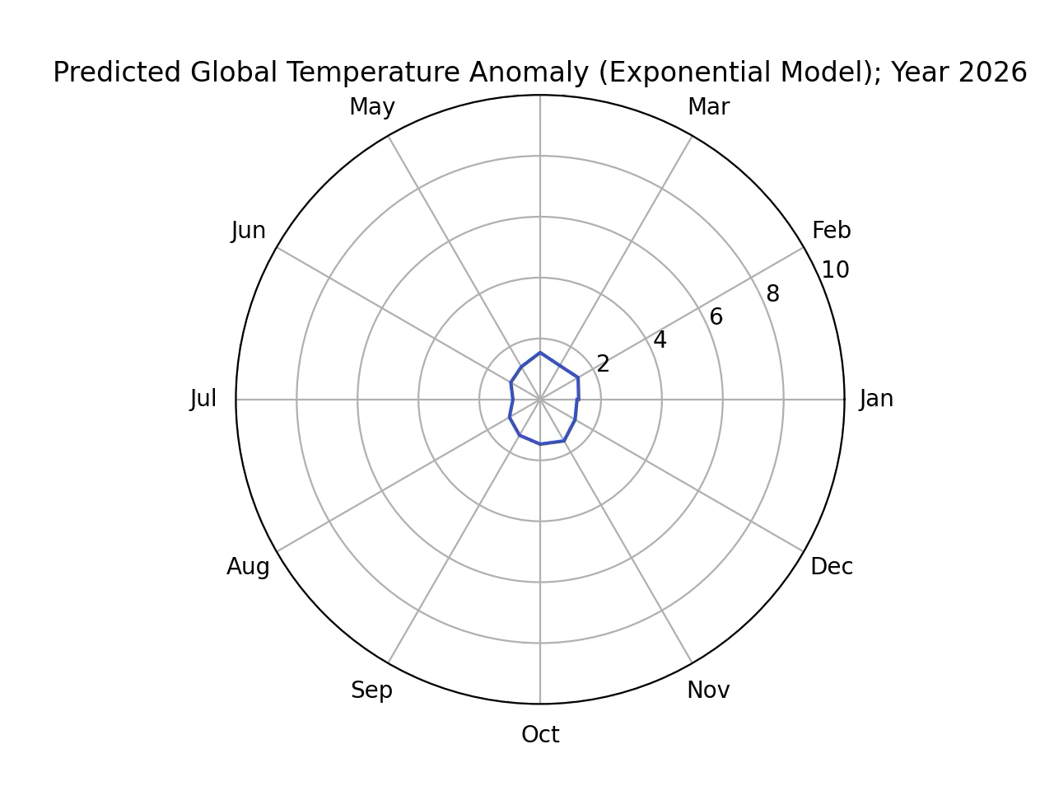
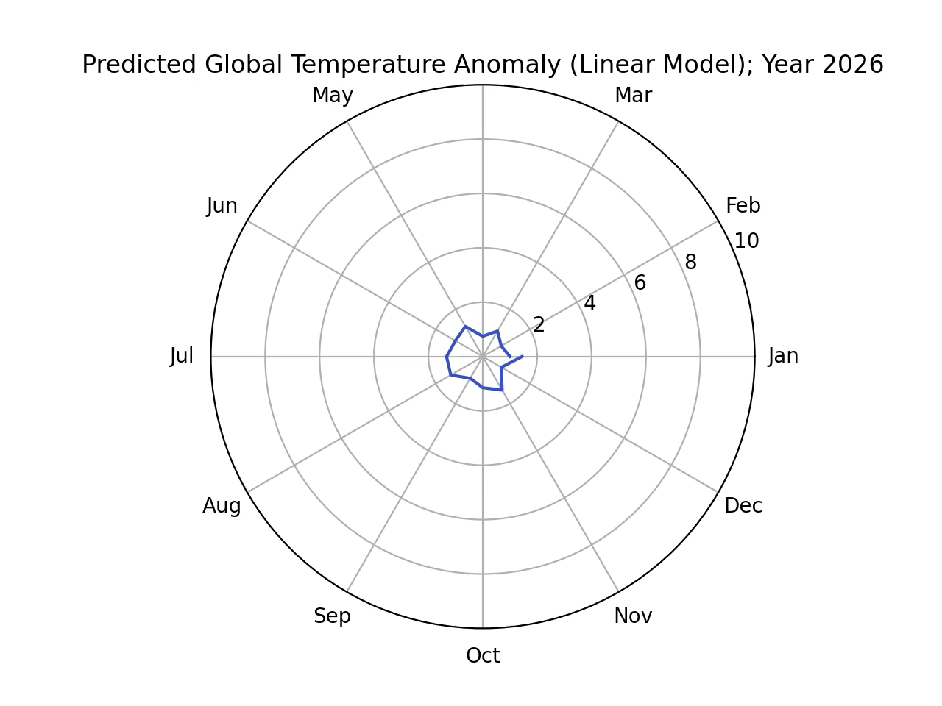
Visualizations

Slide 4
References
Data
[1] GISTEMP Team, 2025: GISS Surface Temperature Analysis (GISTEMP), version 4. NASA Goddard Institute for Space Studies. Dataset accessed 2025-11-24 at https://data.giss.nasa.gov/gistemp/.
[2] Lenssen, N., G.A. Schmidt, M. Hendrickson, P. Jacobs, M. Menne, and R. Ruedy, 2024: A GISTEMPv4 observational uncertainty ensemble. J. Geophys. Res. Atmos., 129, no. 17, e2023JD040179, doi:10.1029/2023JD040179.
Temperature Anomaly and Climate Change Information; Climate Spiral
[3] Mark SubbaRao. (2023). NASA Climate Spiral 1880-Present. Zenodo. https://doi.org/10.5281/zenodo.15881696
[4] NASA. (2025, January 28). This is how scientists measure global temperature - NASA science. NASA. https://science.nasa.gov/earth/measuring_global_temperature/
[5] Mark SubbaRao, & Jenny Marder Fadoul. (2025). Shifting Distribution of Land Temperature Anomalies, 1964-2024. Zenodo. https://doi.org/10.5281/zenodo.15922567
[6] Dahlman, R. L. A. L. (2025, May 29). Climate change: Global temperature. NOAA Climate.gov. https://www.climate.gov/news-features/understanding-climate/climate-change-global-temperature
[7] Noll, M. (2023). Exponential Life-Threatening Rise of the Global Temperature. https://doi.org/10.31223/x5t95v
[8] Jarvis, A., & Forster, P. M. (2024). Estimated human-induced warming from a linear temperature and atmospheric CO2 relationship. Nature Geoscience, 17(12), 1222–1224. https://doi.org/10.1038/s41561-024-01580-5

Slide 5
References cont.
Code References
Used numpy, matplotlib, scipy, sklearn documentation
Went to this website to understand Gaussian noise:
[9] Sonna, M. (n.d.). Guide to adding noise to your data using Python and Numpy. Medium. https://medium.com/@ms_somanna/guide-to-adding-noise-to-your-data-using-python-and-numpy-c8be815df524
Went to this website to understand how to graph my data in polar coordinates:
[10] Dataquest. (2023, February 23). Generating climate temperature spirals in Python. https://www.dataquest.io/blog/climate-temperature-spirals-python/

