Slide 1
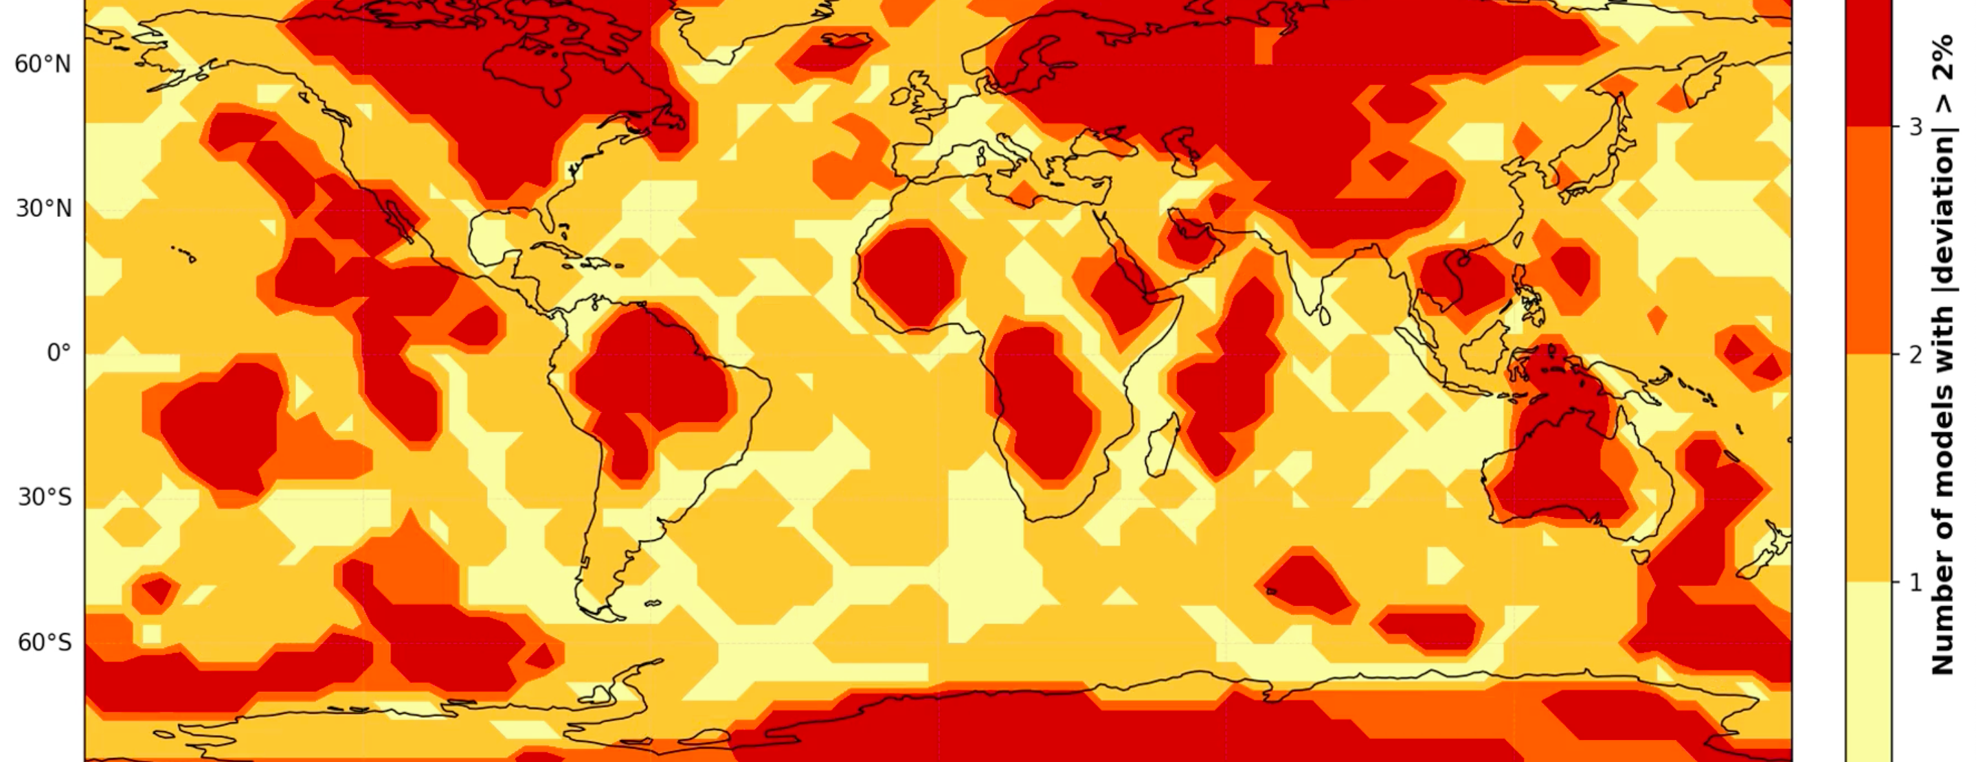
Earth model deviations
Barbara Borcherds

Slide 2
Upper mantle S-wave, tomographic earth models from surface to CMB (2800km depth)
REVEAL (ETH Zurich, 2024), S2.9EA (2008), S362ANI (2008) HMSL-S06 (UCSD 2008)
Each model contributes either 0 or 1 for every square on map at each depth
Vote of 1 (yes) if that model has dvs>2% at that specific depth and 0 (no) if not
Perturbation percentage already in these model and didn’t have to be calculated separately
Notes:
Primary waves: move medium in direction of travel
Secondary waves: only through solids, medium moves perpendicular to travel
Both can be used to make voting maps/reference models, I arbitrarily chose S-waves and then stayed consistent
S2.9EA and S362ANI (improvements to S2.9EA) have same authors
Why these models?-trial and error, easiest to download, I tried using LOWE but the file seemes to be corrupted and returned values on the order of 10^36 so I went with ones that worked easiest
Lat-lon pixel: either you can cycle through chosen sizes (for I in range(lat) for j in range(lon) or use a previous model as the template)
Each model has slightly varying depths-used ‘nearest’ to get voting map
Each model has their own reference which can be found in the description of the model
There is a website from oxford where you can compare many different models, S-wave, P-wave for more interest

Slide 3
