Slide 1
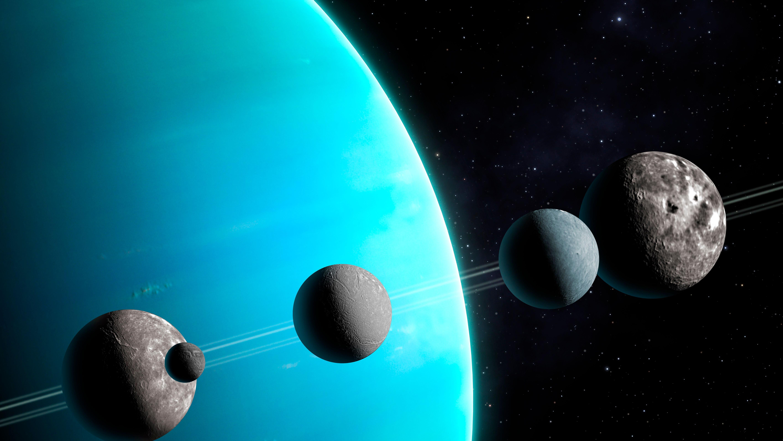
Orbital Differences Between Uranus’s Regular and Irregular Moons
By: Karan Bhakta

Slide 2

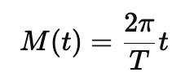
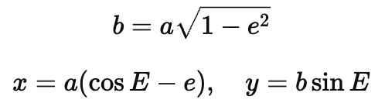
Topic and methods used
Topic
Models the Uranian System: Uranus and 26 of its moons
Compares the orbits between regular vs irregular moons
- Regular: Sphere shape and formed with Uranus
- Irregular: Asteroids or Kuiper-belt-type bodies that Uranus grabbed with its gravity later on
Shows both a 3D view and a 2D top view to visualize orbital structure.
Methods
Keplerian two-body orbit mode
Kepler’s equation – converts time into position
Ellipse geometry
Inclination / 3D tilt
1

Slide 3
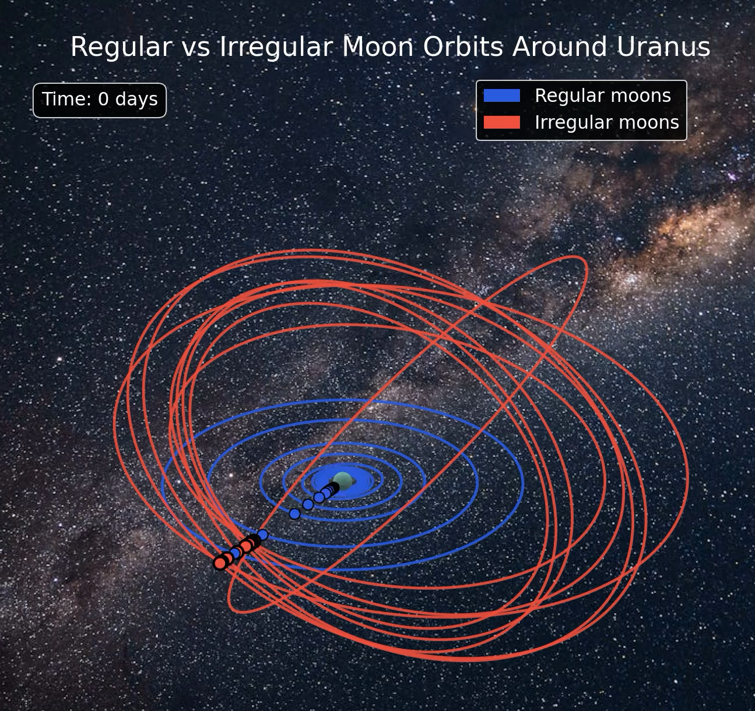
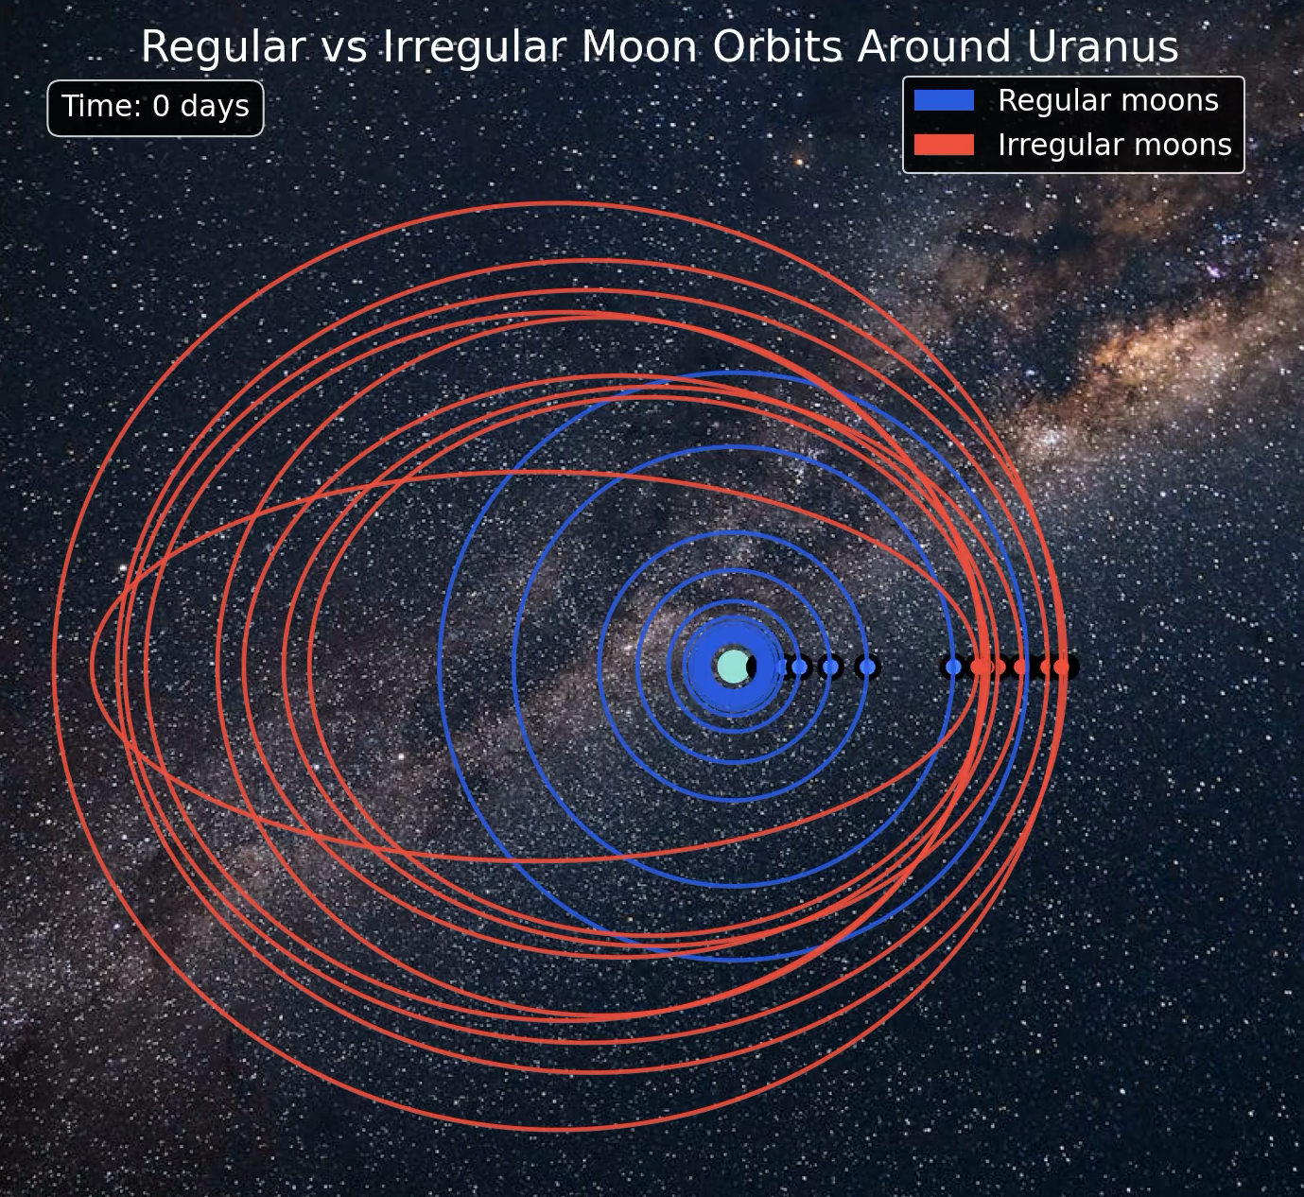
Animations
2

Slide 4
References
https://science.nasa.gov/uranus/moons/
https://en.wikipedia.org/wiki/Moons_of_Uranus
https://ssd.jpl.nasa.gov/
3

