Slide 1
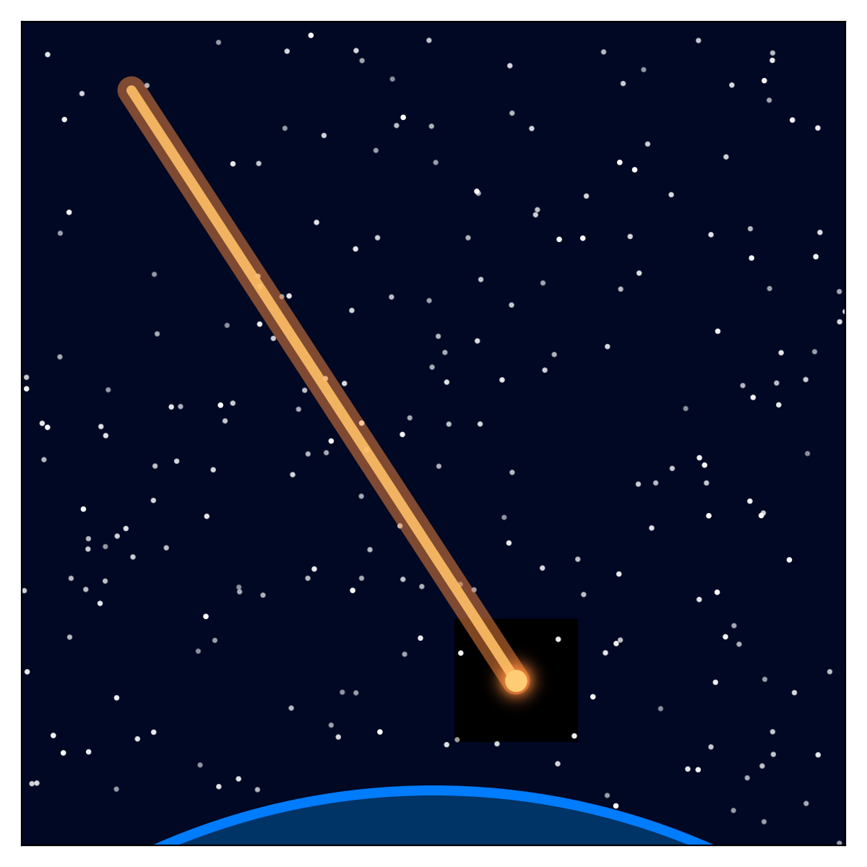
Modeling Meteoroid Ablation and Atmospheric Light Curves
Tanvi Batra

Slide 2

What Happens to a Meteoroid?
A meteoroid enters the atmosphere at 20–70 km/s and slams into the air.
The air in front of it compresses and heats up, causing the surface of the meteoroid to melt and vaporize.
This process - ablation - is what starts the meteor’s glow.

Slide 3
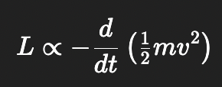
The Physics Behind the Glow
The meteor’s light comes from the air, not the rock.
As the meteoroid loses mass, energy is dumped into the atmosphere.

Slide 4


