Slide 1
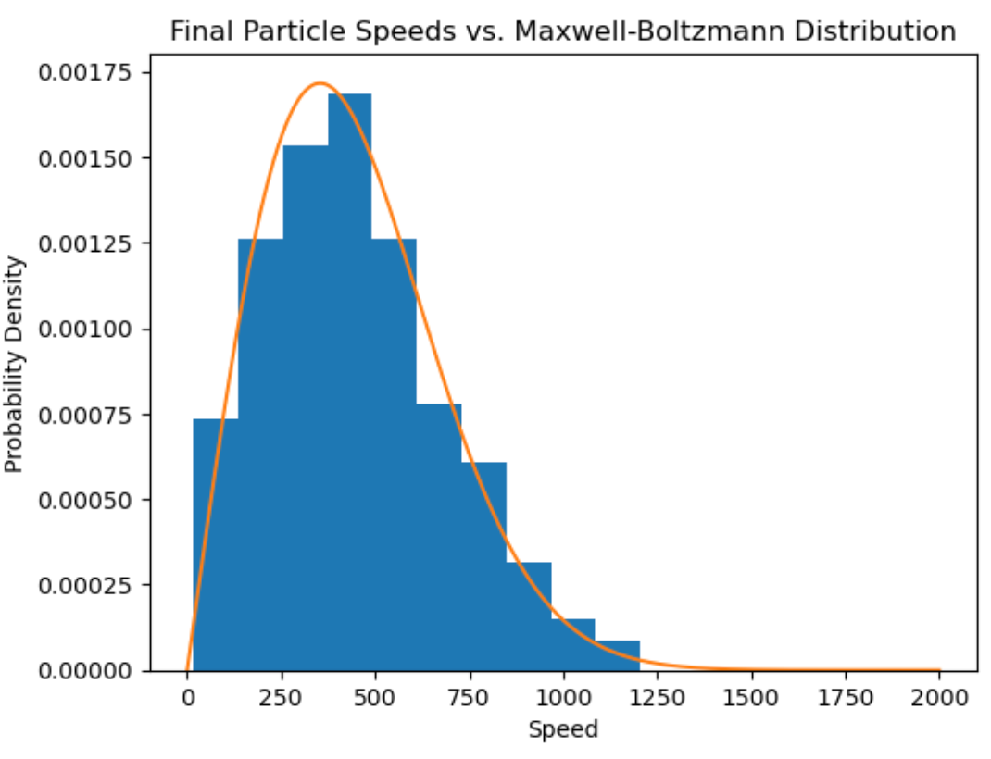
Emergence of the Maxwell Boltzmann Distribution through particles in a box
By: Garrett Andre

Slide 2
2D Hard-Sphere Gas Simulation & Velocity Statistics
Goal: create a 2 dimensional billiard ball model to simulate an ideal gas
Requirements/Methods:
Use of random numbers for initial positions
Use of molecular dynamics to model collisions
Pairwise collision detection
Elastic collision velocity updates
Reflecting boundary conditions
Theoretical Boltzmann Curve + histogram of speeds
As the model evolves and ‘thermalizes’ the probability density of speeds fits to the theoretical boltzman curve that is plotted

Slide 3
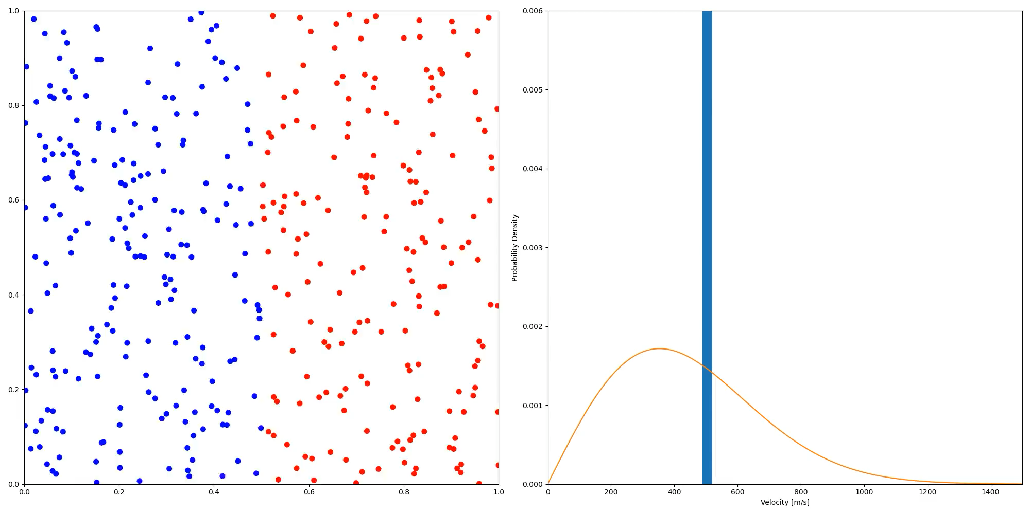
Animation

