Slide 1
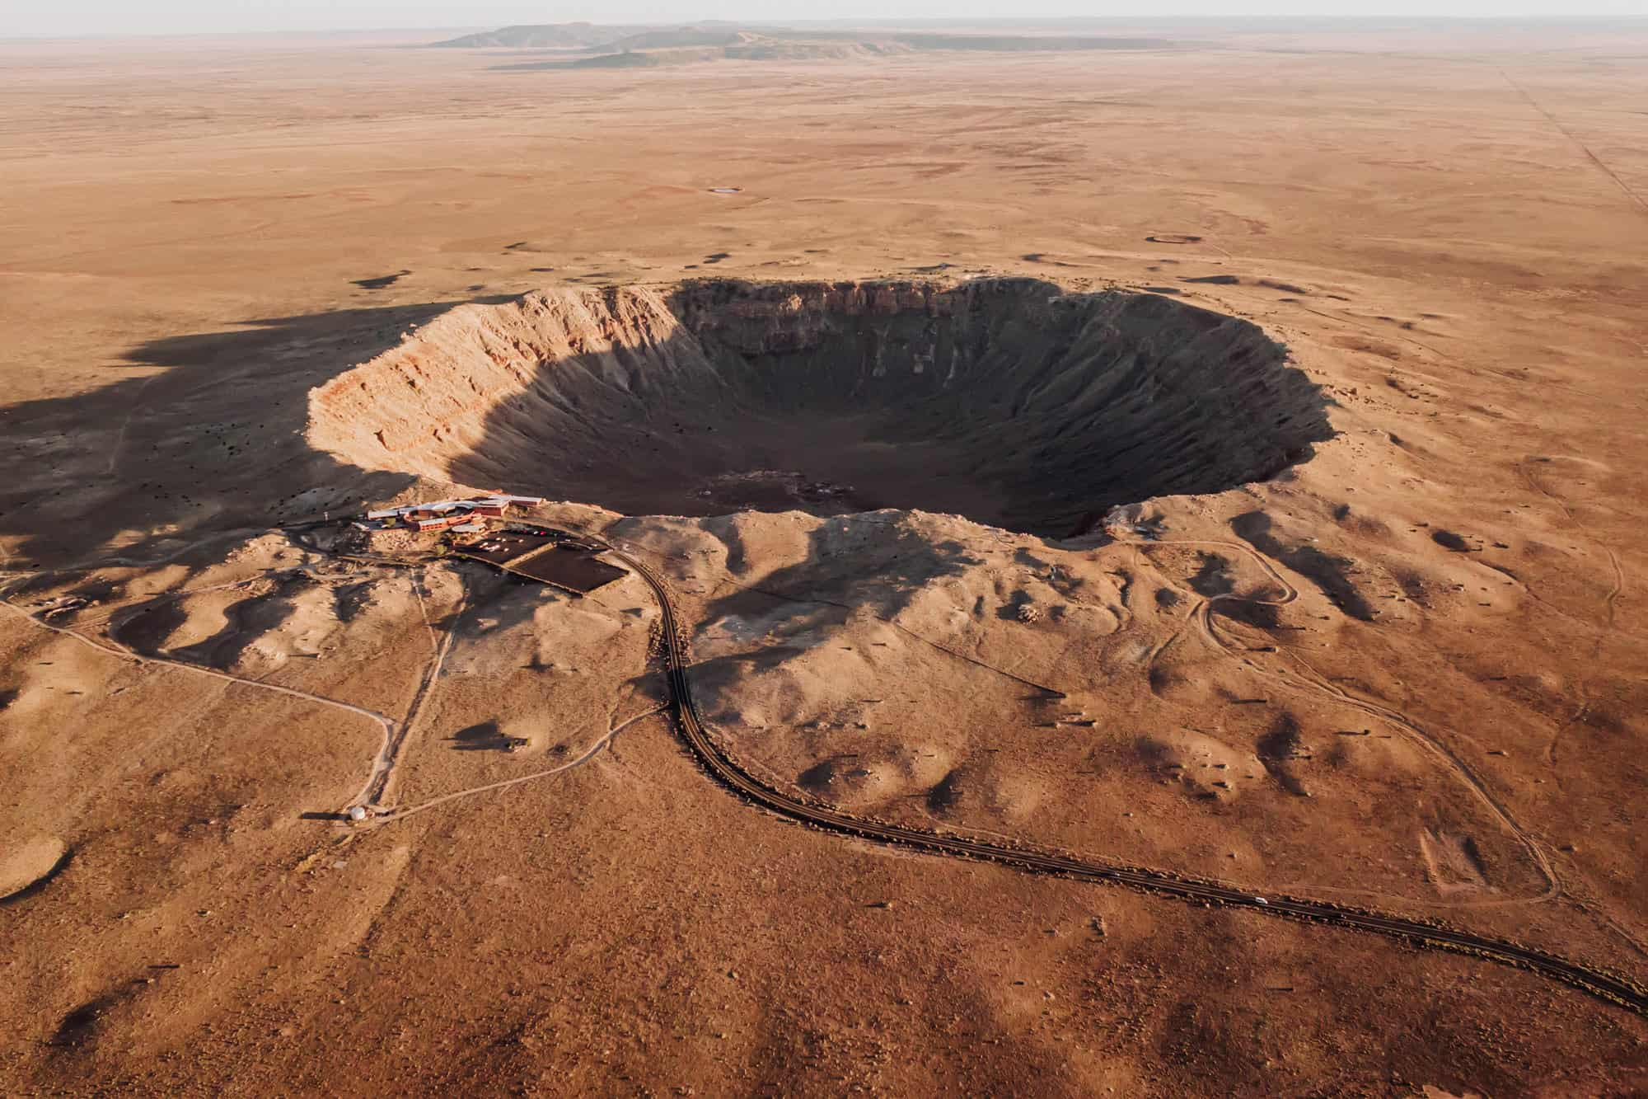
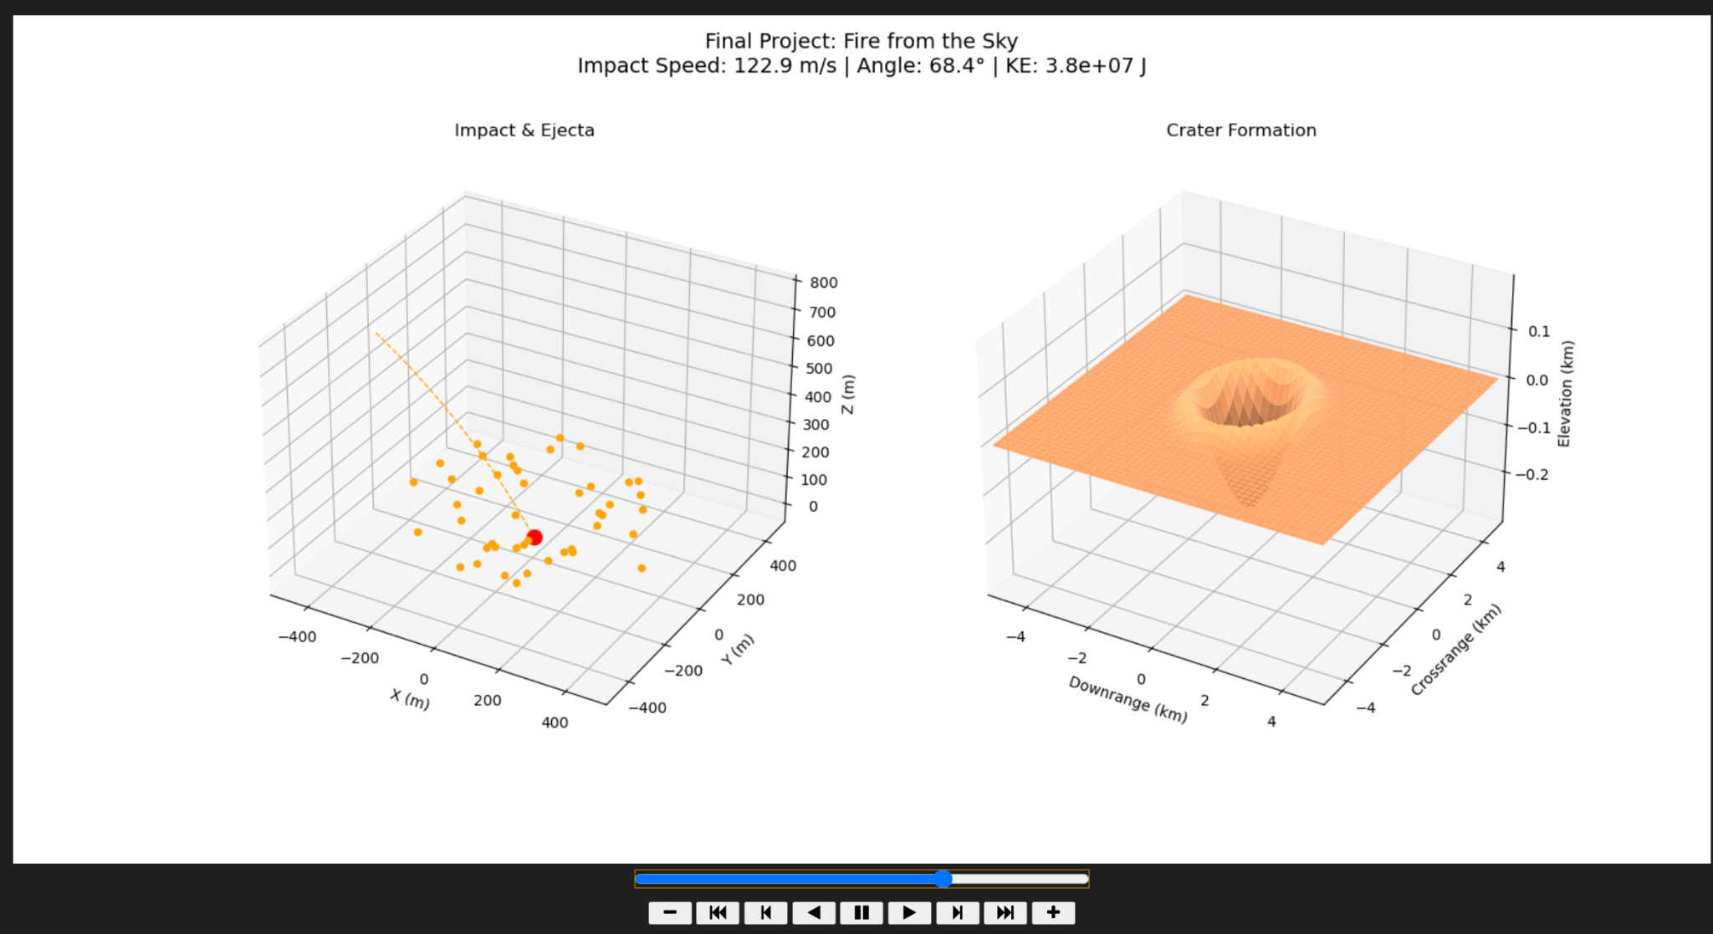
Fire from the Sky: 3D Meteor Trajectory and Crater Formation
By Mohammed Amin
EPS 109
Month Year

Slide 2
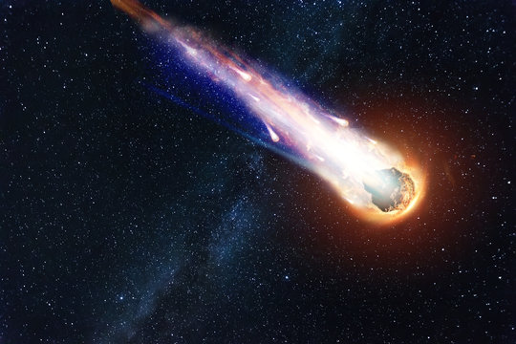
Goal
A 3D meteor entering an atmosphere under gravity and drag.
The meteor’s impact on a flat planetary surface.
The resulting crater formation, including a bowl, raised rim, and ejecta.
A small parameter study: how changing impact speed and angle changes crater size and depth.
Impact craters are everywhere in the solar system (Moon, Mars, Earth) and record past impact events.
Crater diameter and depth encode information about the impact energy and trajectory.
This project shows how a simple physical model (ODEs + a scaling law) can produce a realistic-looking 3D crater.

Slide 3







Methods: Physics & Crater Model
Meteor Trajectory (3D ODE)
State:
Forces:
Gravity:
Quadratic drag:
Atmosphere:
(exponential density vs altitude)
Numerics: integrate ODEs until z = 0 (impact)
Record impact speed, impact angle, and kinetic energy
2. Energy-Based Crater Scaling
Crater diameter scales with ¼ power of impact energy
3. Crater Surface, Ejecta, and Parameter Study
Build a 2D crater surface in km as a Gaussian bowl + raised ejecta ring (crater + rim).
Launch ballistic ejecta particles from the impact point with random directions and speeds, moving under gravity only.
Run a parameter study by varying impact speed and angle (slow/shallow, baseline, fast/steep).
Erosion lab!

Slide 4
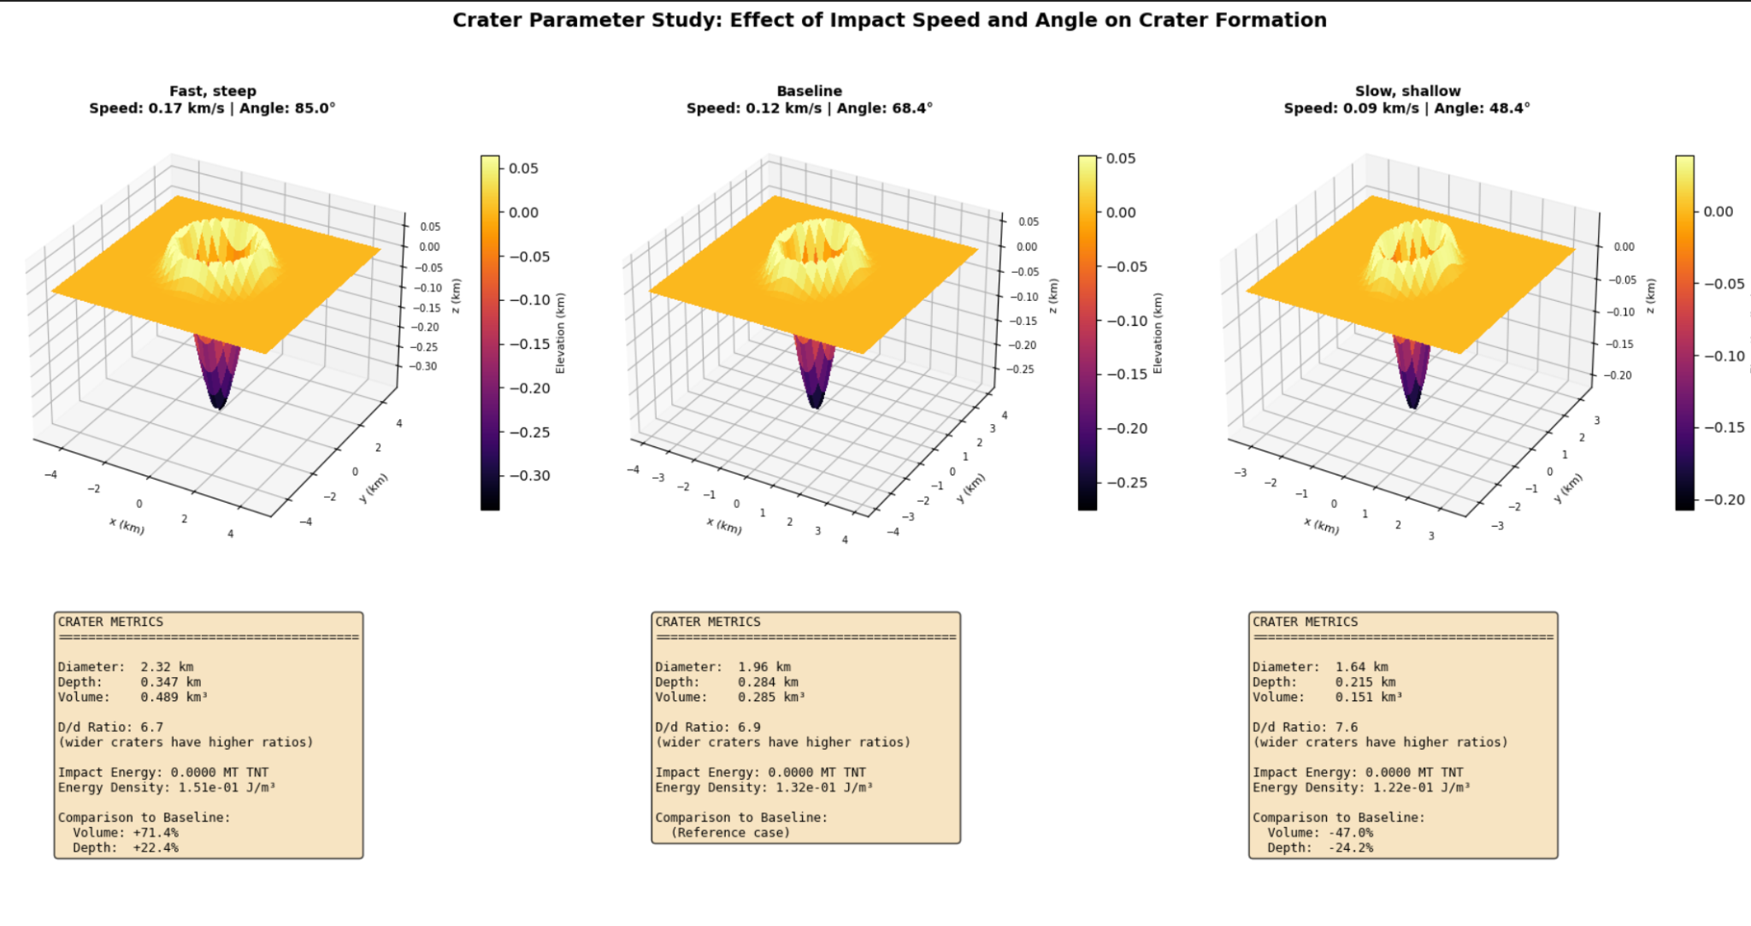

Slide 5
