Slide 1
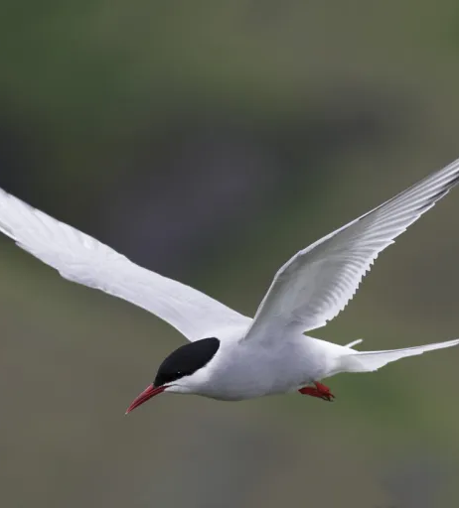
From Pole to Pole: A Stochastic Model of Arctic Tern Migration
Shahad Althenayan

Slide 2
Topic:
This project models the Arctic tern’s pole-to-pole migration using a simplified computational approach. Instead of reproducing exact GPS tracks, the goal is to show how a tern could travel from the Arctic to Antarctica and back by combining purposeful navigation with environmental randomness.
Methods used:
Stochastic Agent Model:
The tern is modeled as a single moving agent.
Real tracking data is used only to estimate major migration regions (Arctic → Iceland → Tropical Atlantic → Southern Ocean → Antarctica).
These regions become waypoints for the simulation.
Biased Random Walk:
Each step = movement toward the next waypoint + random noise representing wind and uncertainty.
Produces a realistic curved, slightly noisy path rather than a straight line.
I use three notebooks: one supporting notebook to visualize the real tracking data used to estimate waypoints (Arctic_Tern_Real_Migration_Analysis), one core notebook for the required stochastic simulation (Arctic_Tern_Migration_Simulation), and one bonus notebook that adds a full round-trip simulation and color-coded regions (Arctic_Tern_Migration_Roundtrip_Simulation).

Slide 3
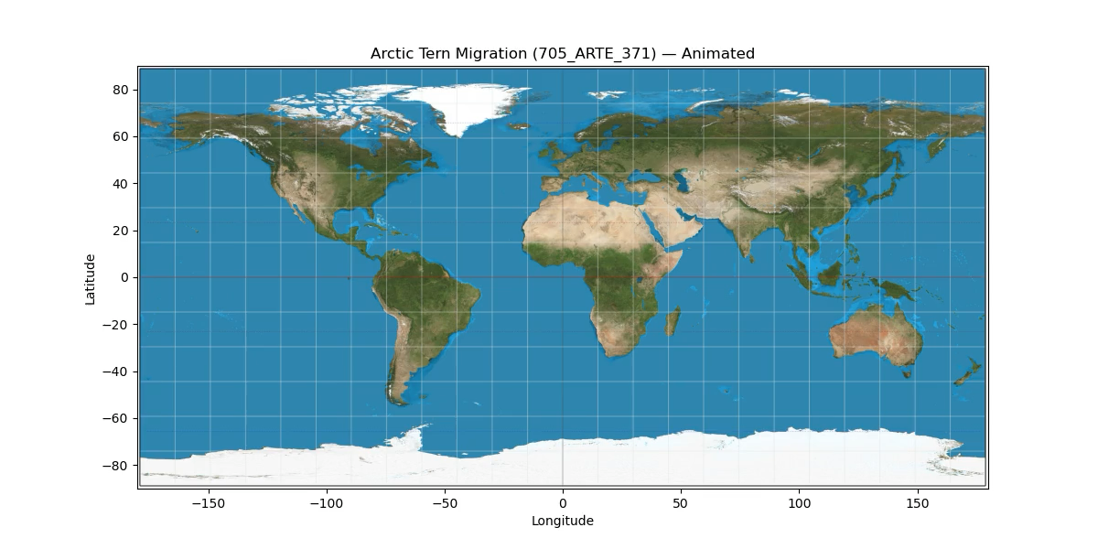
This is real tracking data for 1 Arctic tern. I use it to estimate the regions the bird travels through. Source:
https://ipt.env.duke.edu/resource?r=zd_705
Notes:
This is real tracking data for 1 Arctic tern using satellite tracking data from the OBIS-SEAMAP database. This is not a simulation; I use it to estimate the regions the bird travels through.

Slide 4

A biased random-walk simulation that moves the tern toward regional waypoints while adding wind-like randomness.
Notes:
This is the centerpiece of the project. Here I show my biased random walk method, my waypoint-guided navigation, and the animation showing movement over time.

Slide 5
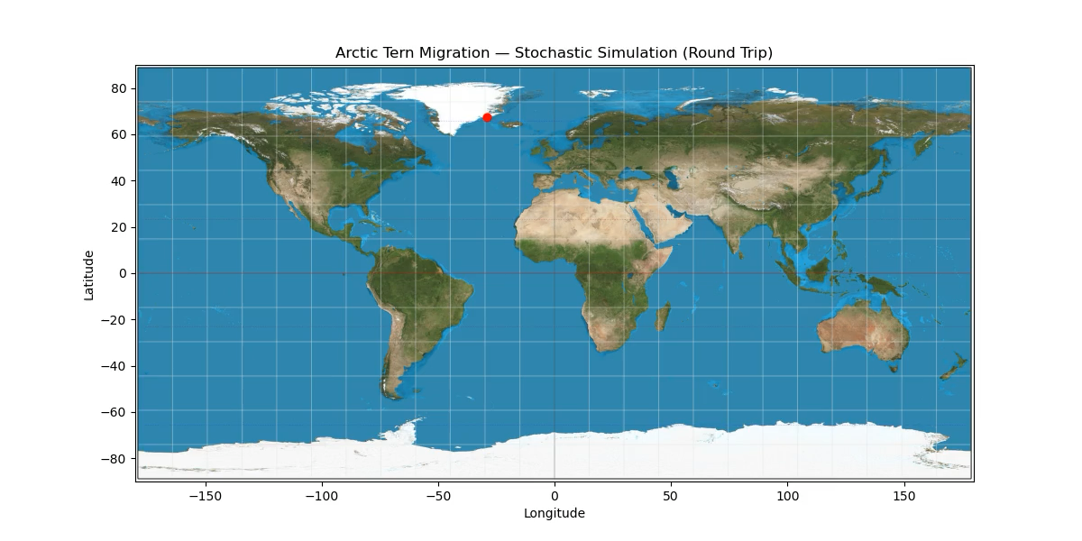
Path color shows latitude zone; the round-trip animation visually shows the tern crossing major ecological regions.
Notes:
Path color shows latitude zone—red in the Arctic, orange in temperate waters, green in the tropics, cyan in the South Atlantic, and blue in the Antarctic—so the round-trip animation visually shows the tern crossing major ecological regions.

