Slide 1
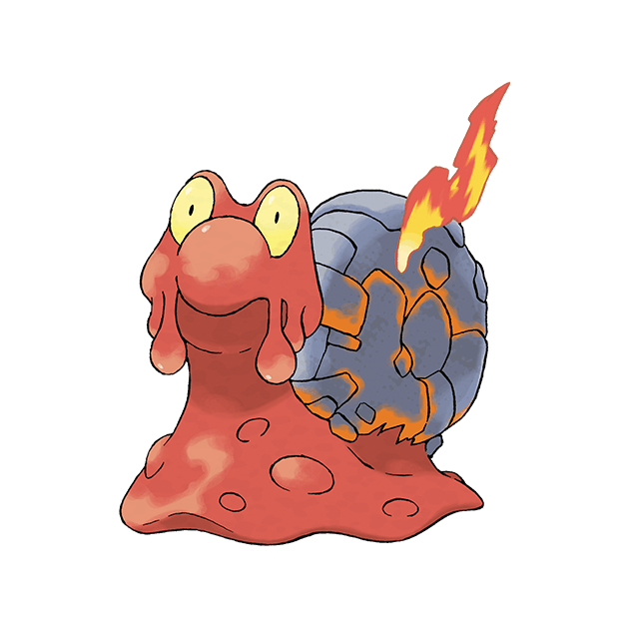
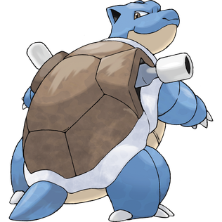

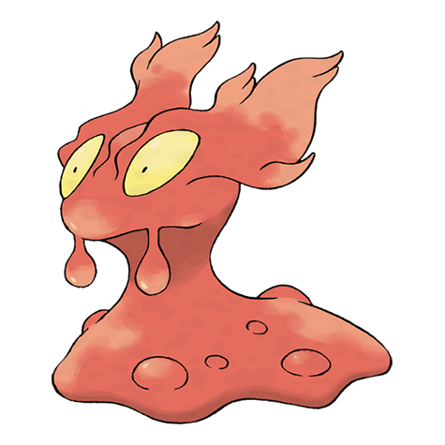
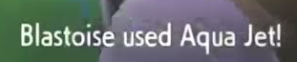
Modeling the Effectiveness of Pokémon Moves using Particle Dynamics
Joshua Almario

Slide 2
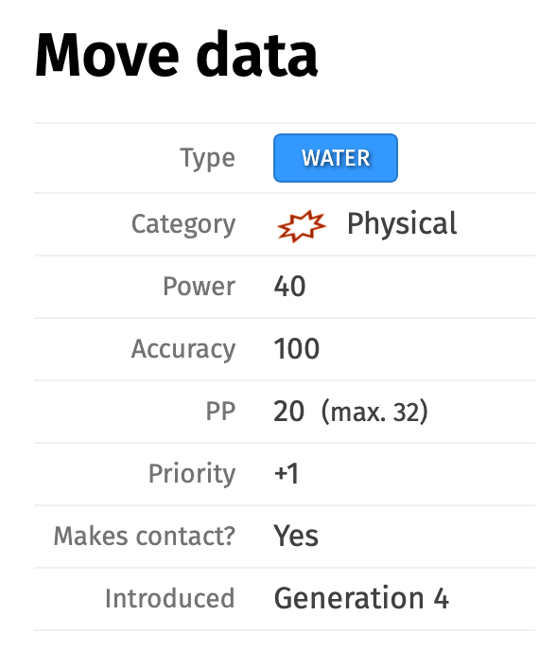
Representing Pokémon Attributes
Pokémon battles typically encoded as numbers and equations
What if certain moves were represented as particles moving over time?
  Water Gun
  Aqua Jet
  Surf
Type matchups
  Water particles on a fire Pokémon?
Particle behavior
  More concentrated vs less concentrated distributions
  Modeled using probabilities
Data for Aqua Jet
Bulbapedia

Slide 3
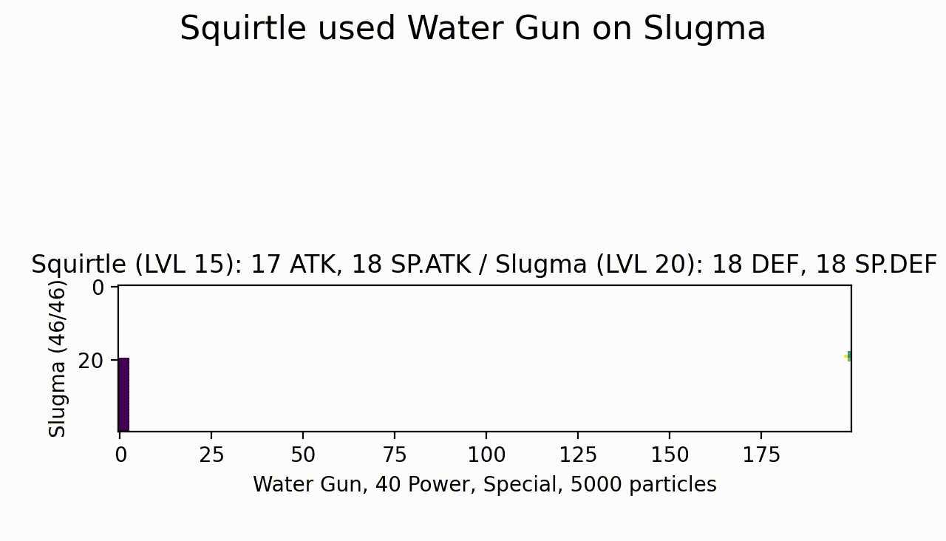

Slide 4
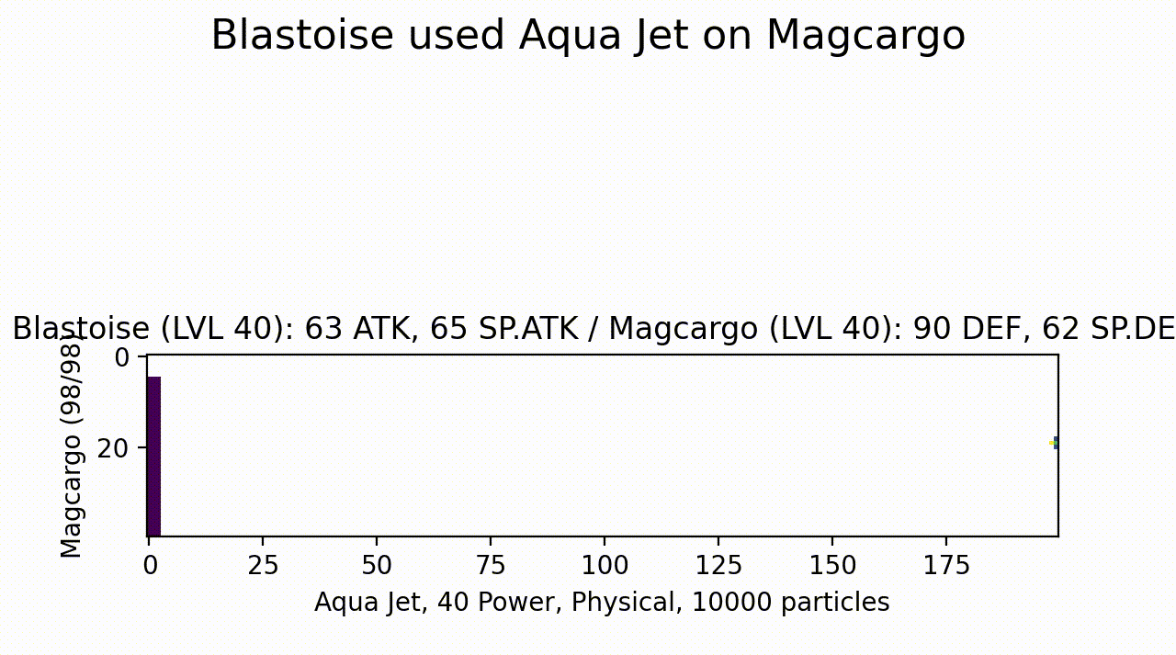

Slide 5
