Slide 1
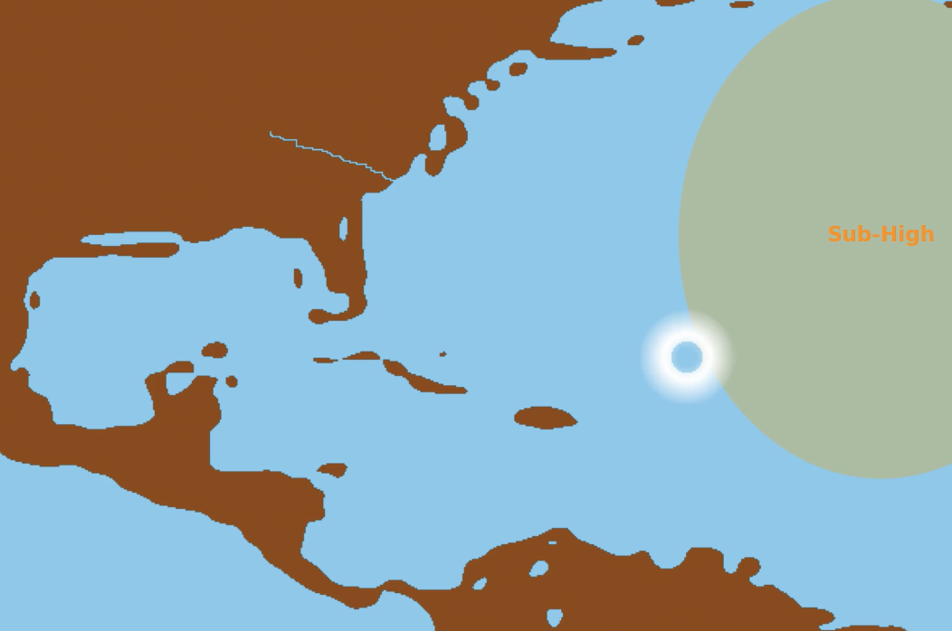
Hurricane evolution simulation
Name: Box Zhang

Slide 2
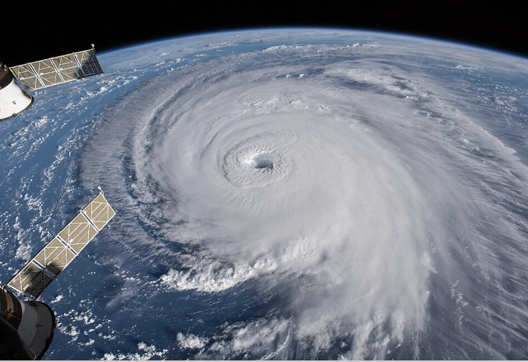
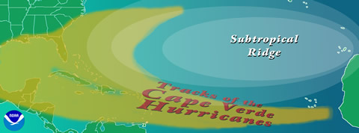
Topic
Method
Hurricane evolution
  Trajectory
  size (eye, eyewall, surrounding rainbands)
Influencing factor:
  Ocean
  Land
  Subtropical high pressure system
Random walk from lab 6
Real topography (dataset from lab 4)
Pixel graphics from lab 2
Diagram showing typical tracks of North Atlantic hurricanes (courtesy NOAA)

Slide 3

Animation

